Slide 1
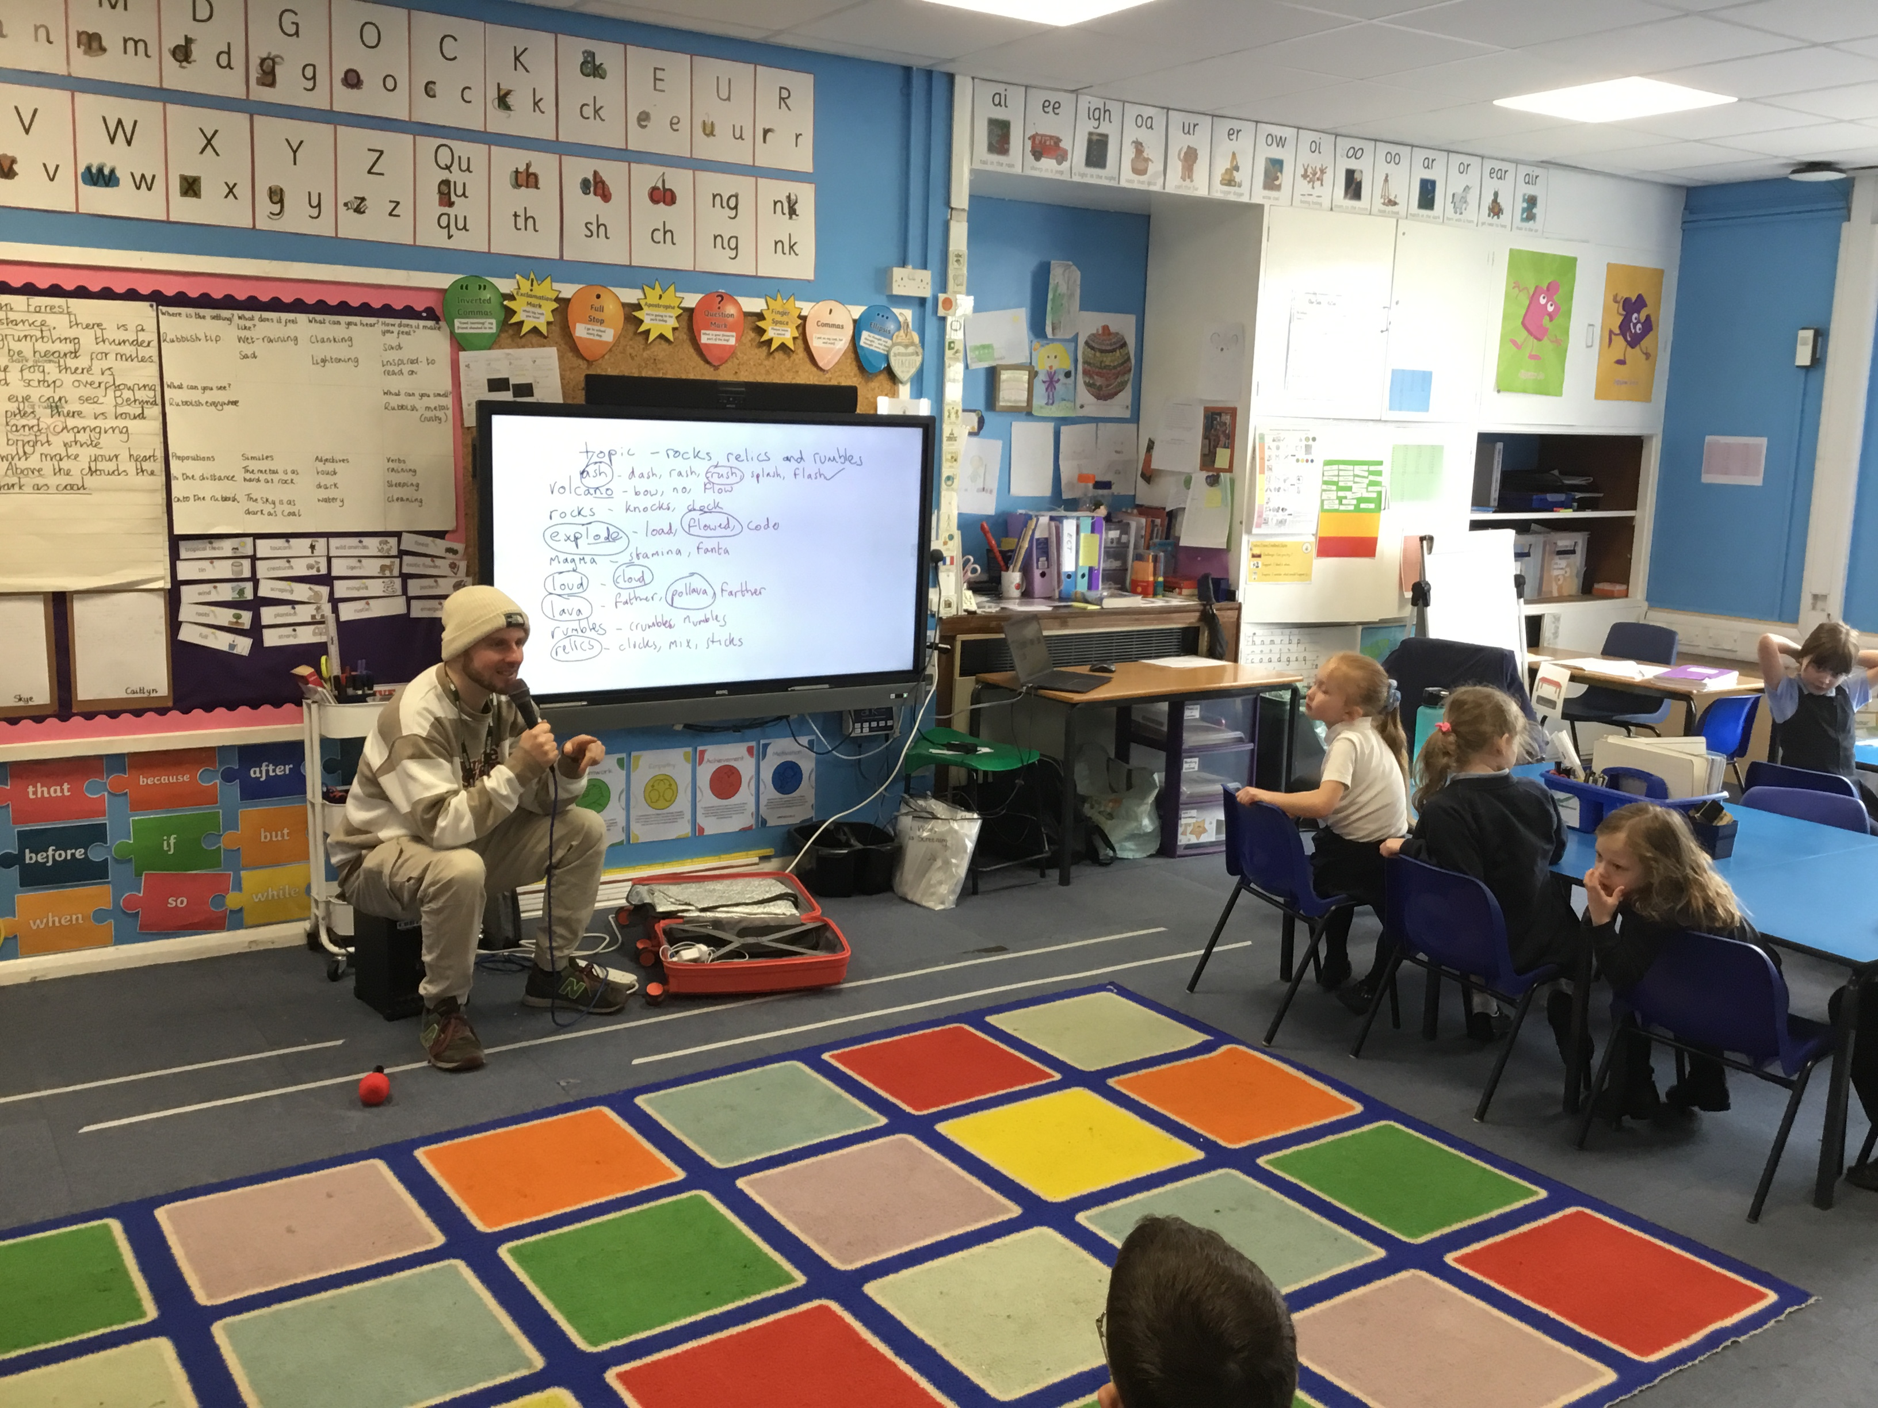
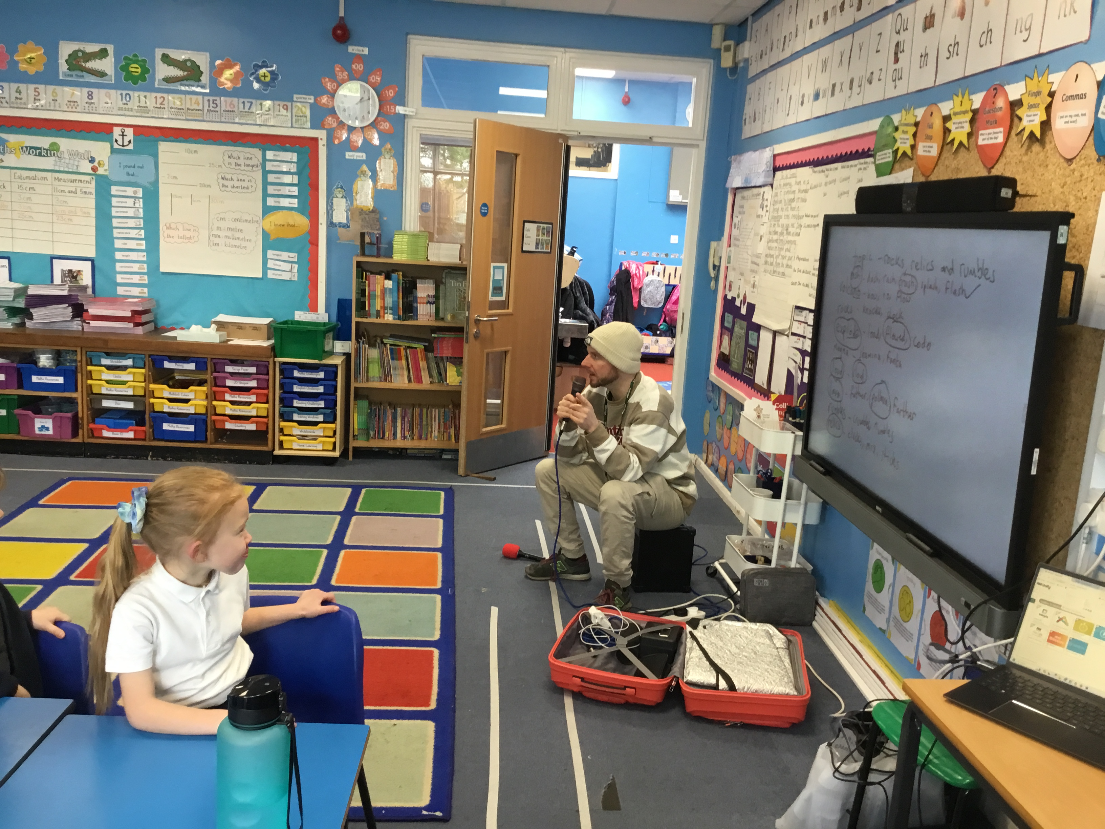
ROB THE RAPPER VISITS DAHL CLASS
On the 2nd February, Rob visited Dahl class as part of an ongoing project to develop pupils’ musical creativity with a focus on rhyme. Rob was an amazing visitor to have and helped the pupils to create some very inventive songs using just 5 words. We explored different rhymes and went on to think of and find different rhyming pairs to match a key theme or idea.

Slide 2
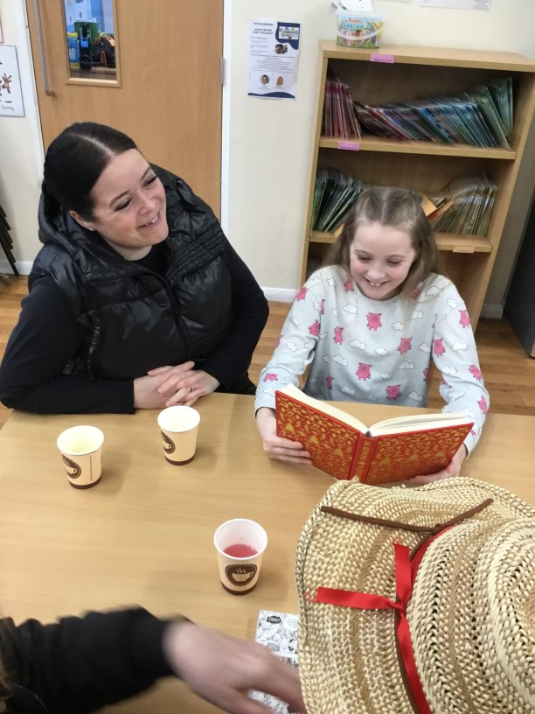
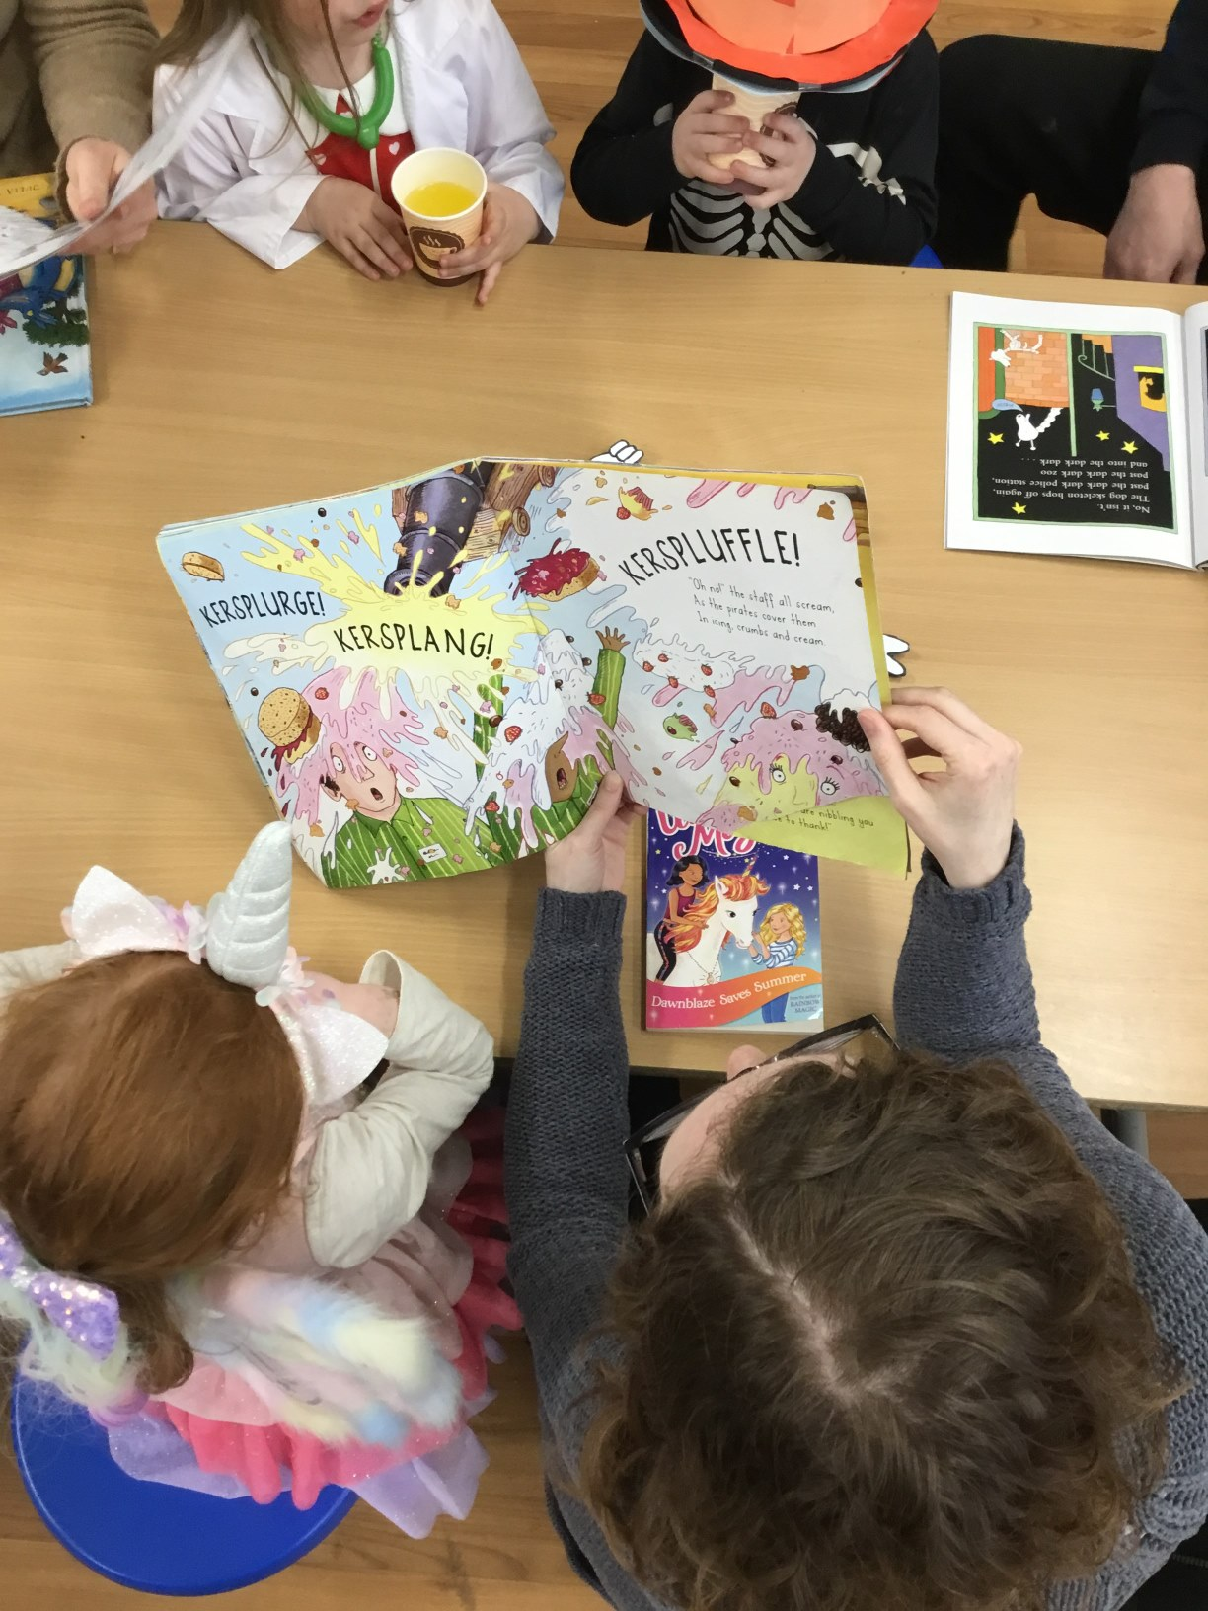
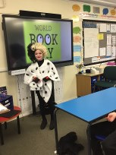
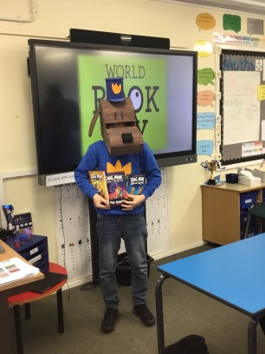
CELEBRATING WORLD BOOK DAY
7th March 2024 -
The children really amazed us on World Book Day with a variety of
creative and amazing costumes on Thursday. We saw everything
from Dogman to Mrs Wormwood and couldn't ask for more! We
know that events such as these couldn't take place without a lot of
behind the scenes work from parents so thank you for helping make
the day memorable.
We would also like to thank our families that were able to (we know
you're very busy) in supporting the school to make WBD all about
enjoying reading and coming to visit to spend some quality reading
time with the children. We even had some returning to class to
present some very detailed book reports!

Slide 3
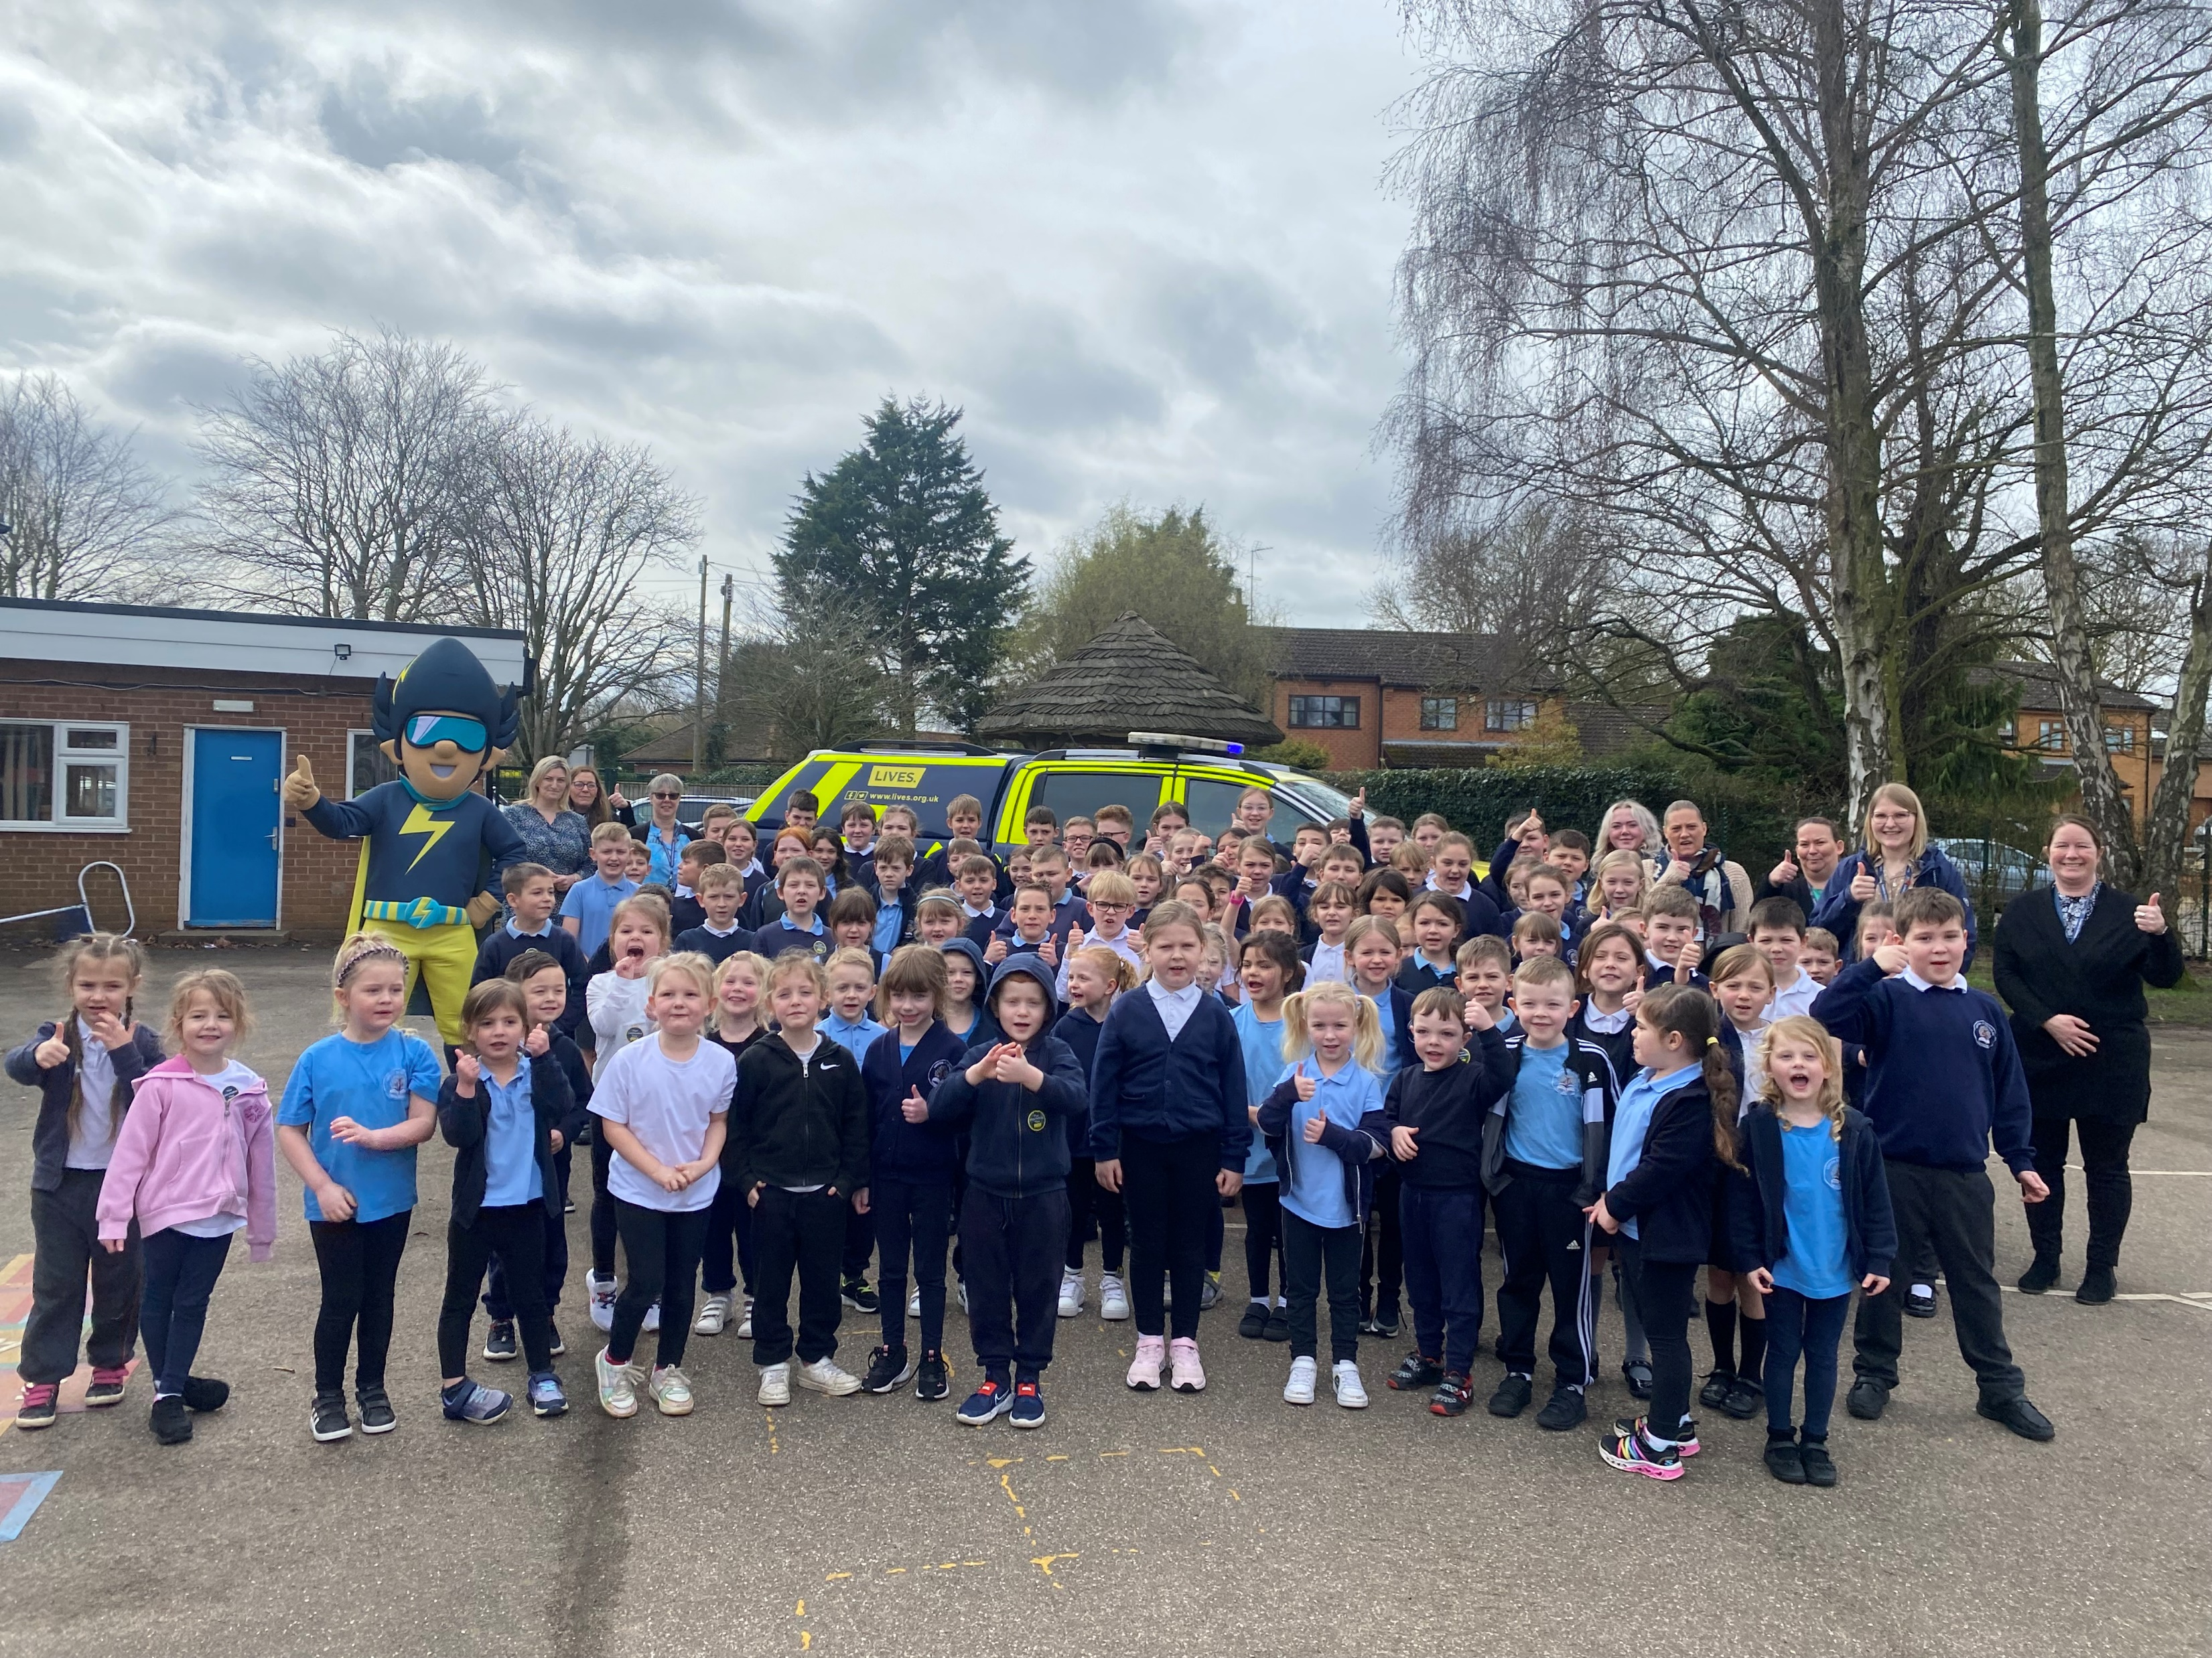
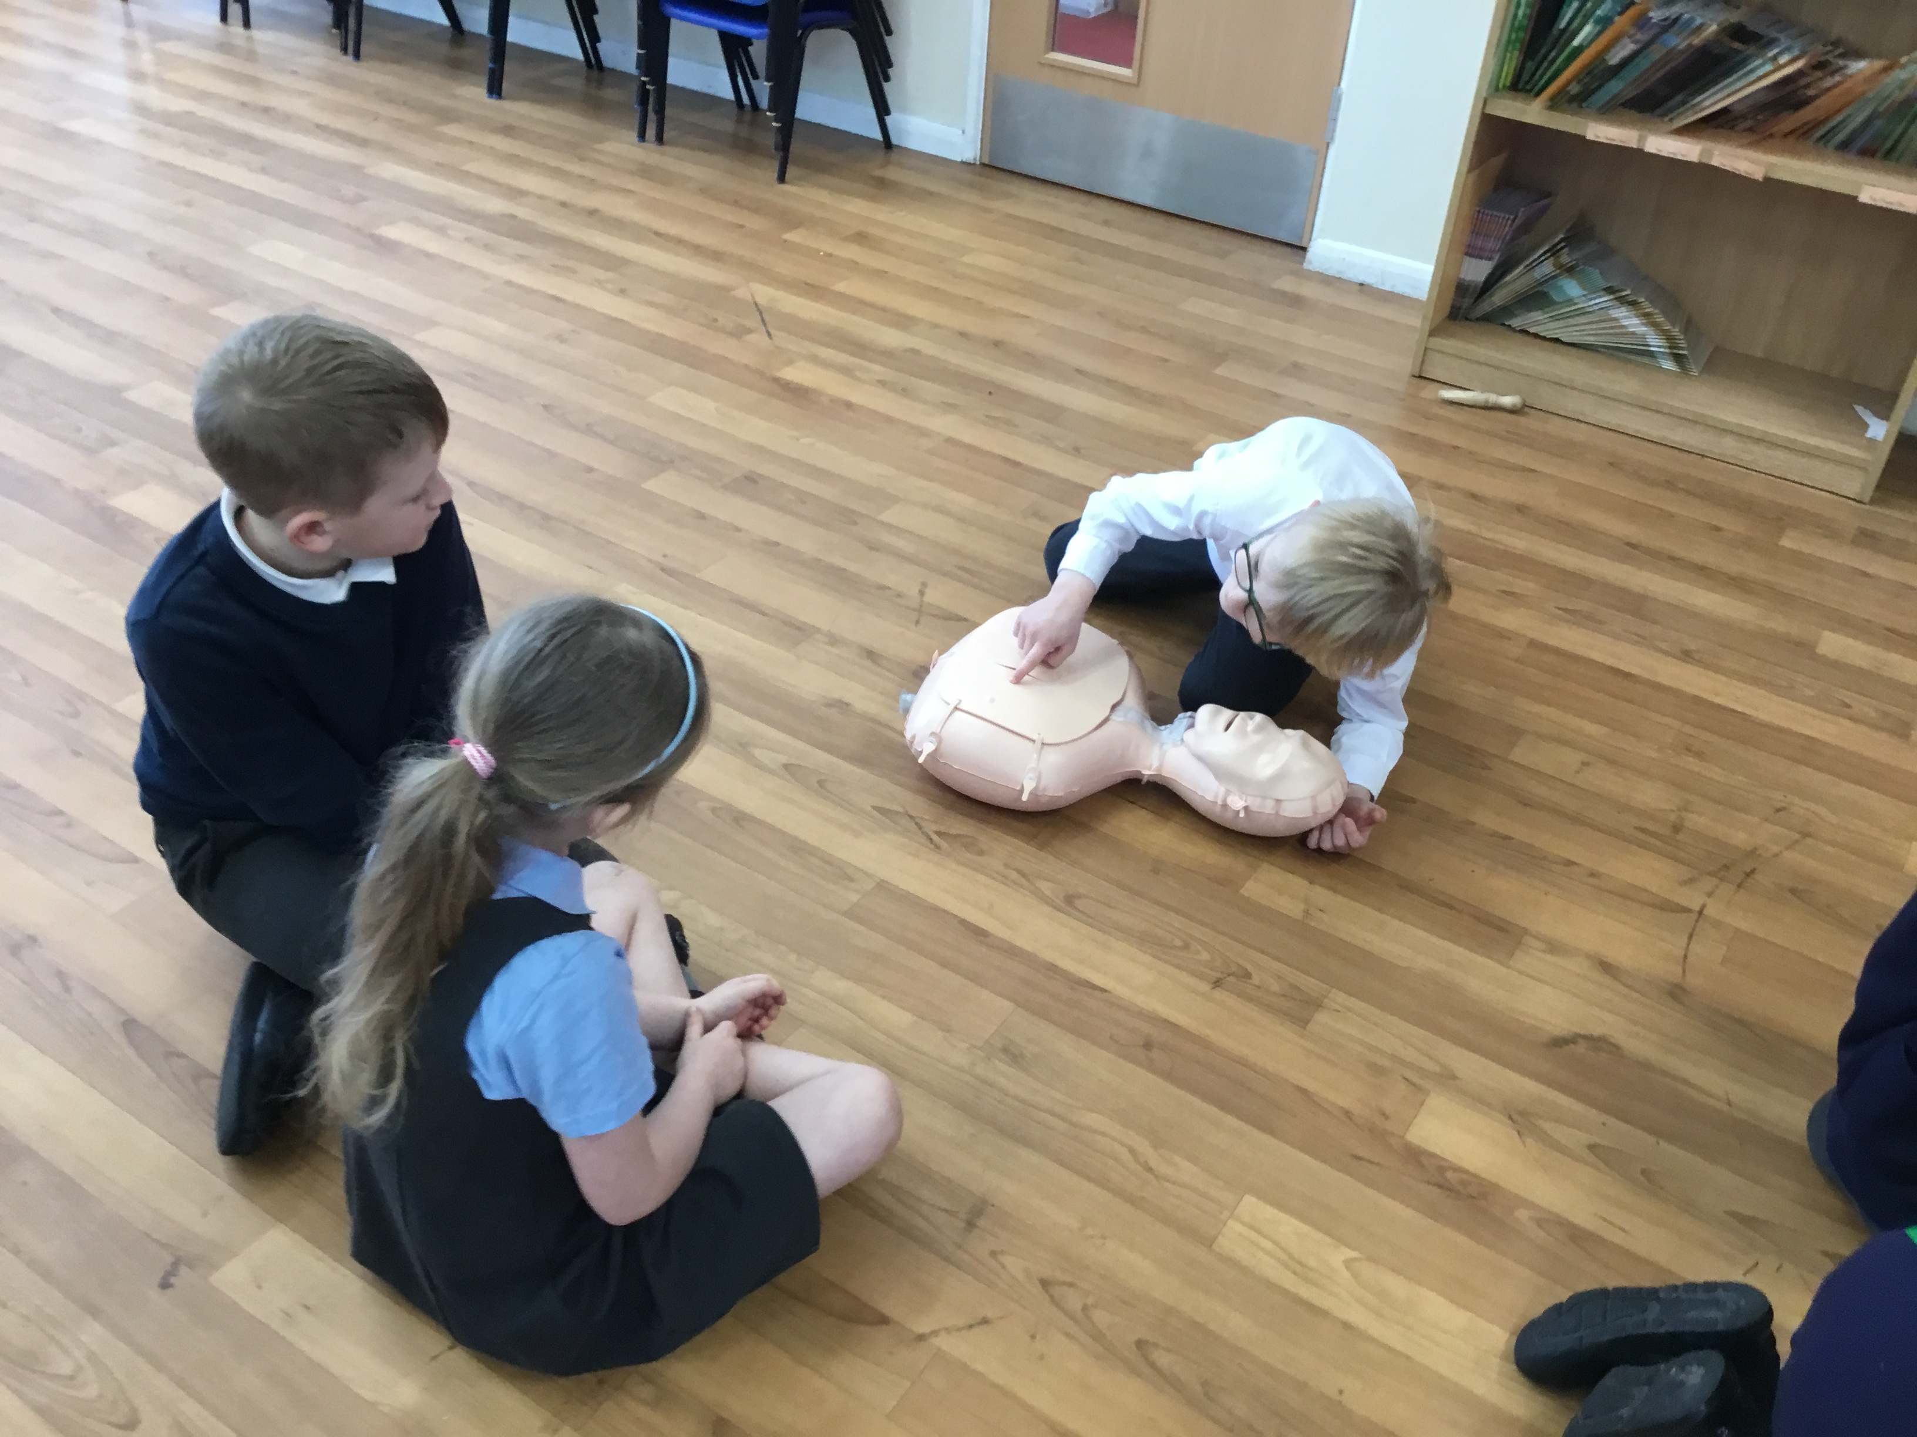
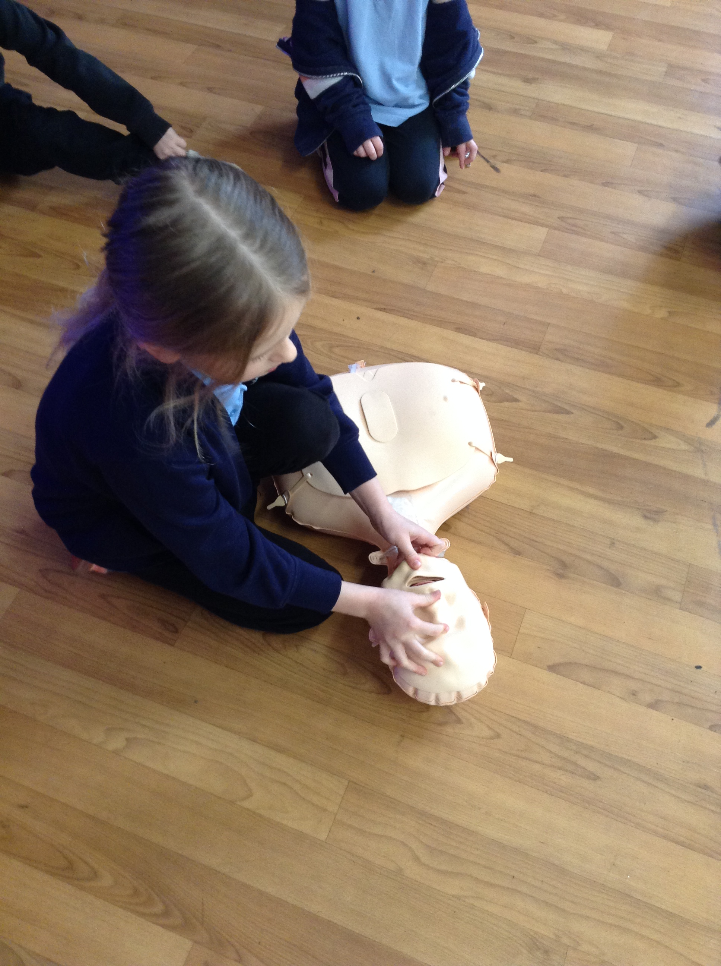
LIVES CPR VISIT
On Wednesday 13th March, Lutton St Nicholas Primary Academy welcomed LIVES into school to deliver lifesaving CPR training to all our pupils. The workshop was engaging and tailored to each year group: children covered everything from how to react in an emergency, what information to provide when speaking to emergency services and the recovery position. The children were able to practise CPR on mannequins, complete an informative booklet and meet a special guest, Defib Dan! The day was well delivered and incredibly informative.

Slide 4
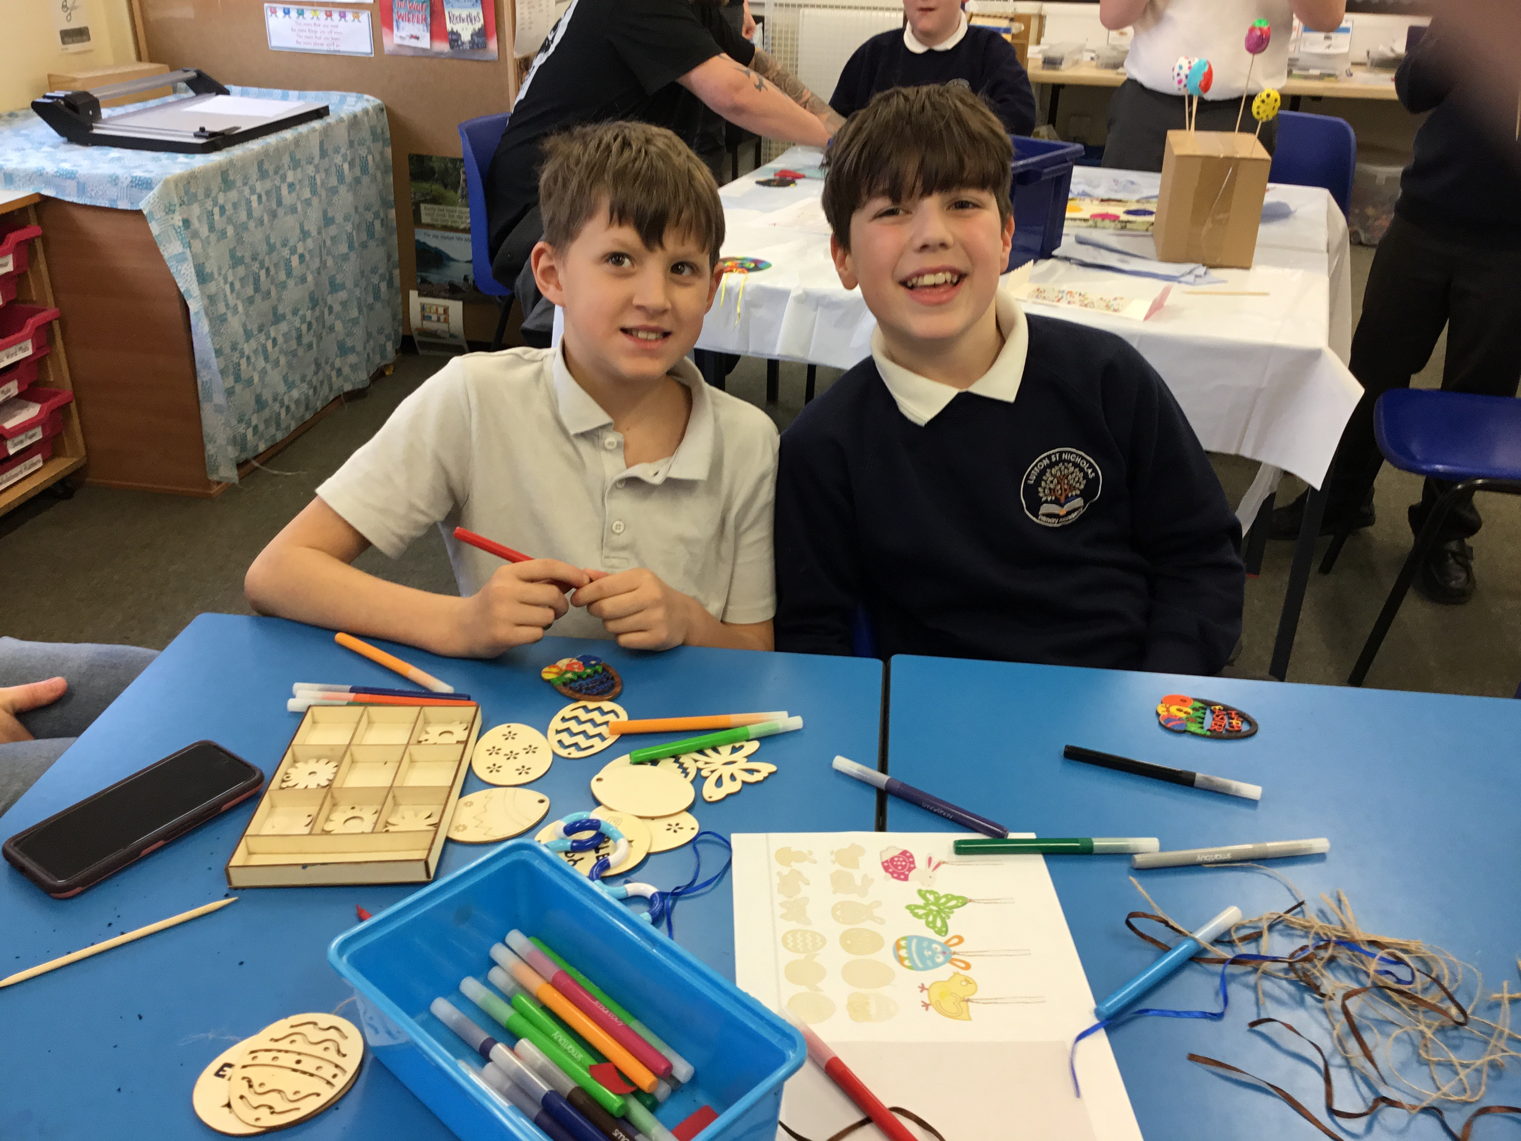
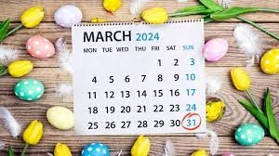
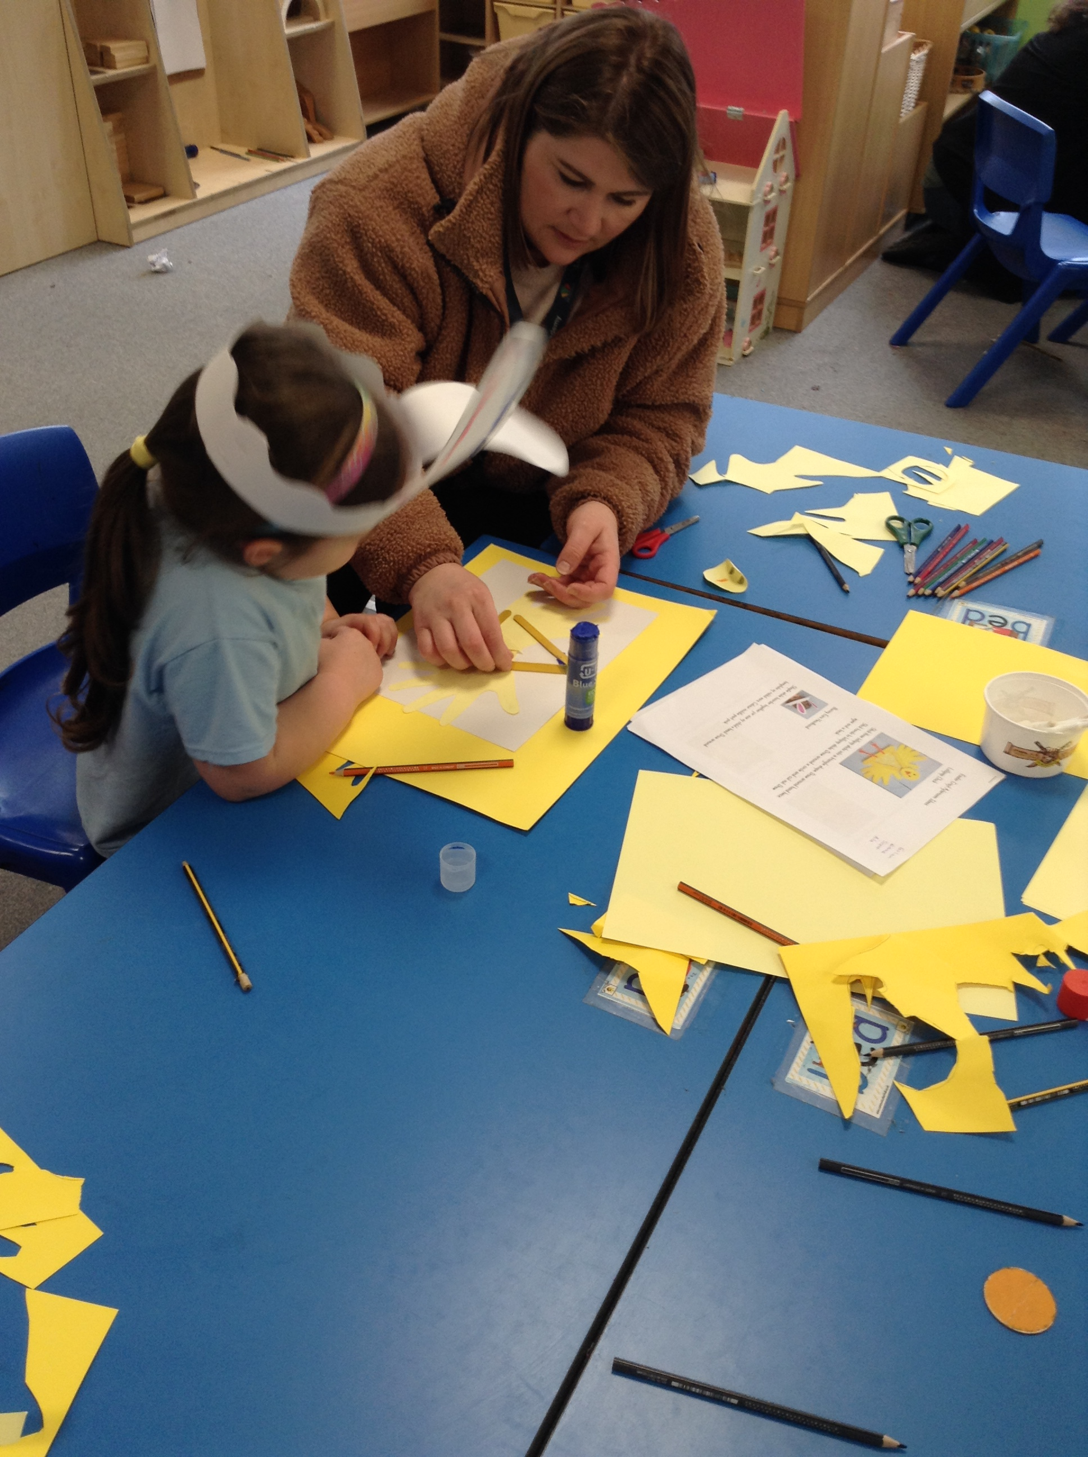
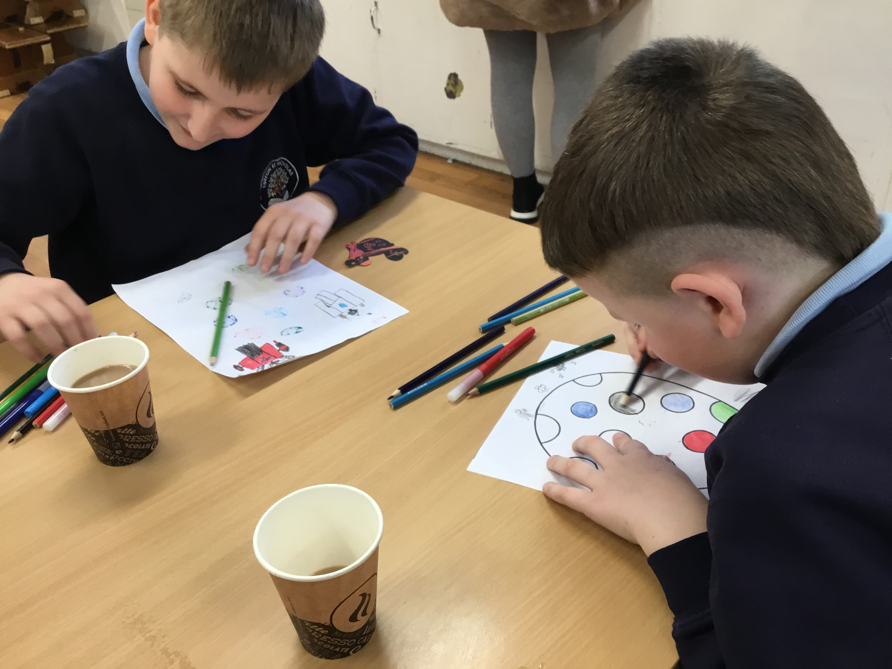
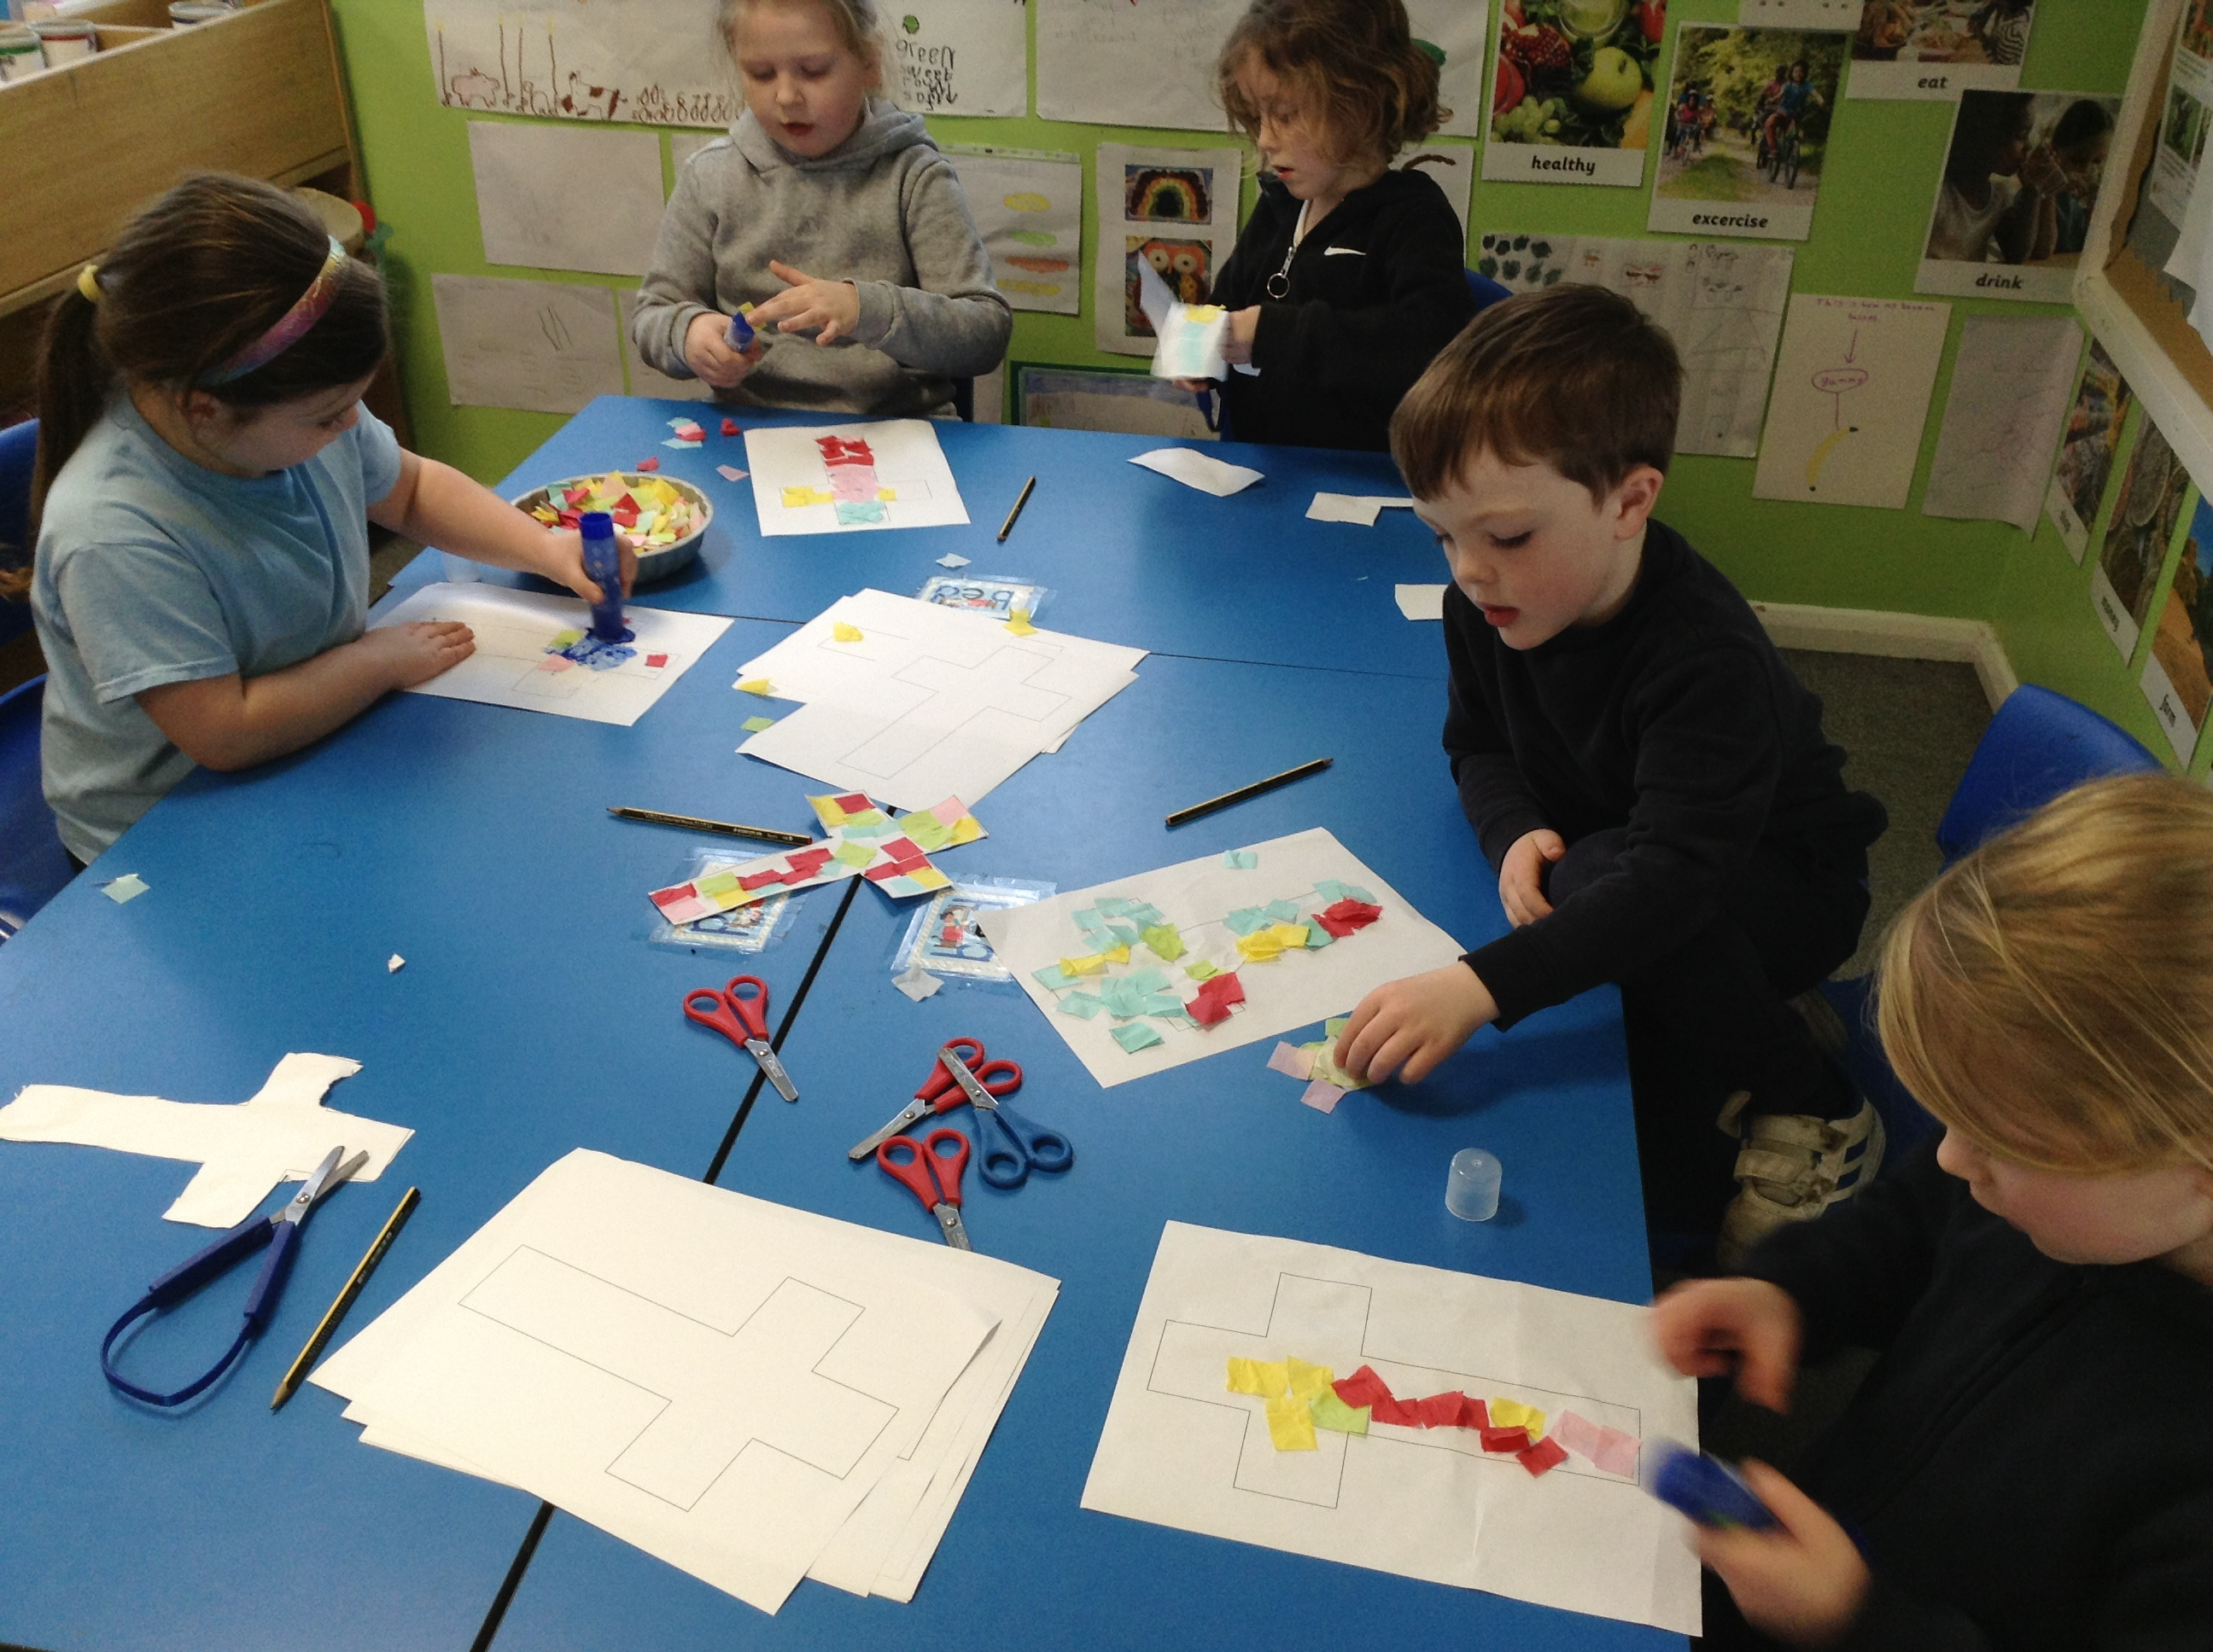
EASTER CRAFTERNOON!
On the 27th March, to celebrate Easter this year, we invited friends and family into school to work alongside their child doing some Easter crafts. FOLS kindly came along to provide refreshments to both adults and children. It was a super day!
Thank you to all of our parents and carers for taking time out of your busy days to spend time with us and your children.

Slide 5
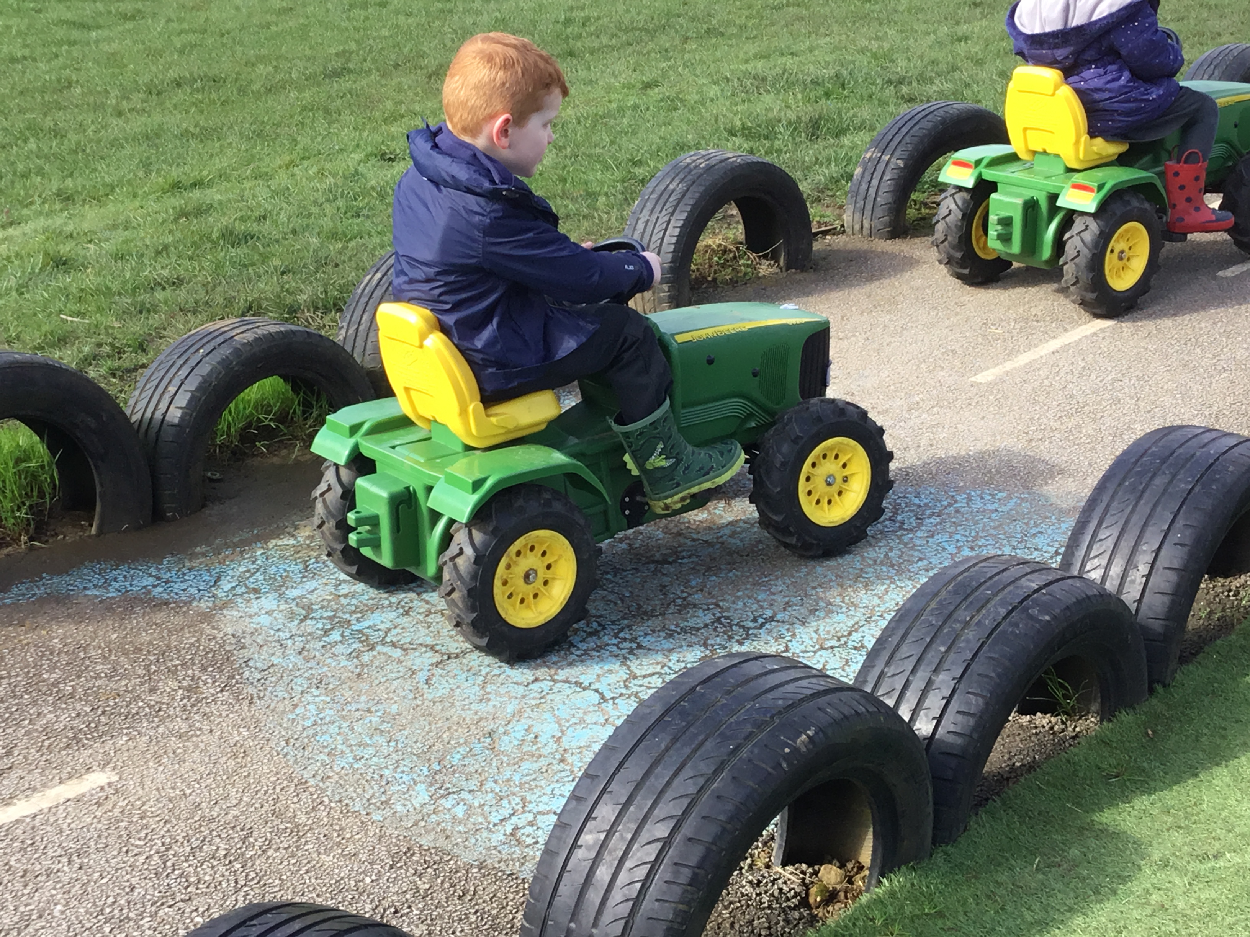
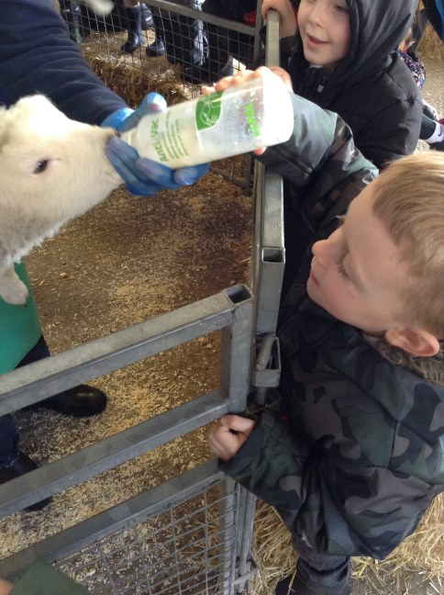
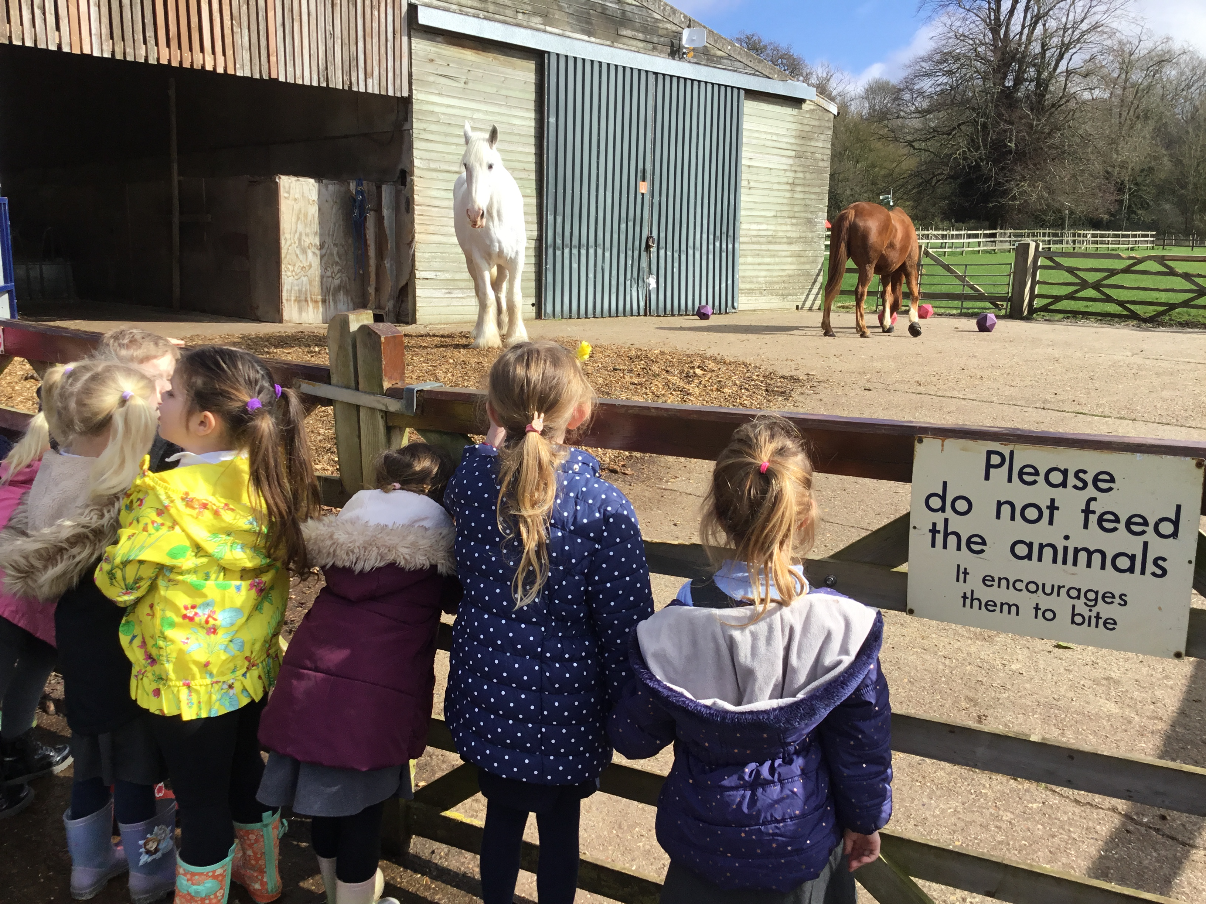
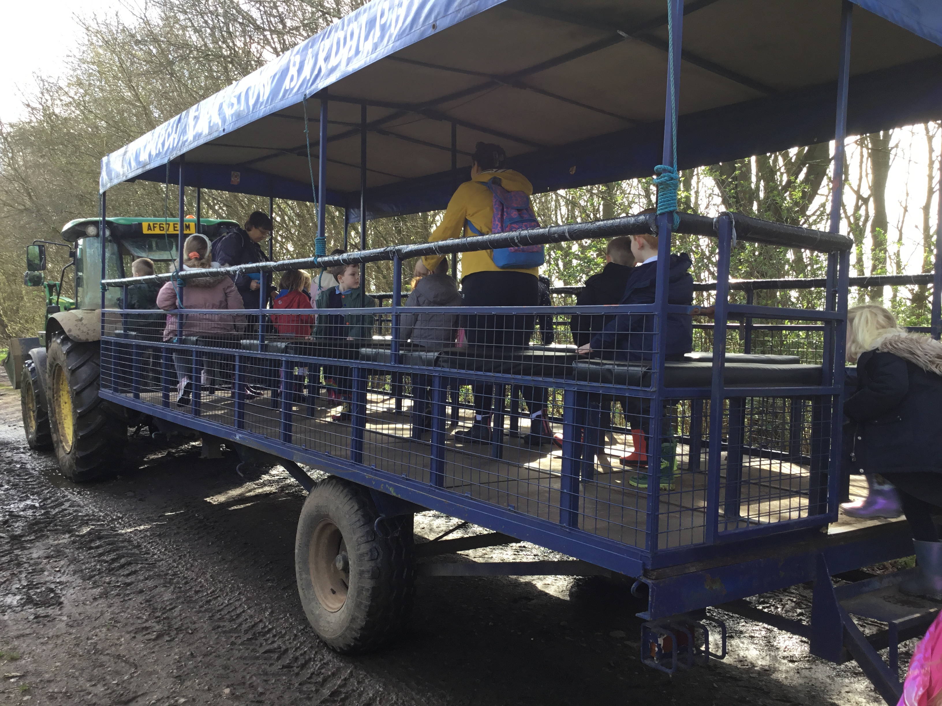
DONALDSON VISIT CHURCH FARM
On Monday 18th March, Donaldson Class enjoyed a class trip to Church Farm in Norfolk. The children were able to feed and stroke a range of animals including Lambs, Rabbits and Guinea Pigs. We were able to try out Tractor driving and were chauffeured around the farm on a full-size tractor too.

Slide 6
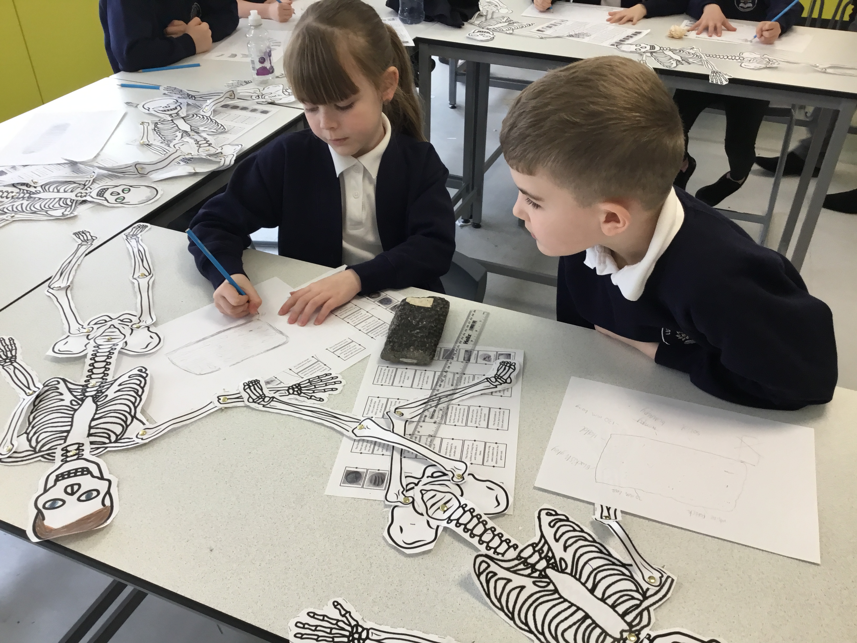
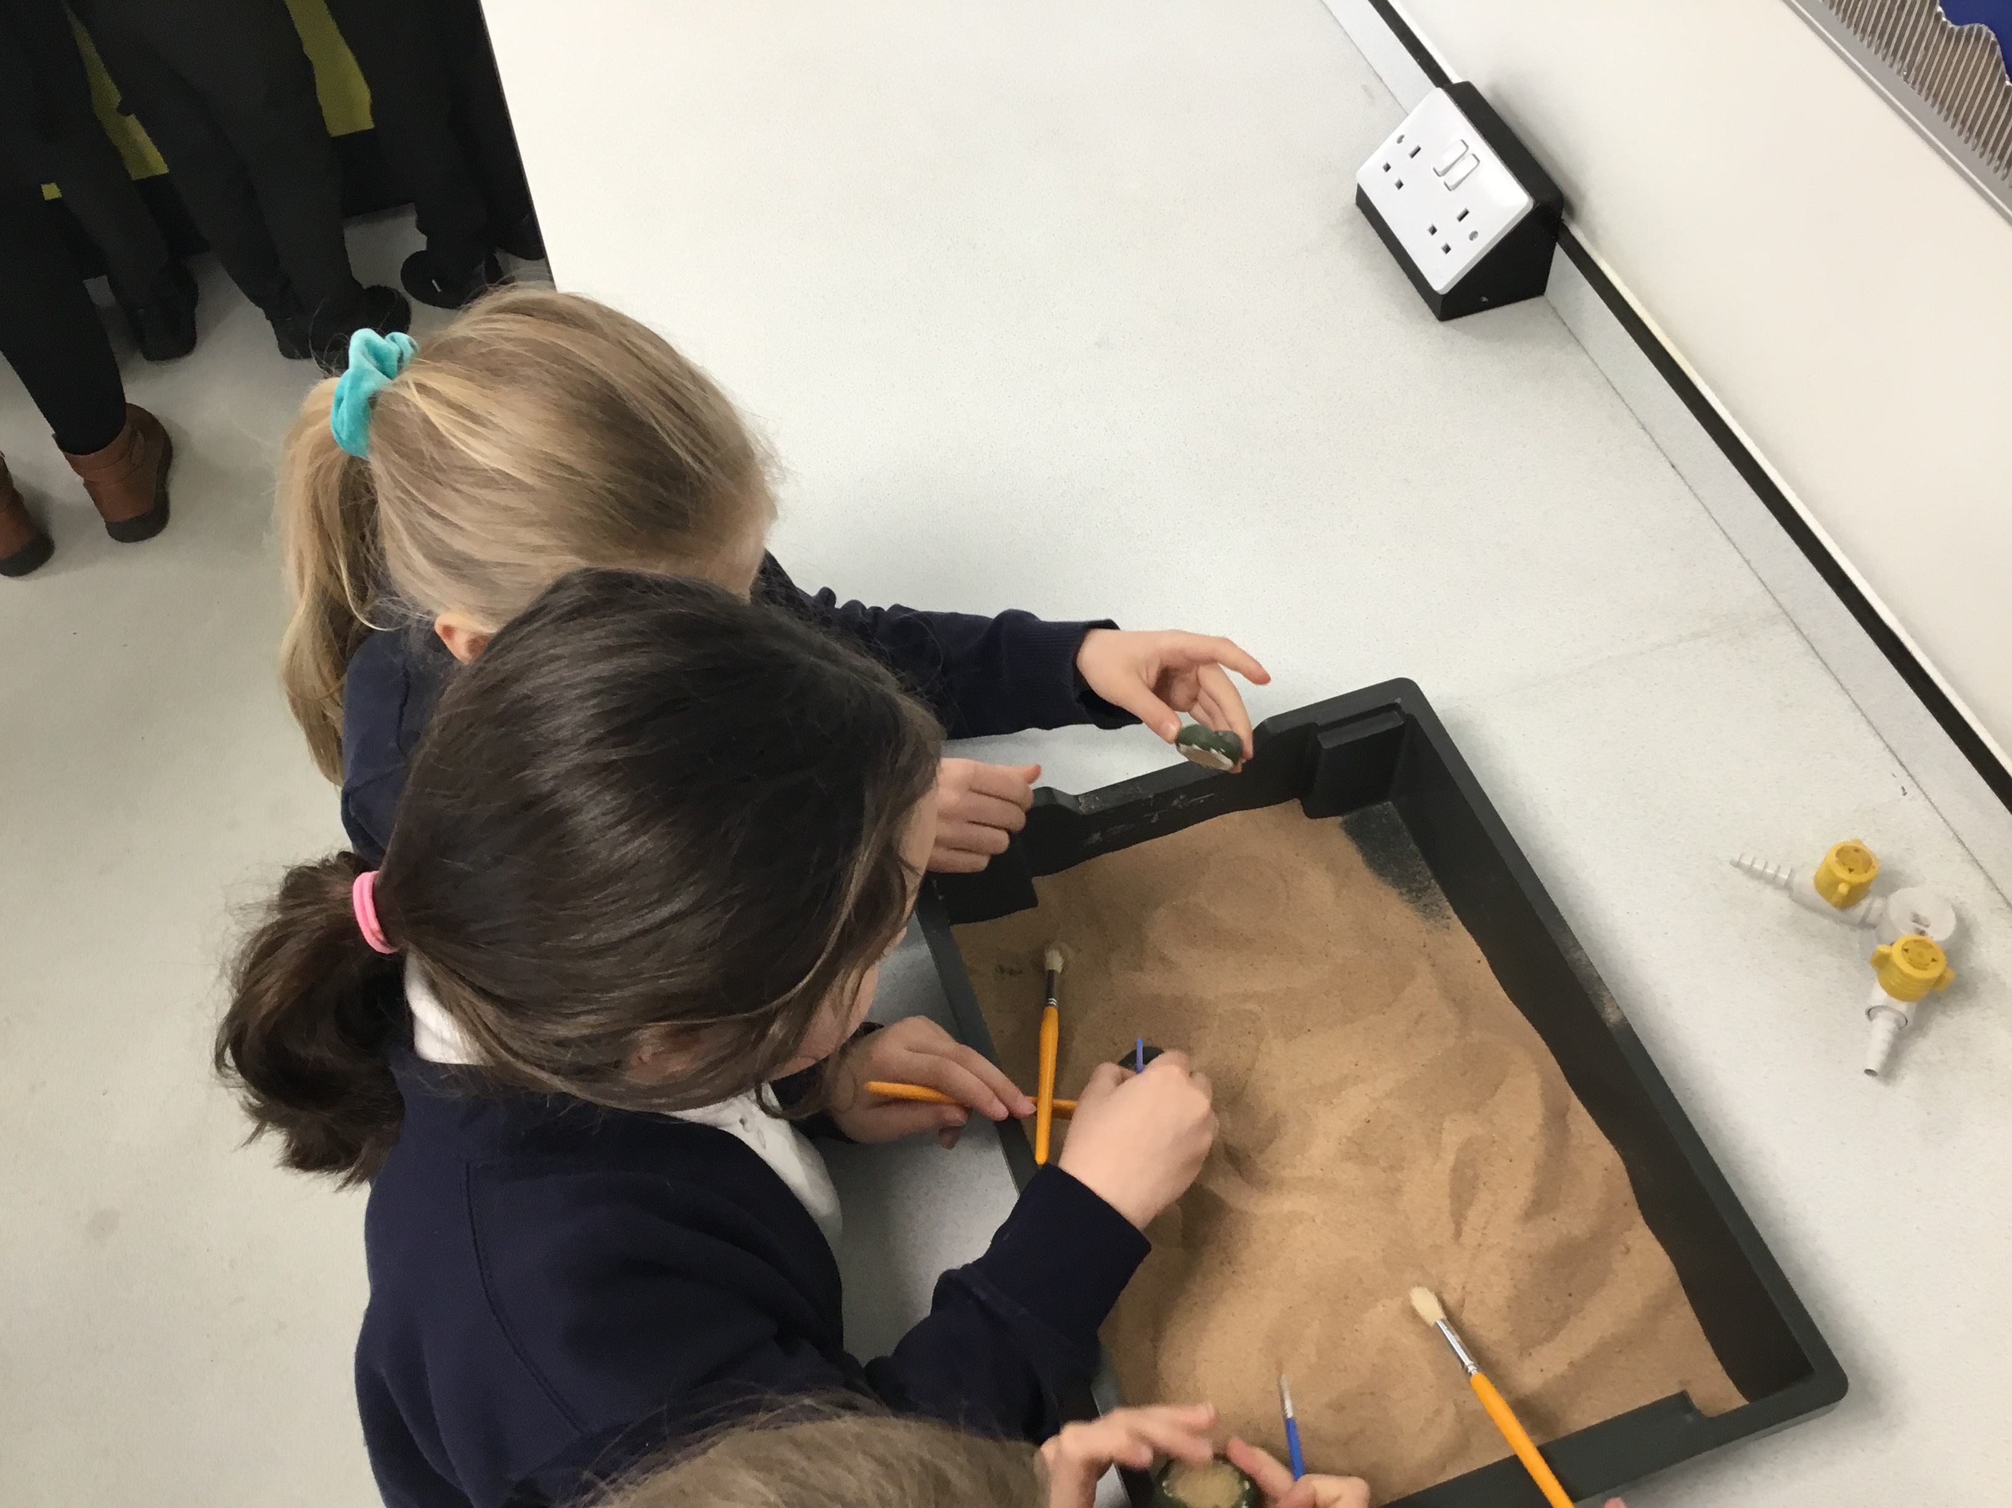
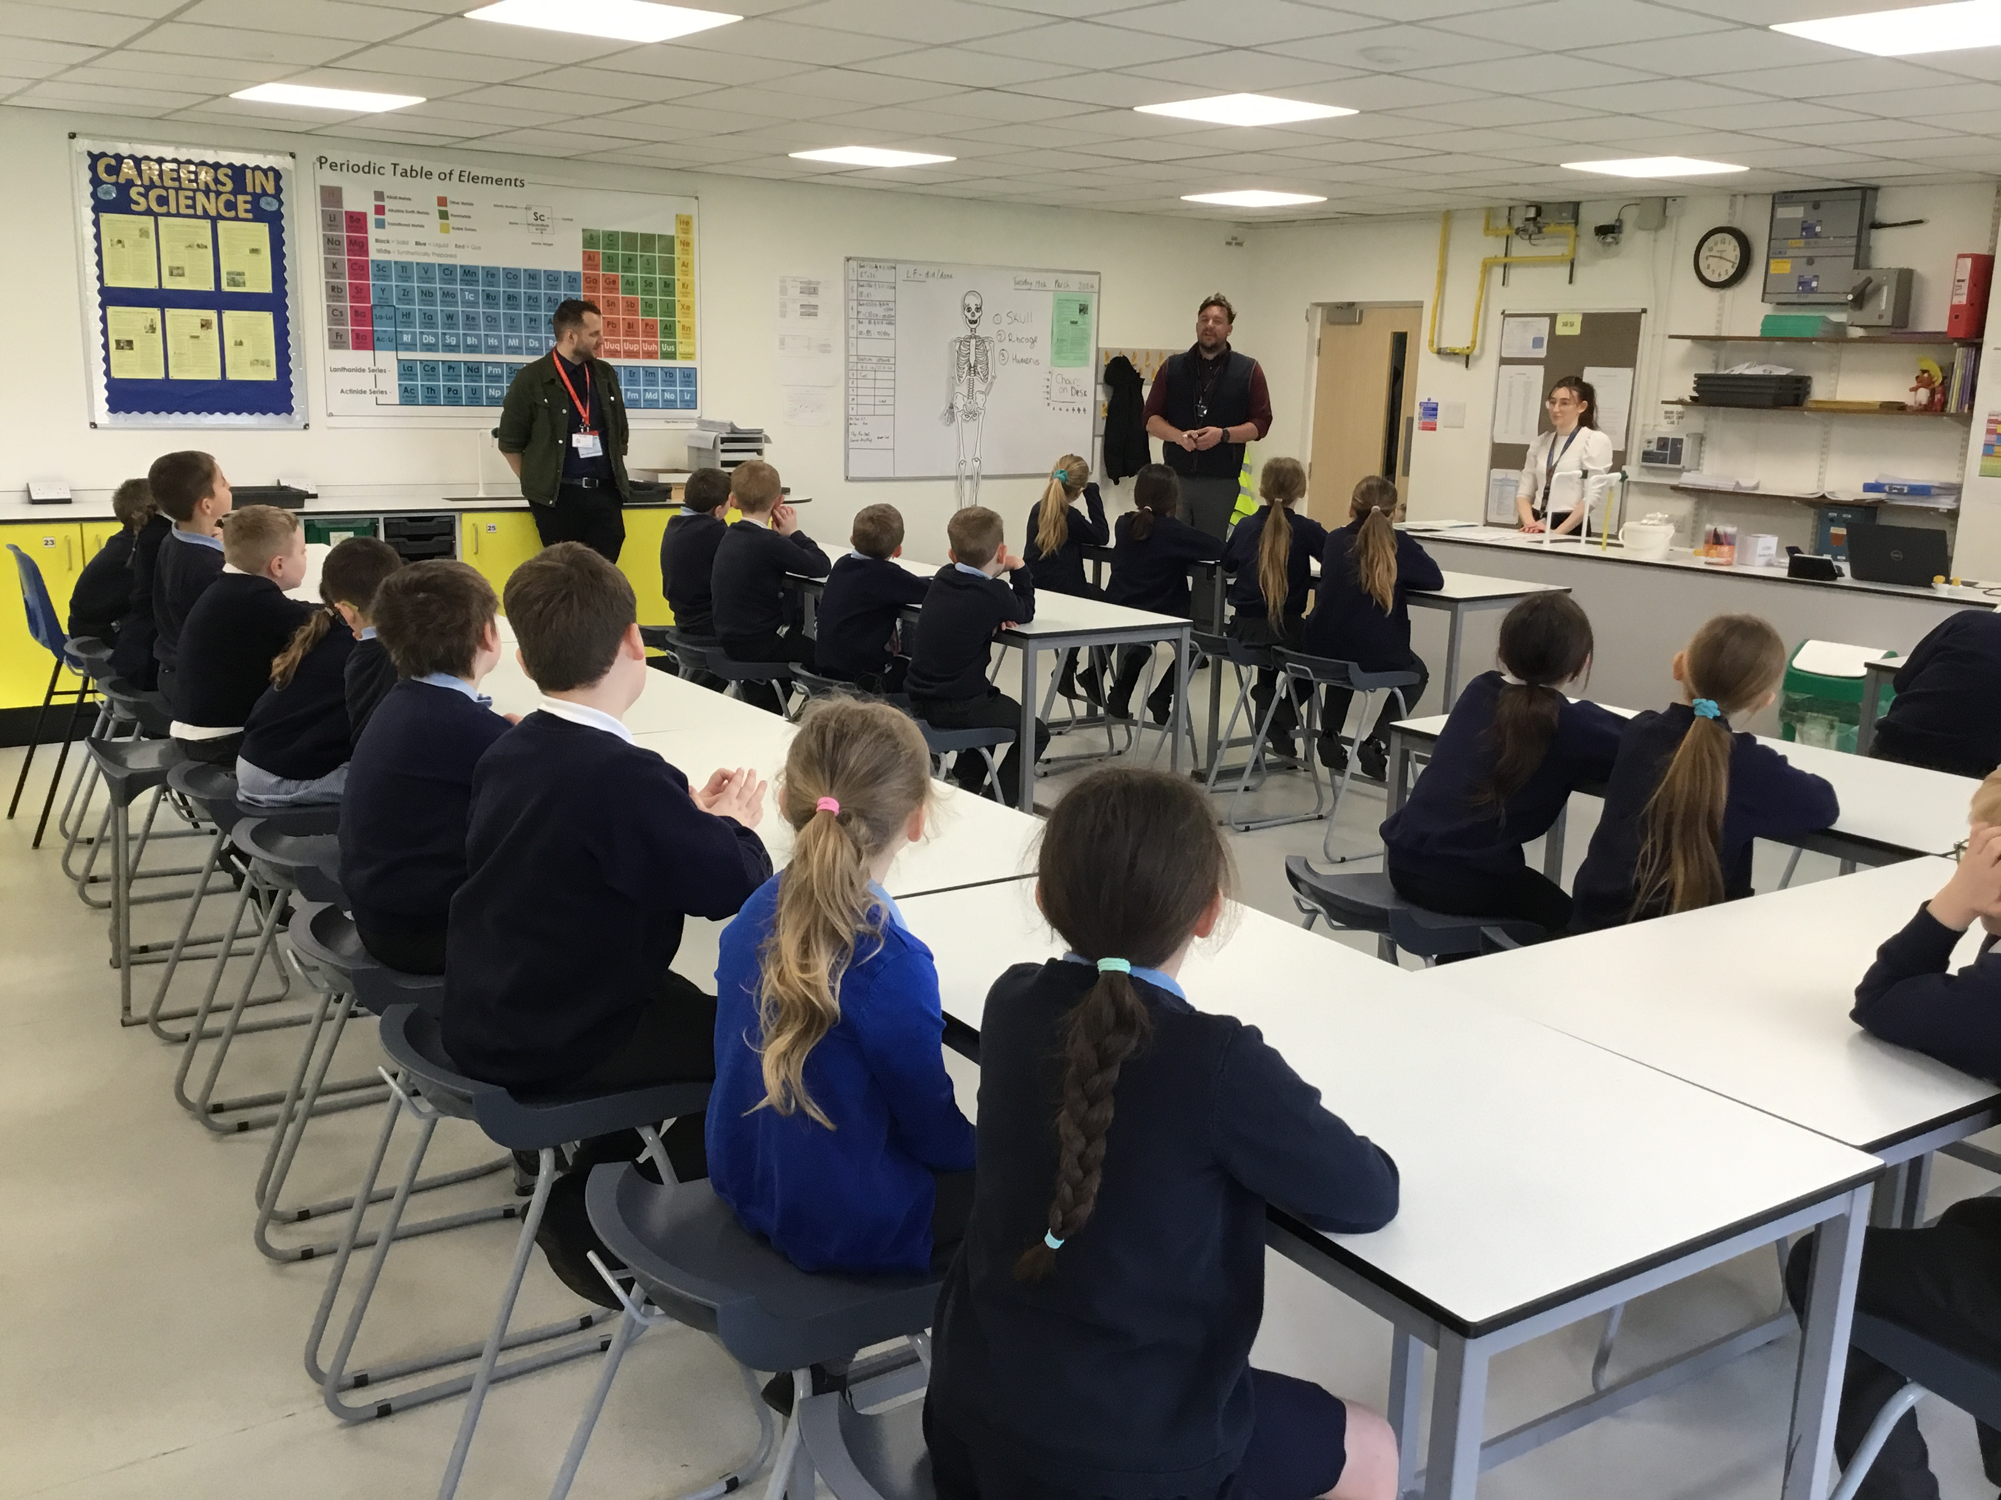
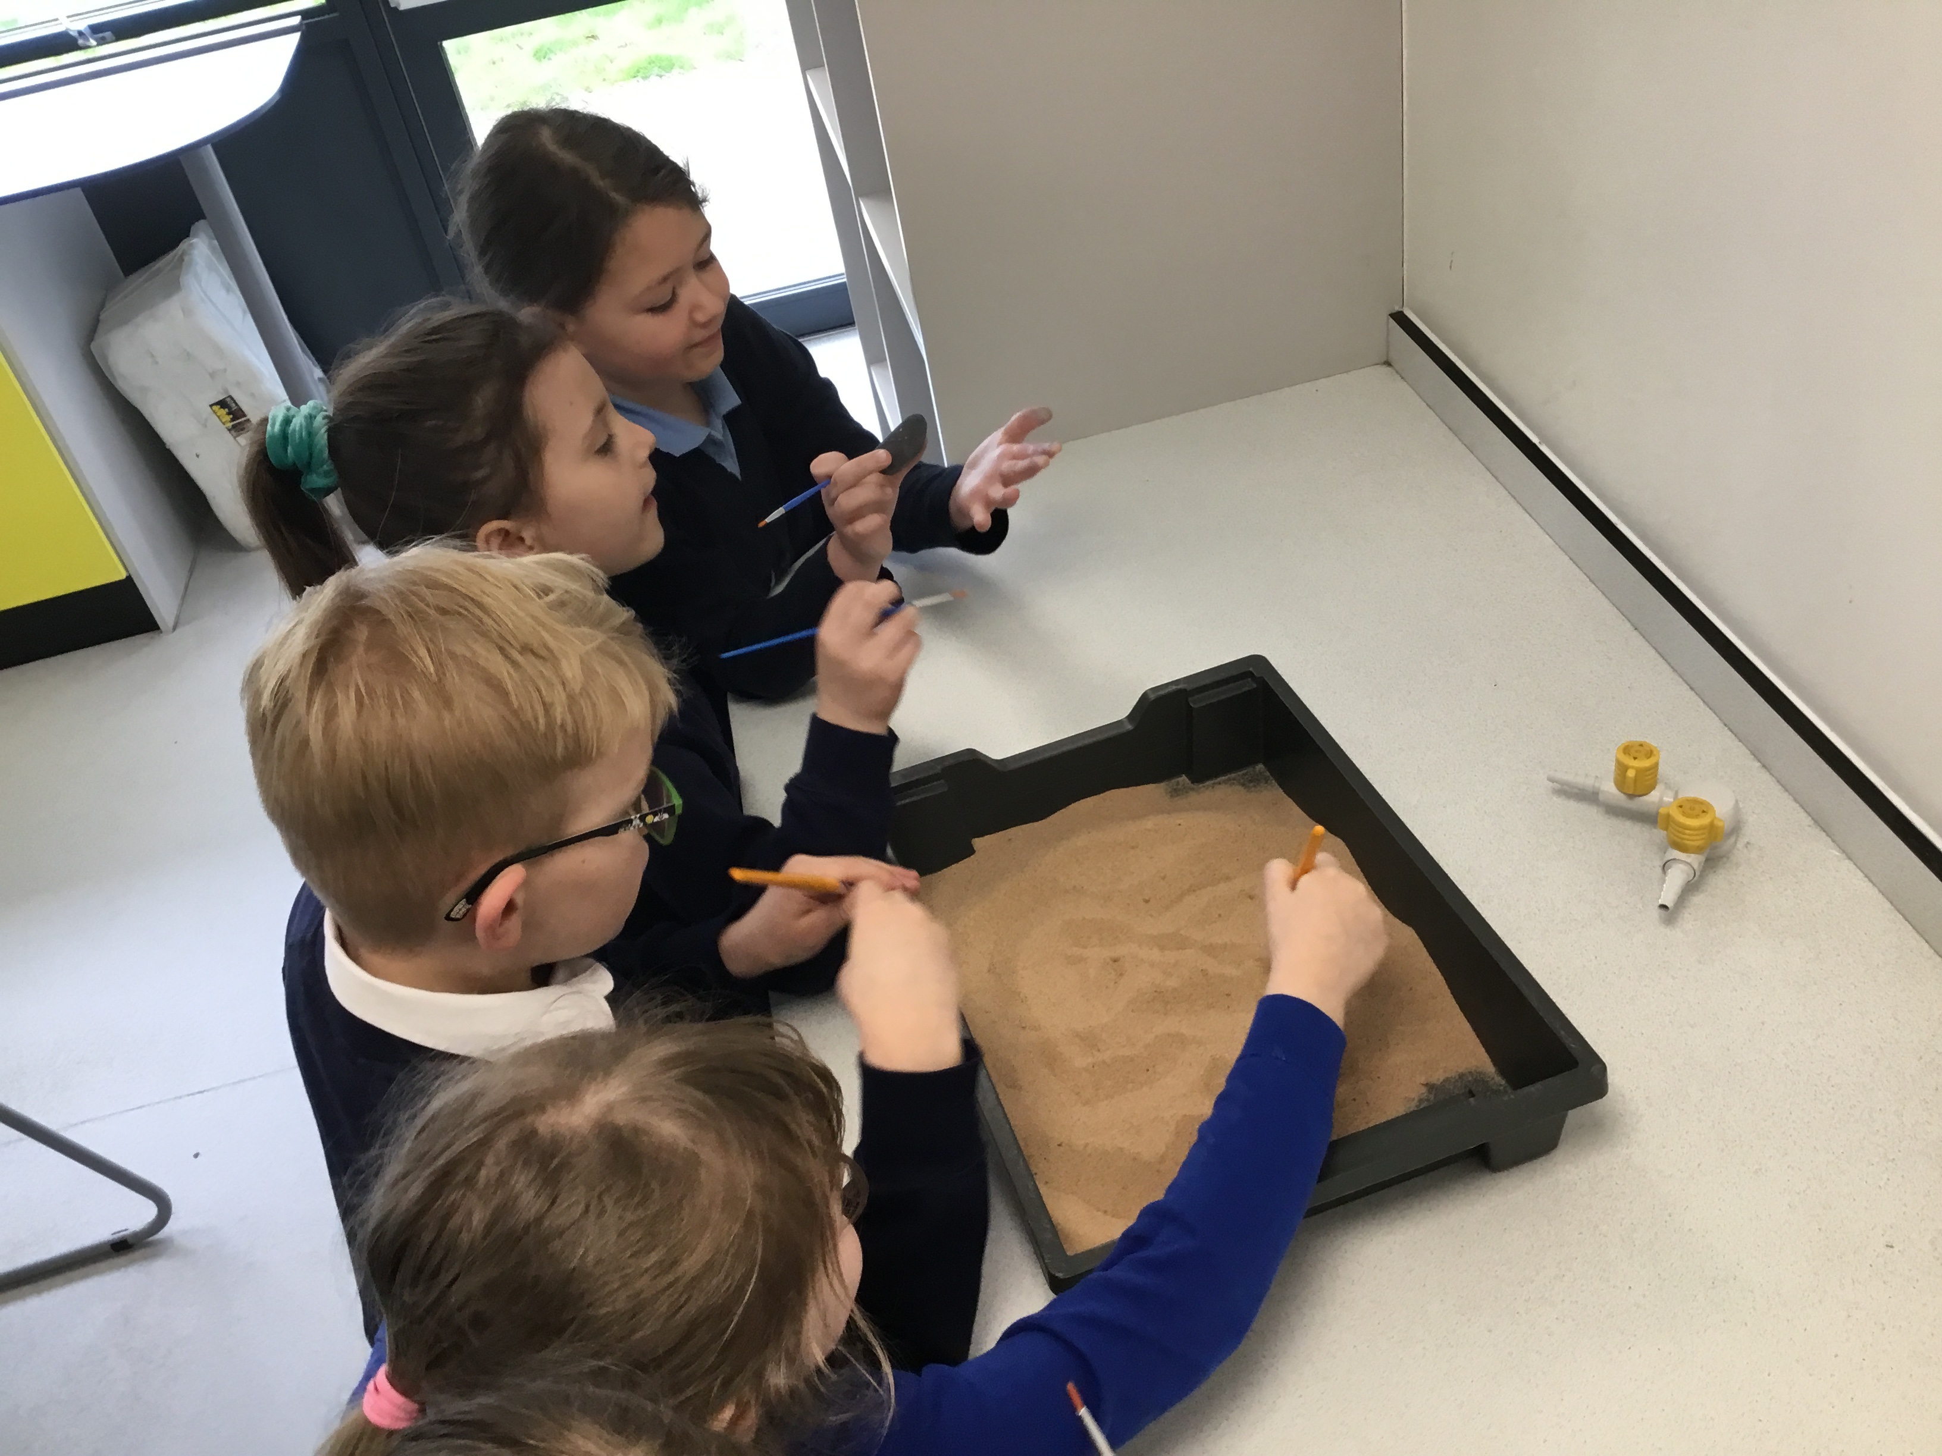
DAHL CLASS FOSSIL AND BONE WORKSHOP
On Tuesday 19th March, Dahl Class were invited to visit the Science Department at University Academy Long Sutton. The children were able to enhance their learning around Fossils. The children learnt all things Human body and became fossil detectives where they used a selection of clues to help them identify the animals each fossil came from.

Slide 7
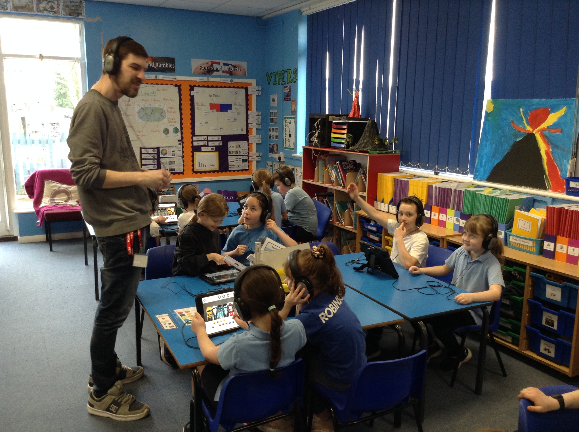
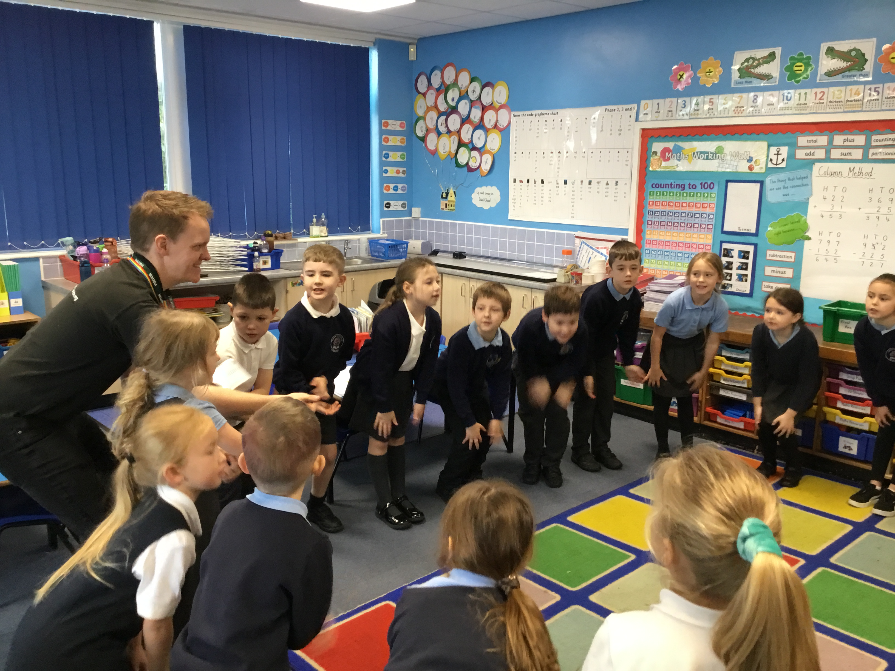
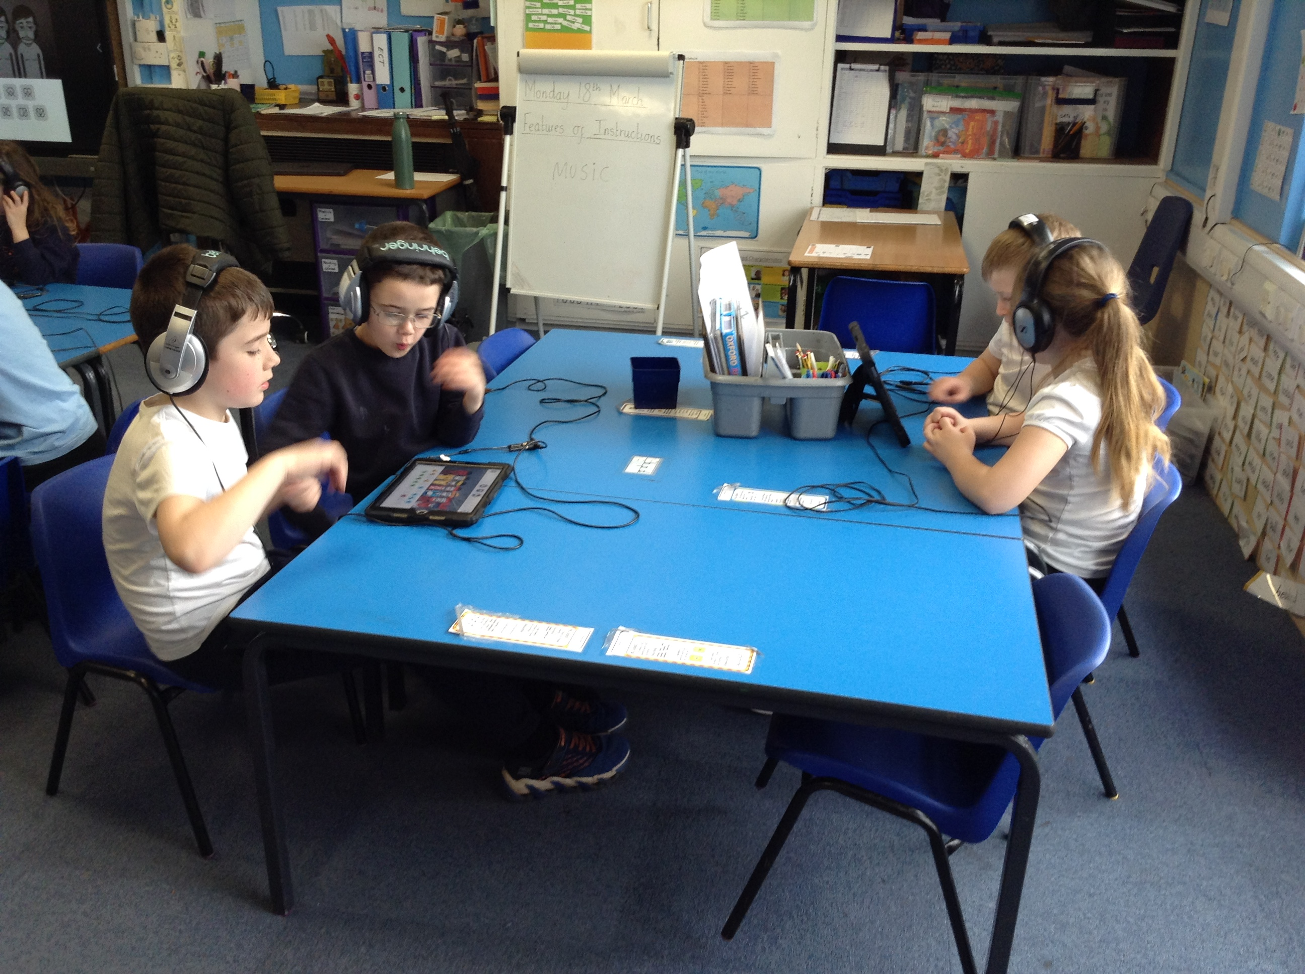
THE SOUND OF MUSIC
Summer Term (13th June 2024):
Over the year, Dahl class have deeply enjoyed being visited by Eddie and Robert from the Lincolnshire Music team who have been working with pupils to develop their understanding of music by providing specialist lessons on how to play the recorder and digital music. Pupils have enjoyed spending time with Robert and Eddie and we are sad to say that as of today, pupils in Dahl class received their last visit from the Lincolnshire Music Service this year.

Slide 8
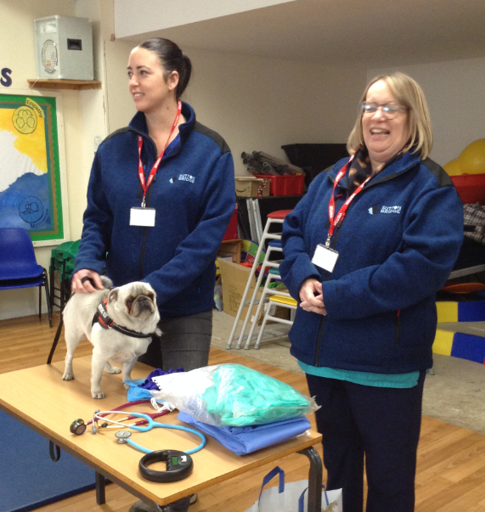
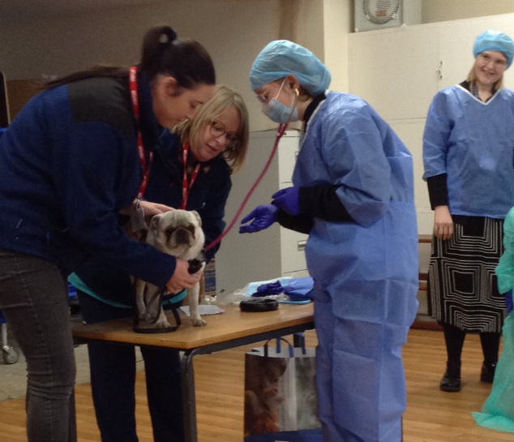
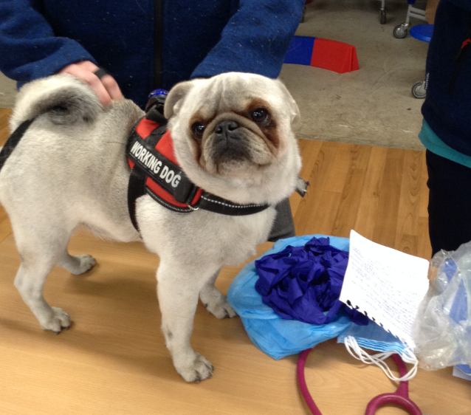
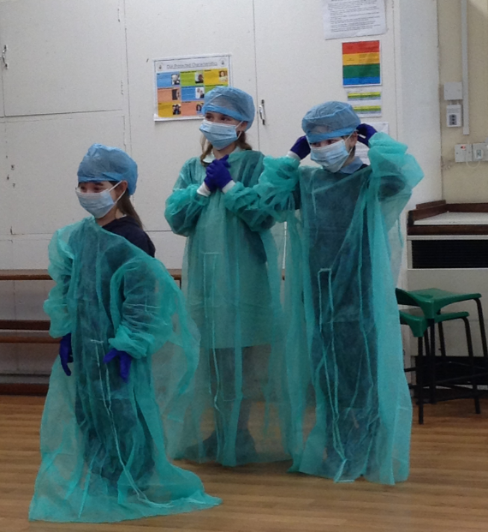
WORLD VETERINARY DAY
On Thursday 25th April, Lutton St Nicholas Primary welcomed some very special guests. Dr Cristina, Simone and Kevin the Pug. Dr Cristina and Simone delivered an action-packed assembly to the children about life as a Vet. The children thoroughly enjoyed this experience and was also able to do some routine examinations on Kevin!

Slide 9
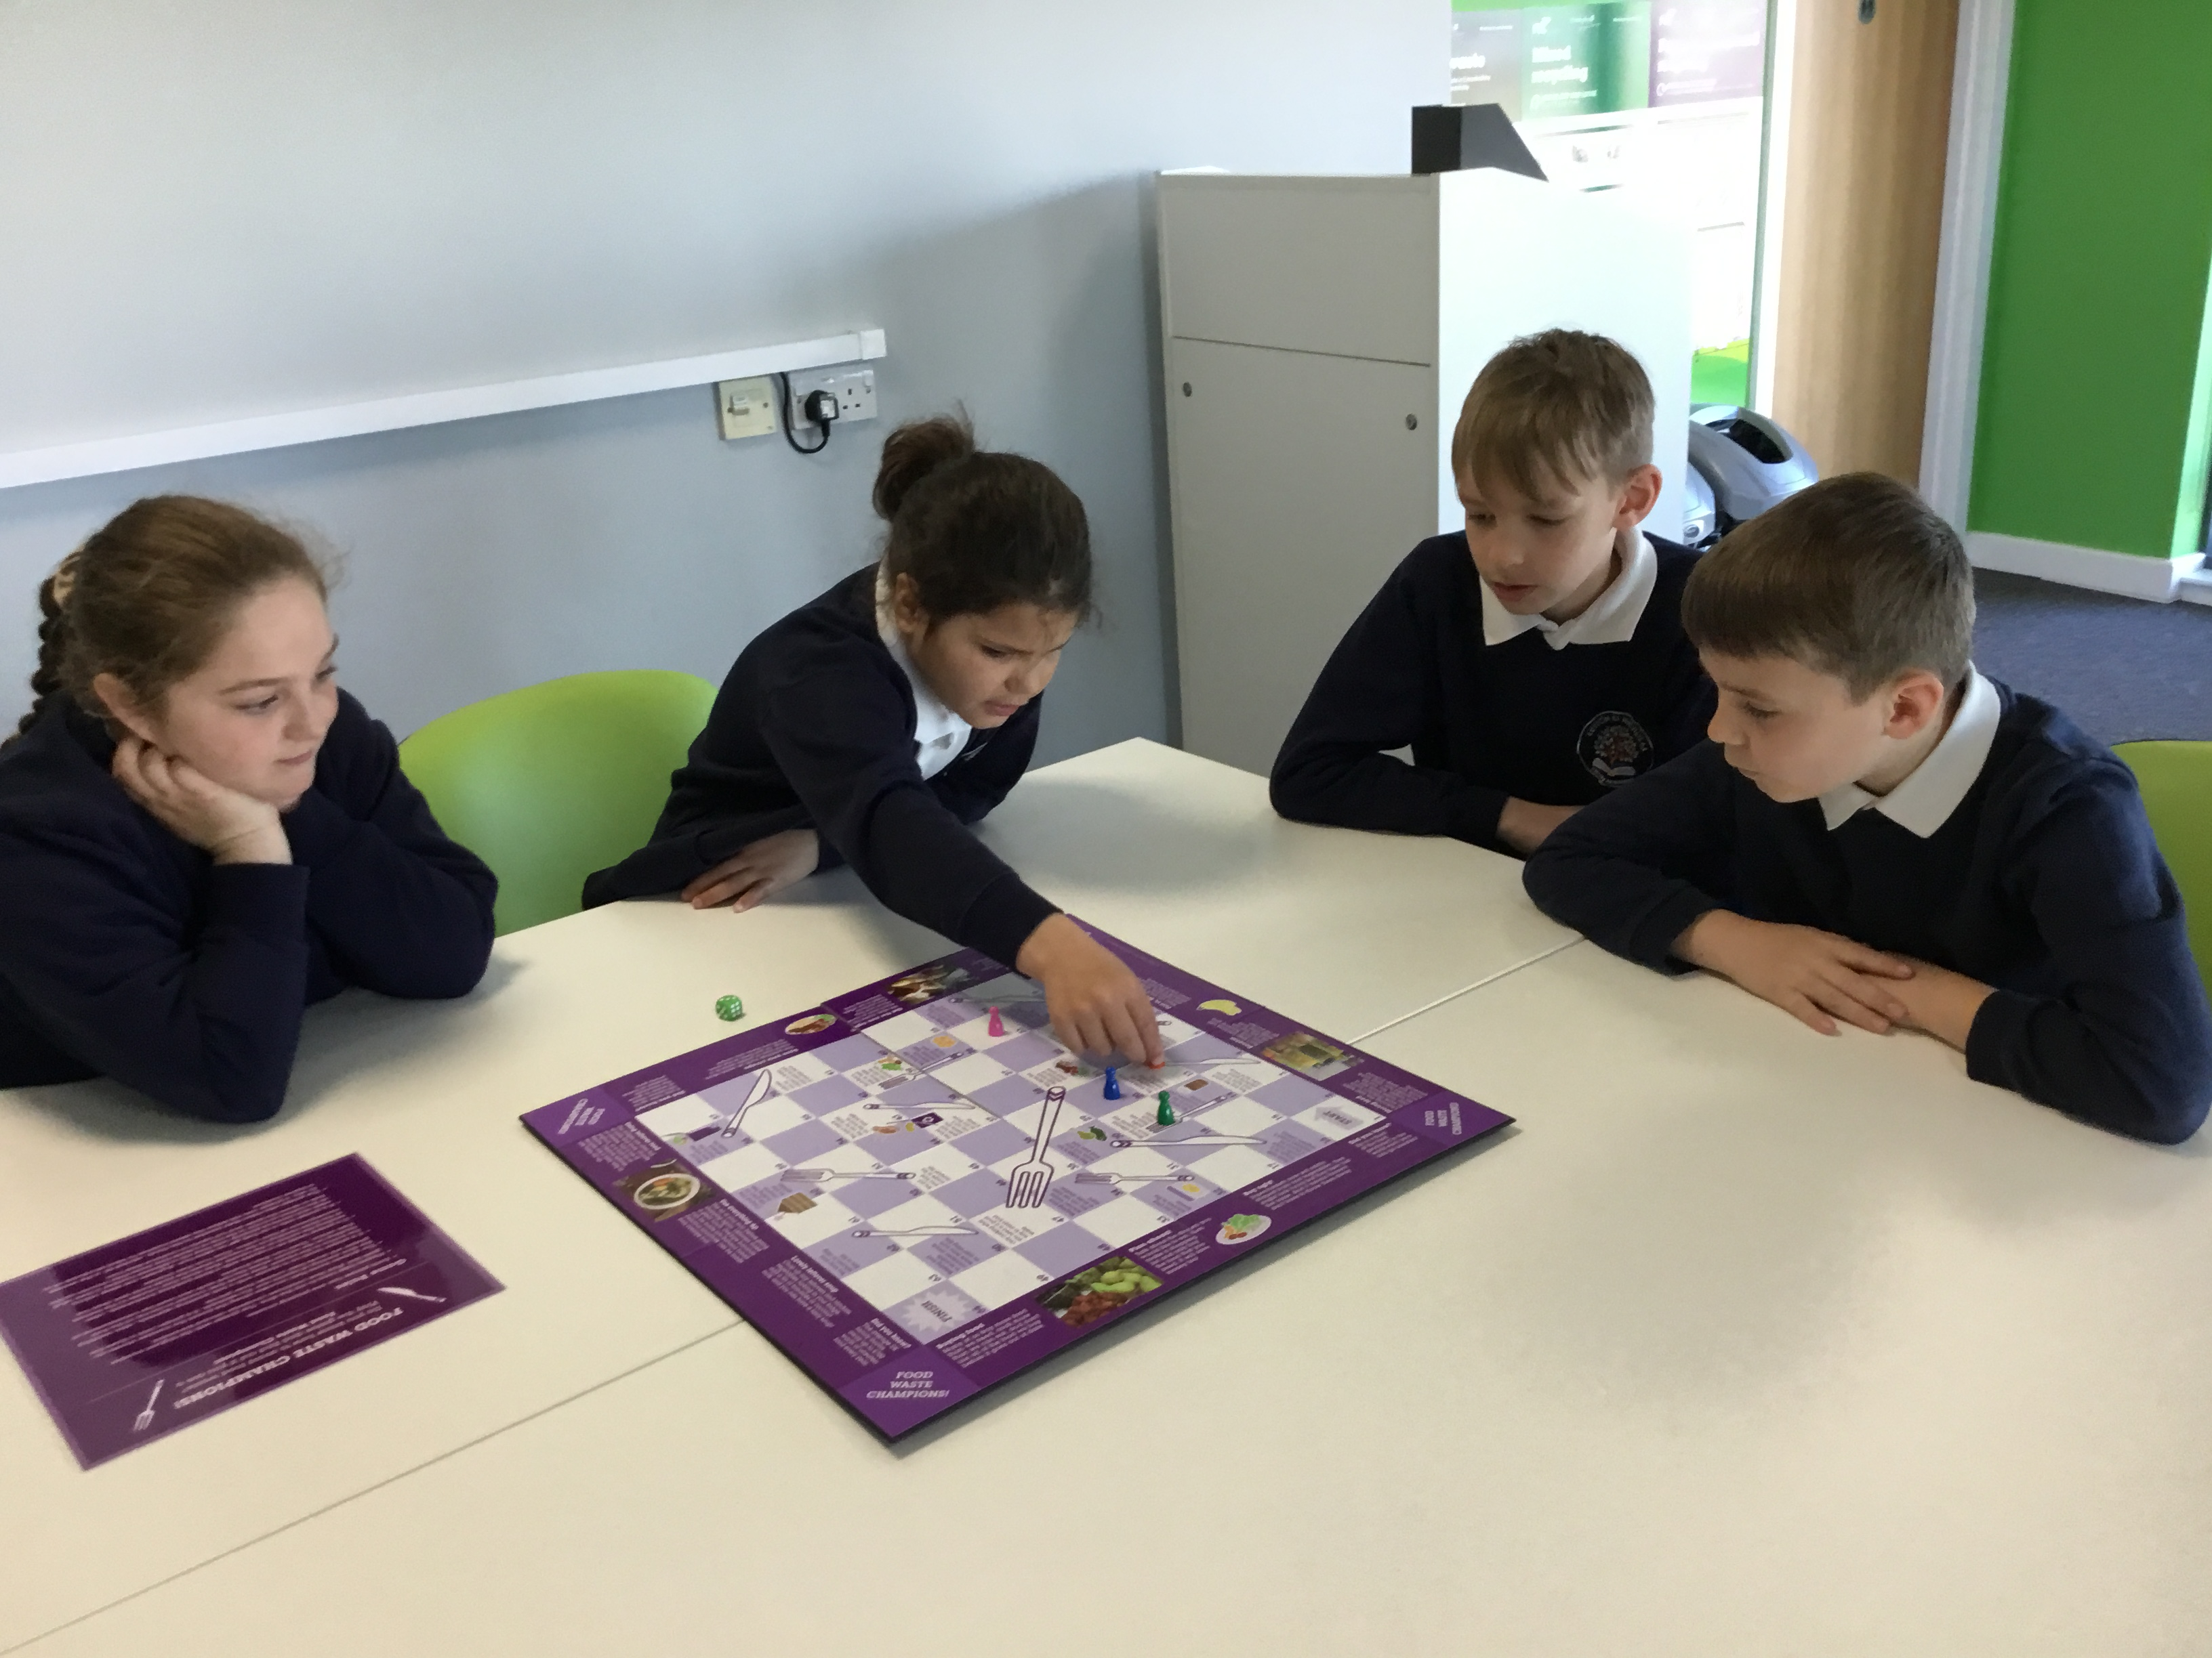
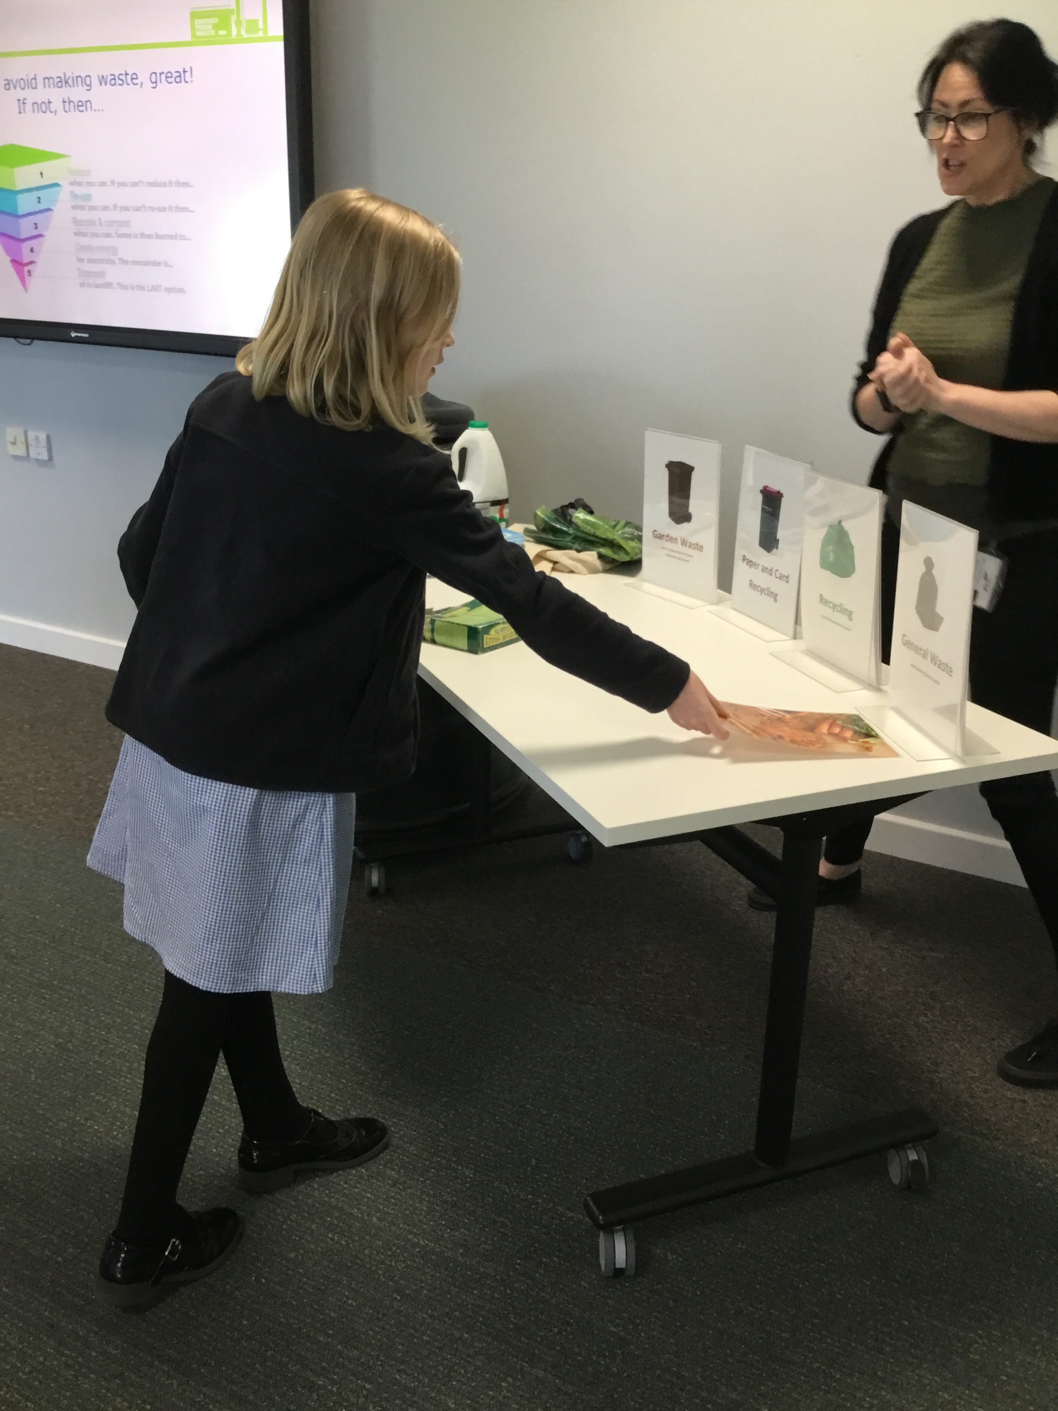
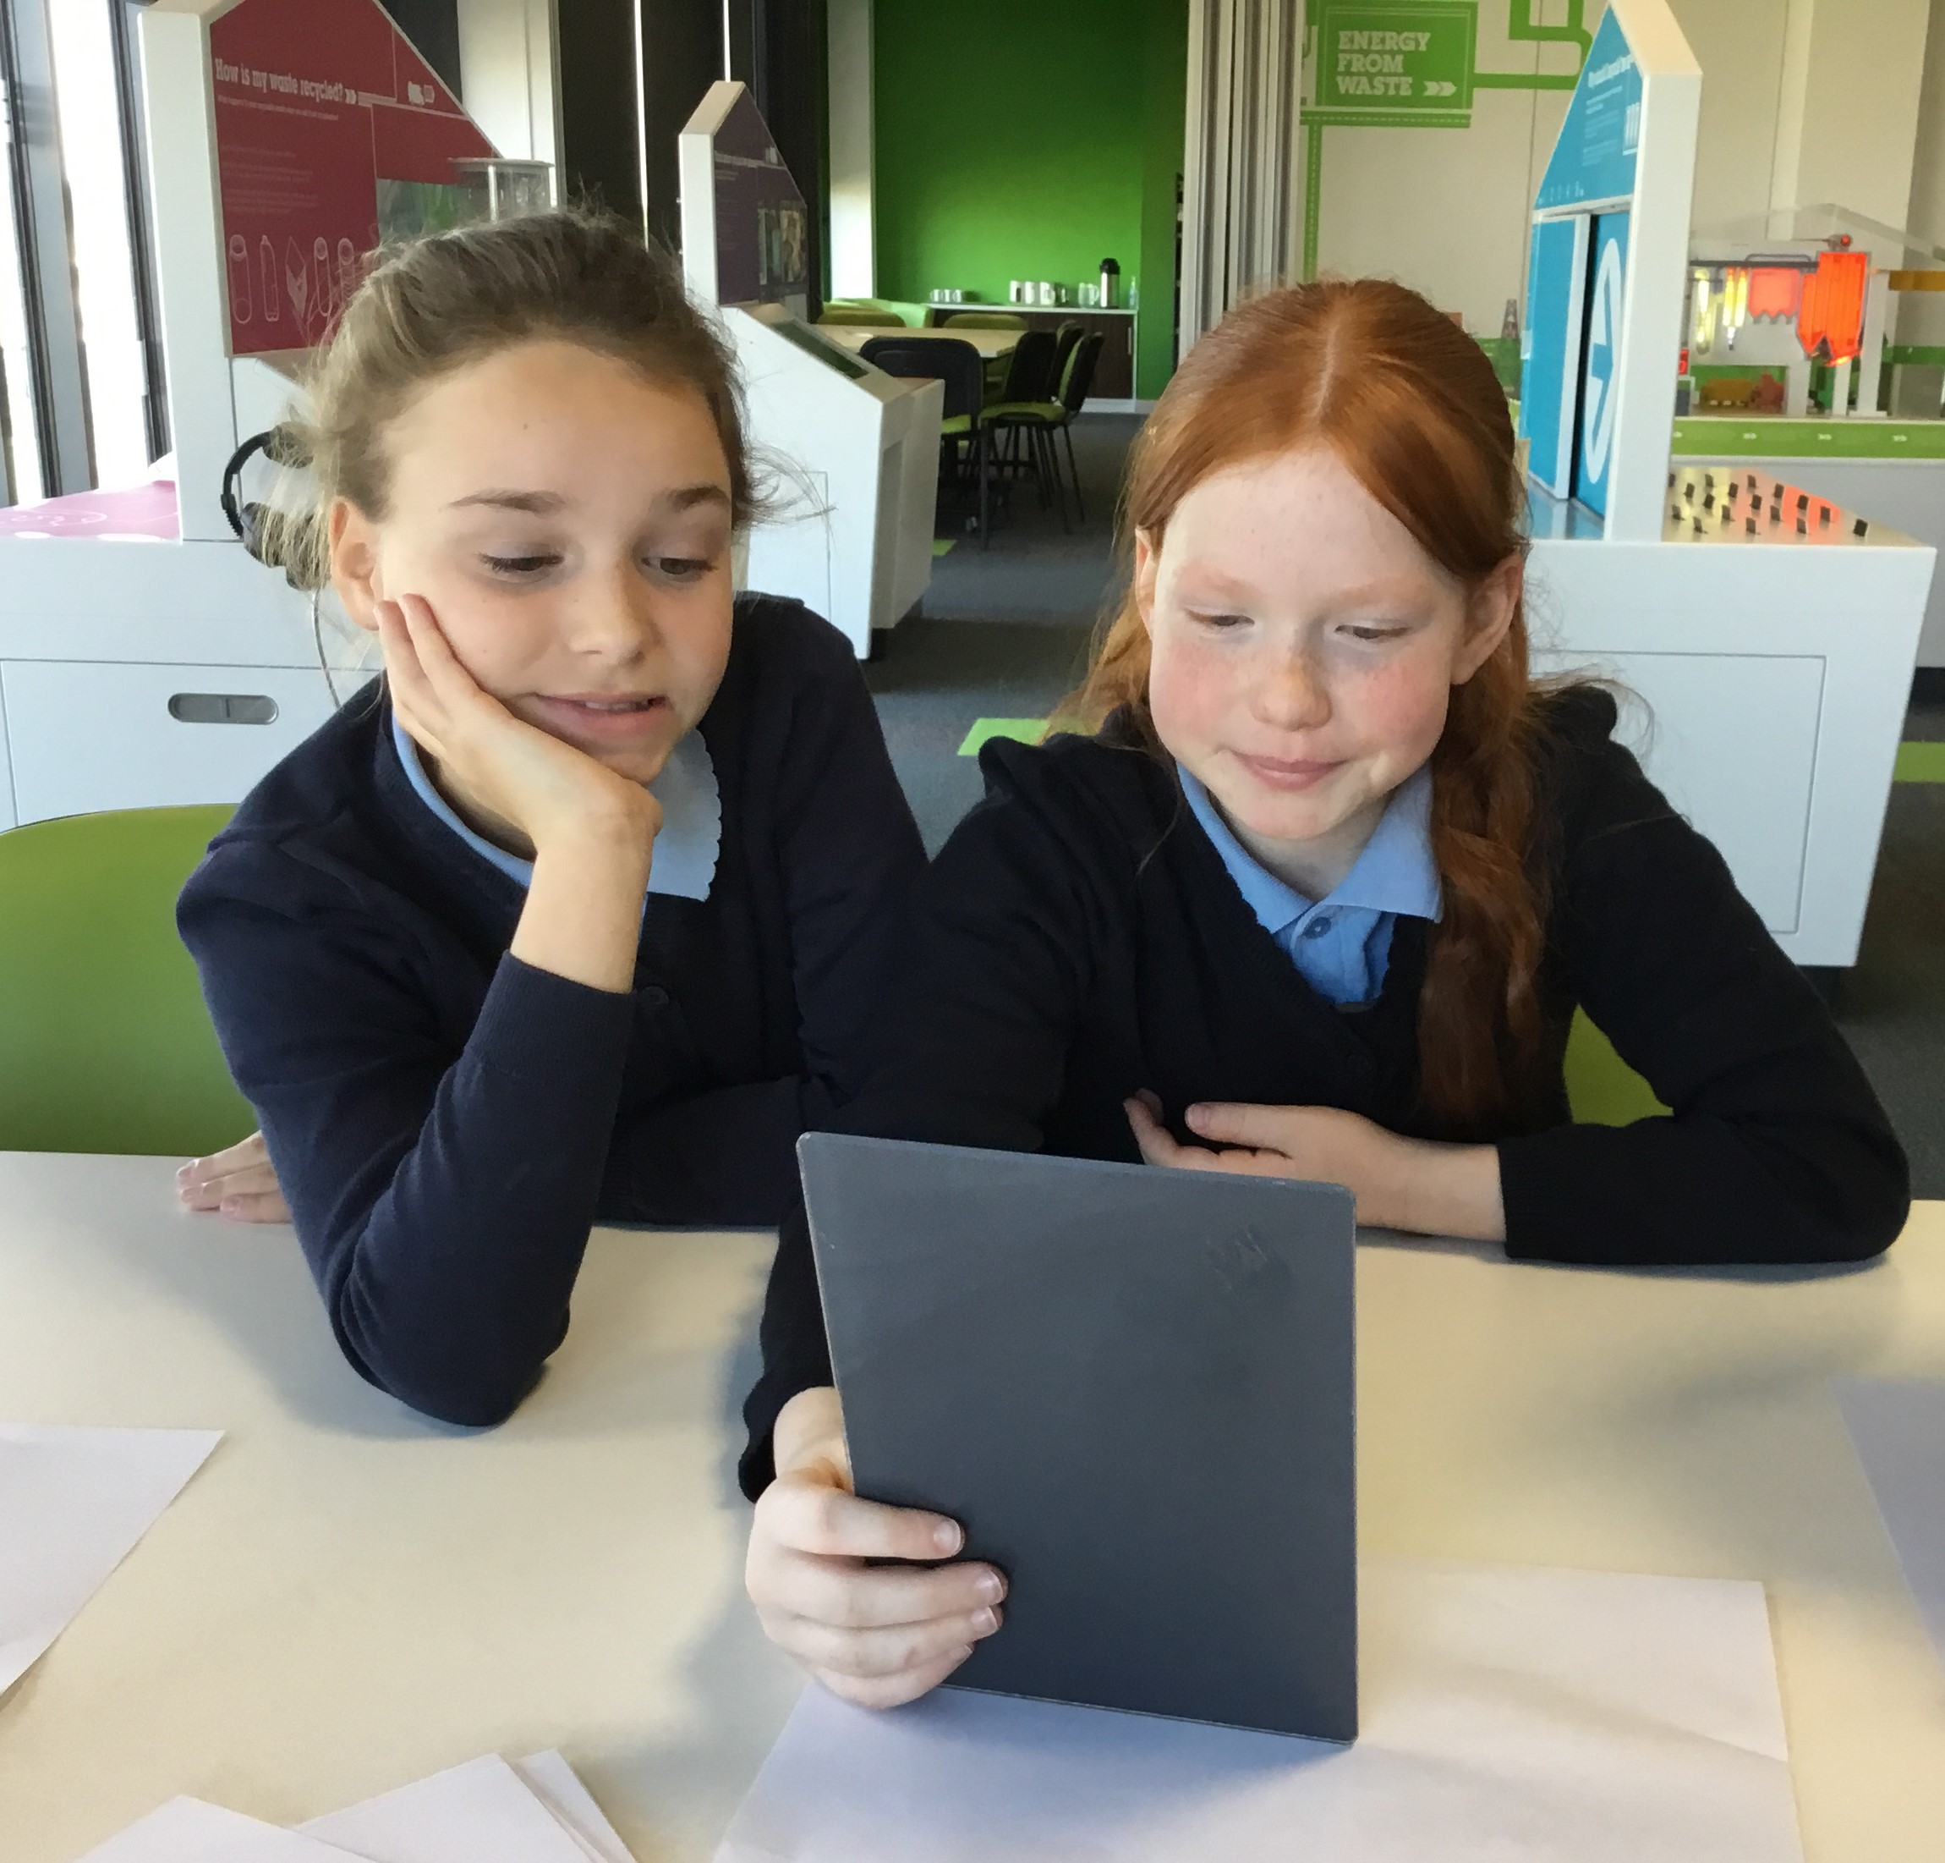
On Tuesday 30th April, Morpurgo class visited the Energy from Waste centre in Lincoln. It was an amazing day where pupils learnt about the 5 Rs of waste (Refuse, Reduce, Reuse, Repurpose and Recycle).
Pupils learnt about how much waste is produced in a local area and the work taking place at the plant to create green energy using the waste and litter we produce as an alternative to landfill sites.
Pupils, unsurprisingly, were amazed and excited to see the giant claws feeding the furnace and exploring how green energy is created.

Slide 10
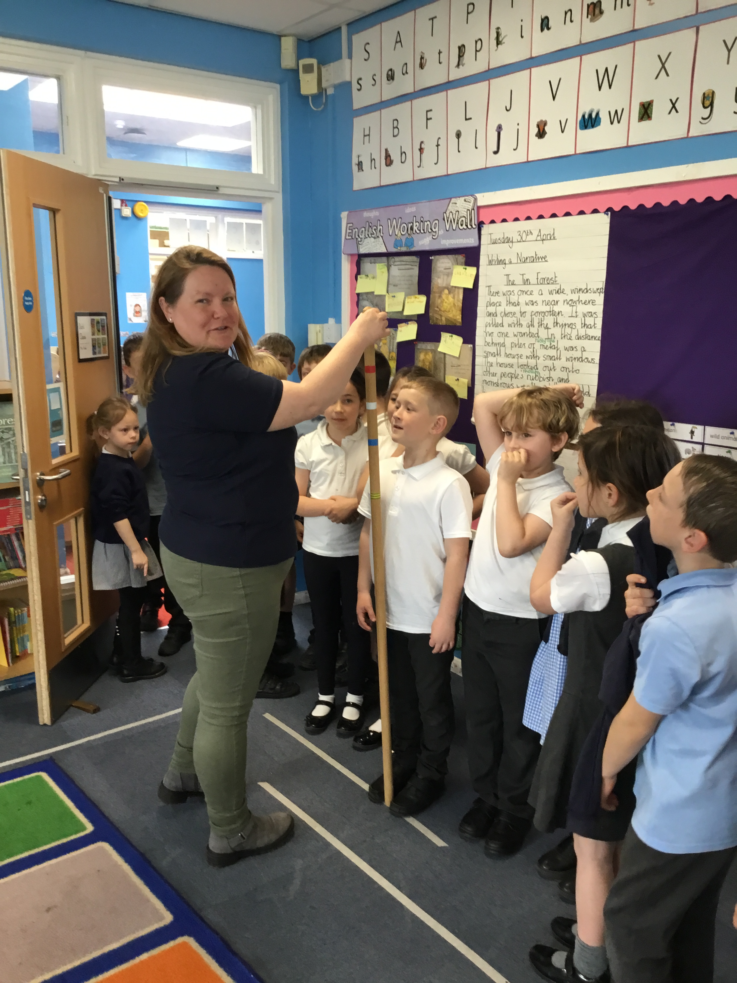
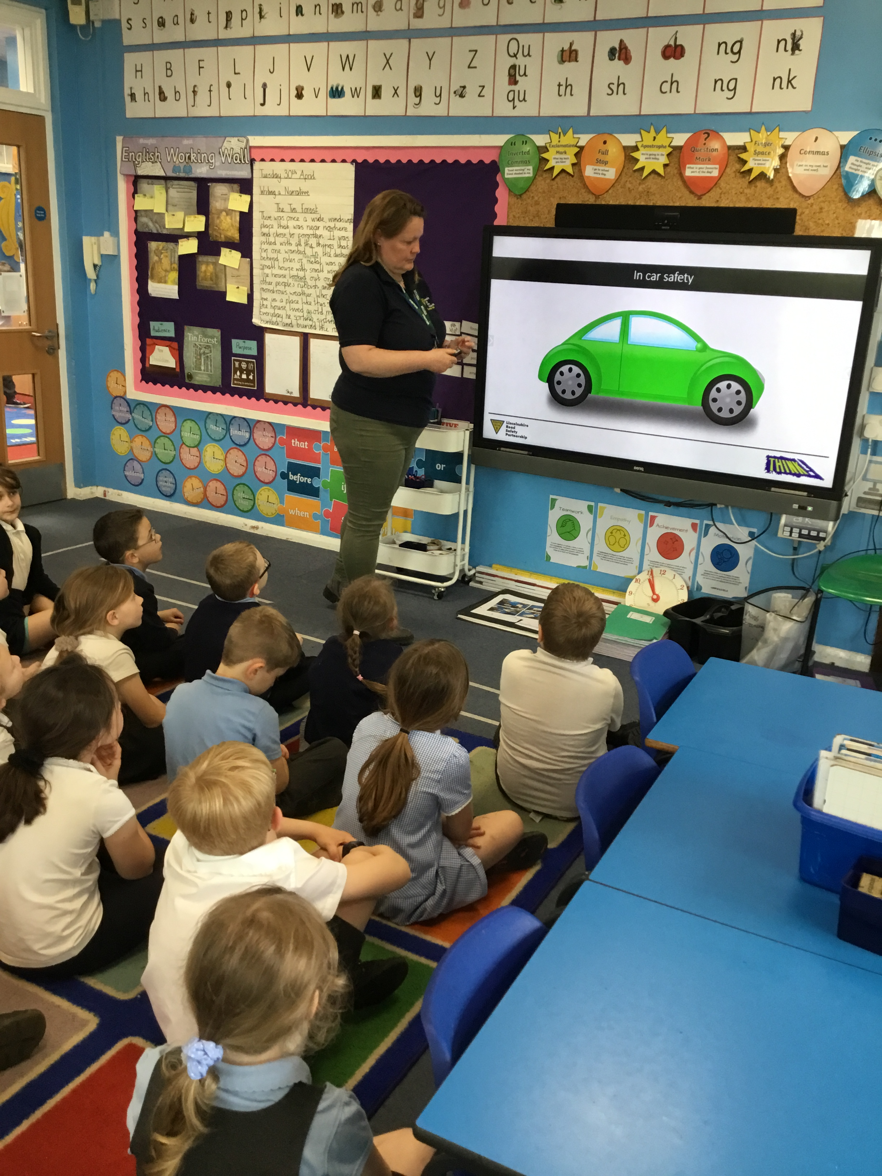
On Wednesday 1st May, Natasha from the Road Safety Partnership visited our academy to speak to our children about the importance of remaining safe when travelling by car.
Natasha visited Dahl and Morpurgo class to discuss the importance of car seats and basic car safety. Pupils asked some incredibly interesting questions and demonstrated some fantastic facts they knew about road safety.
Well done Dahl and Morpurgo class!

Slide 11
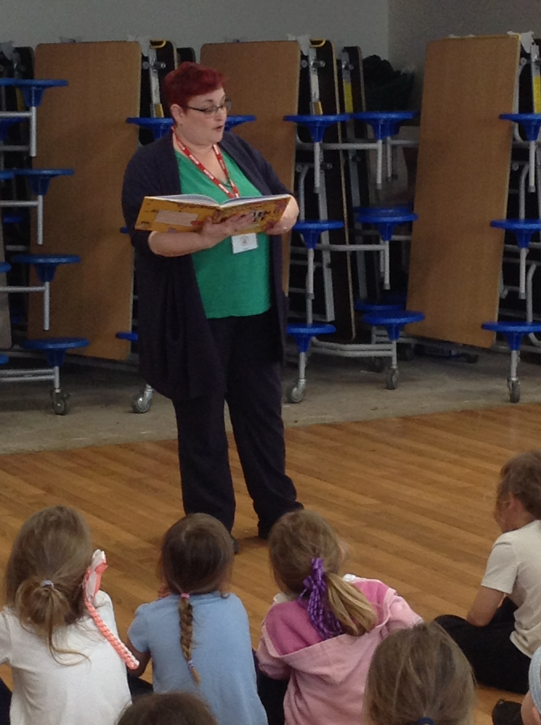
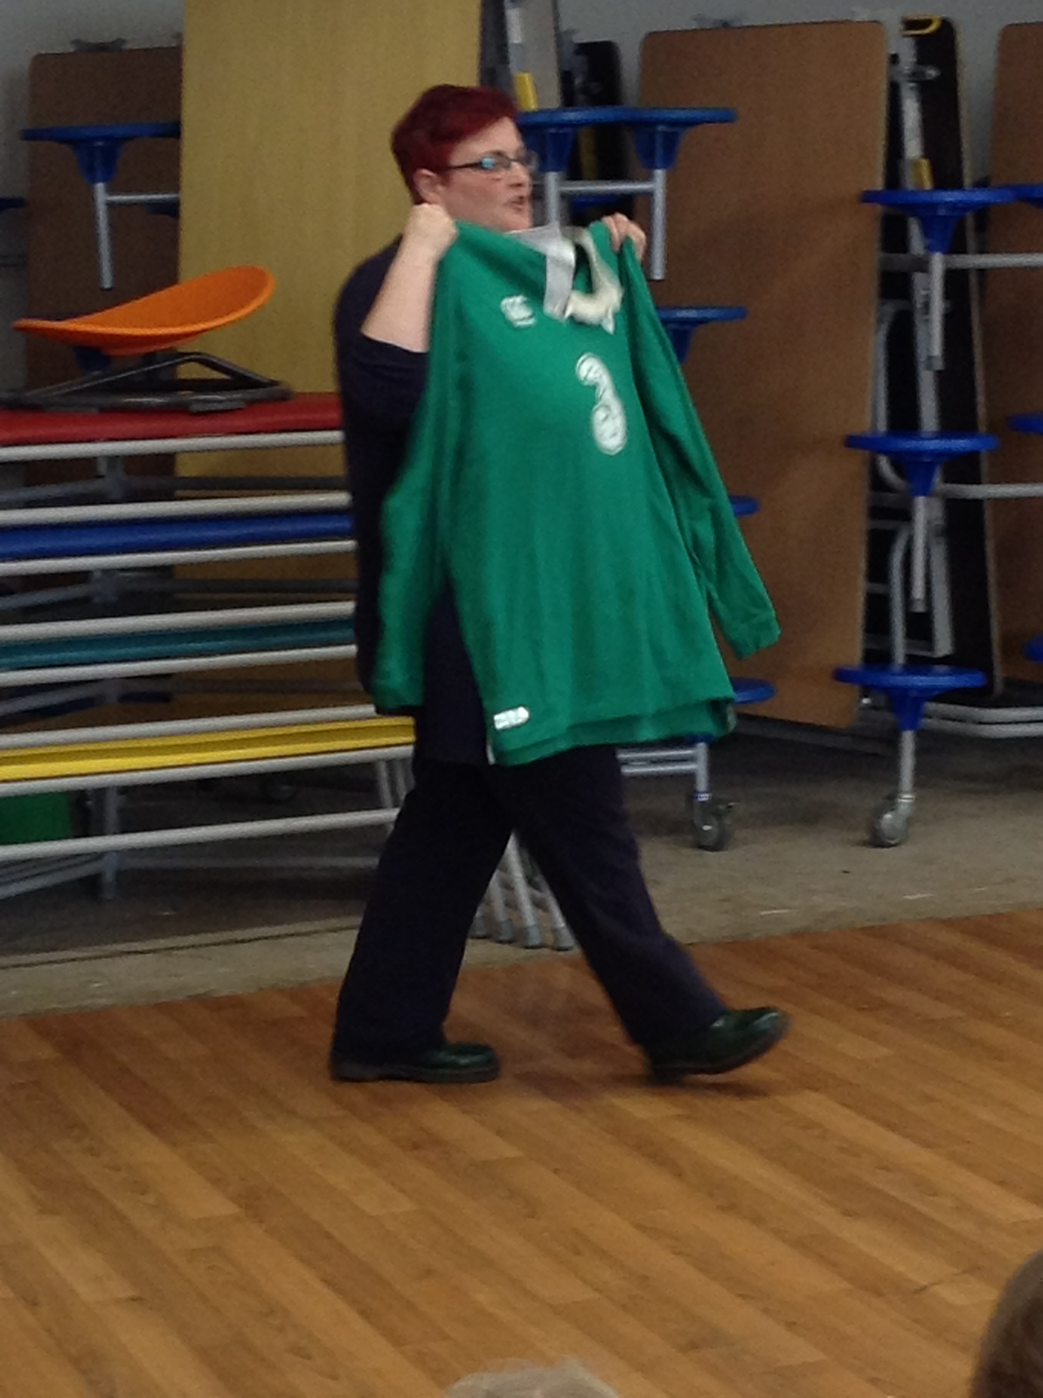
On Thursday 2nd May, Micki our fantastic community worker visited Lutton St Nicholas Primary Academy. We we’re so amazed by Micki’s Easter Workshops and work back in March that we absolutely needed to invite her back. Today, Micki spoke to pupils about one of our school values, ‘teamwork’. Micki helped to teach learners at our school why teamwork is so important and how teamwork comes through in Bible stories.
We look forward to welcoming Micki back on the 11th July when she will be supporting us to prepare pupils for transition.

Slide 12
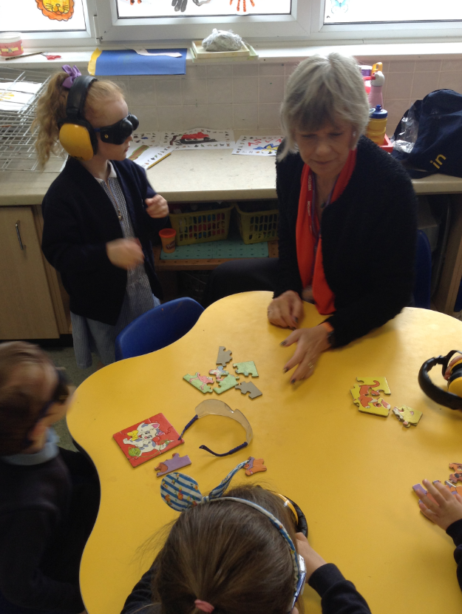
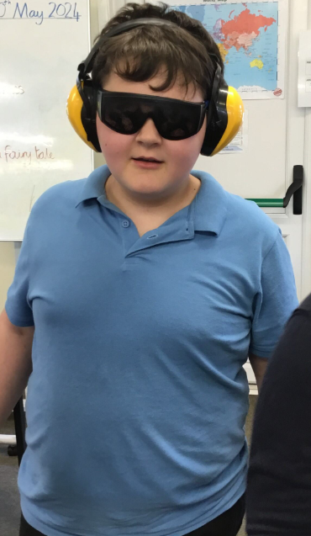
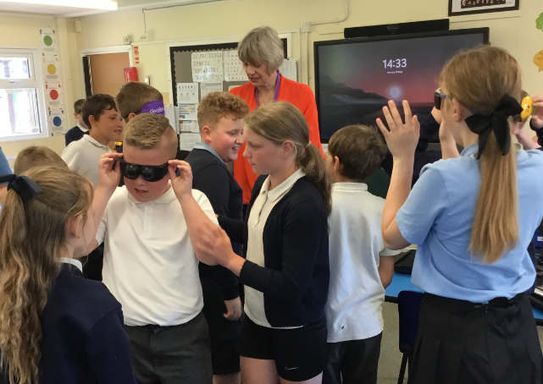
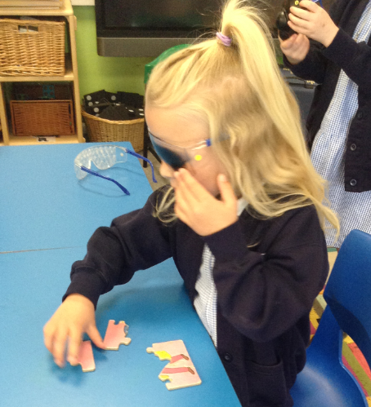
DEAFBLIND AWARENESS DAY
On Monday 20th May, Carolyn from the Deafblind Society visited Lutton St Nicholas Primary and delivered age-appropriate lessons for all our children. The children took part in a range of activities giving them an insight what it is like to be deaf and blind. Pupils explored different glasses to understand the various sight difficulties people suffer from and explored how being deaf or blind can affect every aspect of our day to day lives. Thank you DeafblindUK for helping to raise awareness and for visiting our children.

Slide 13
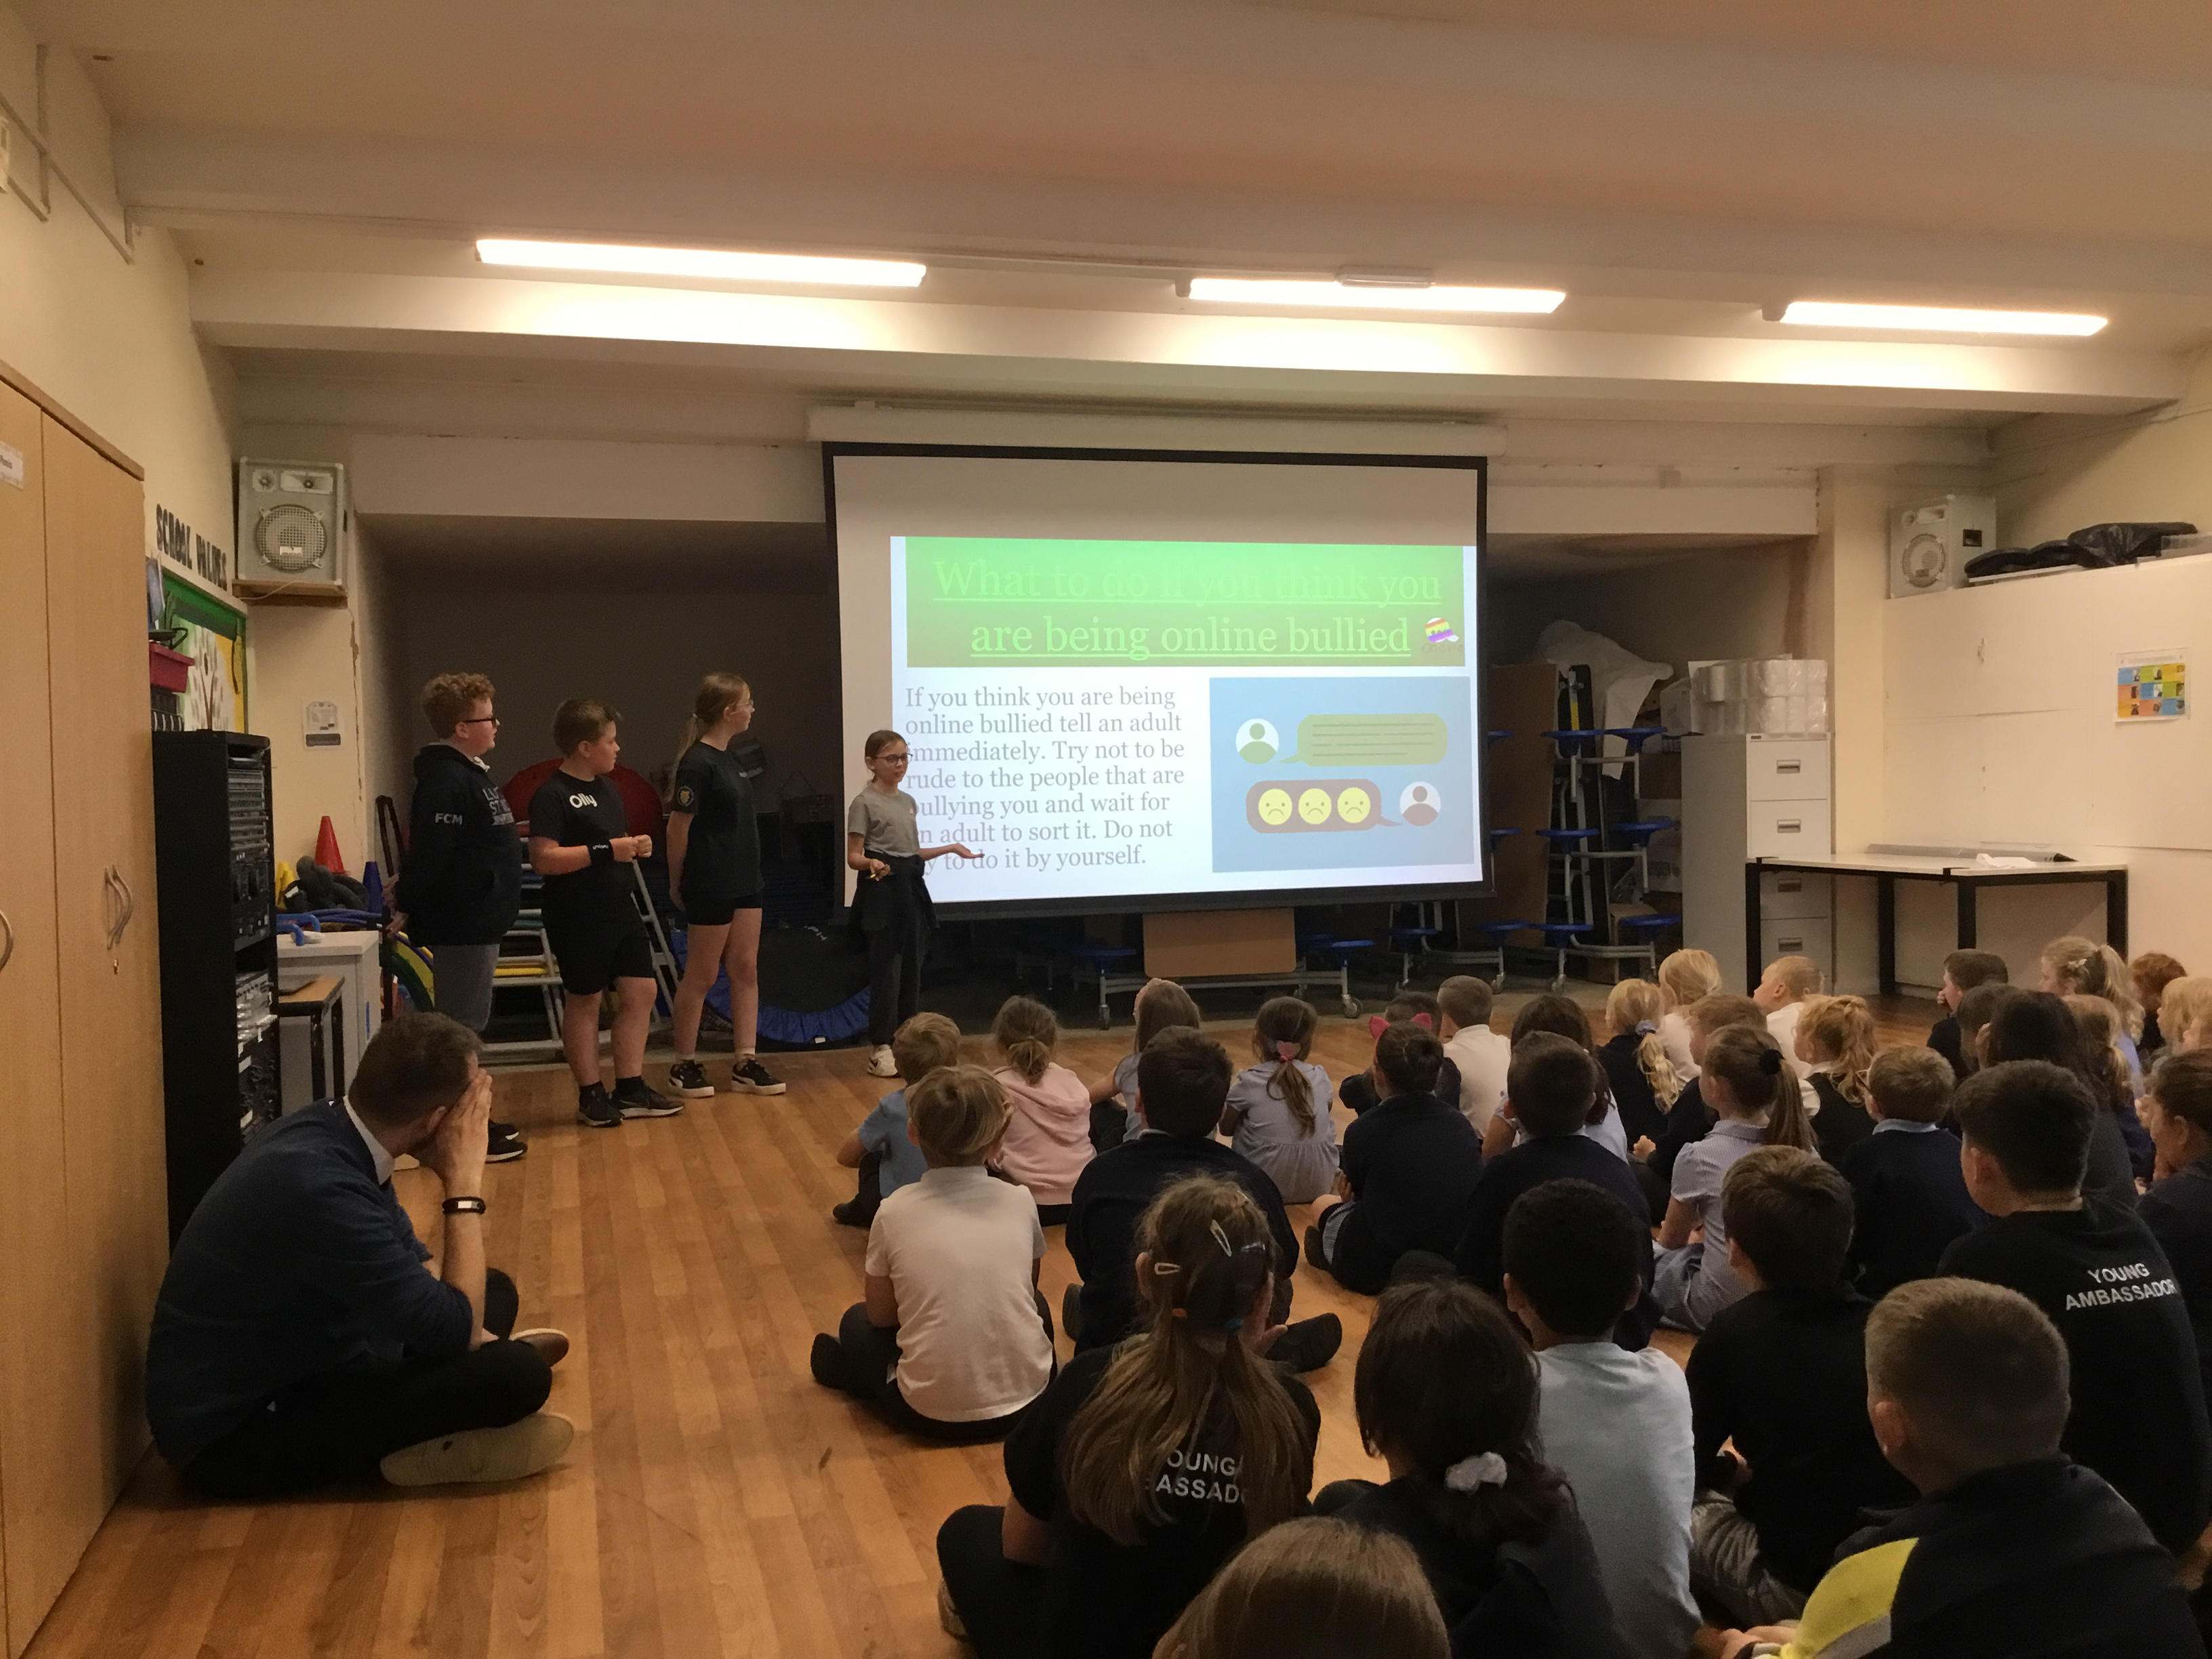
YEAR 6 ONSAFE ONLINE SAFETY ASSEMBLY
On Tuesday 11th June, some of our very dedicated Year 6 pupils delivered an assembly all about online safety. Following their learning in PSHE, the group delivered a fantastic assembly on the different age ratings of apps such as WhatsApp, Facebook and more. They then went into detail and explored dangers such as scams or invites to meet people online and even created their own team name. The group were so dedicated they created their own logo and mascots! Please see a copy of their PowerPoint on our website's safeguarding!

Slide 14
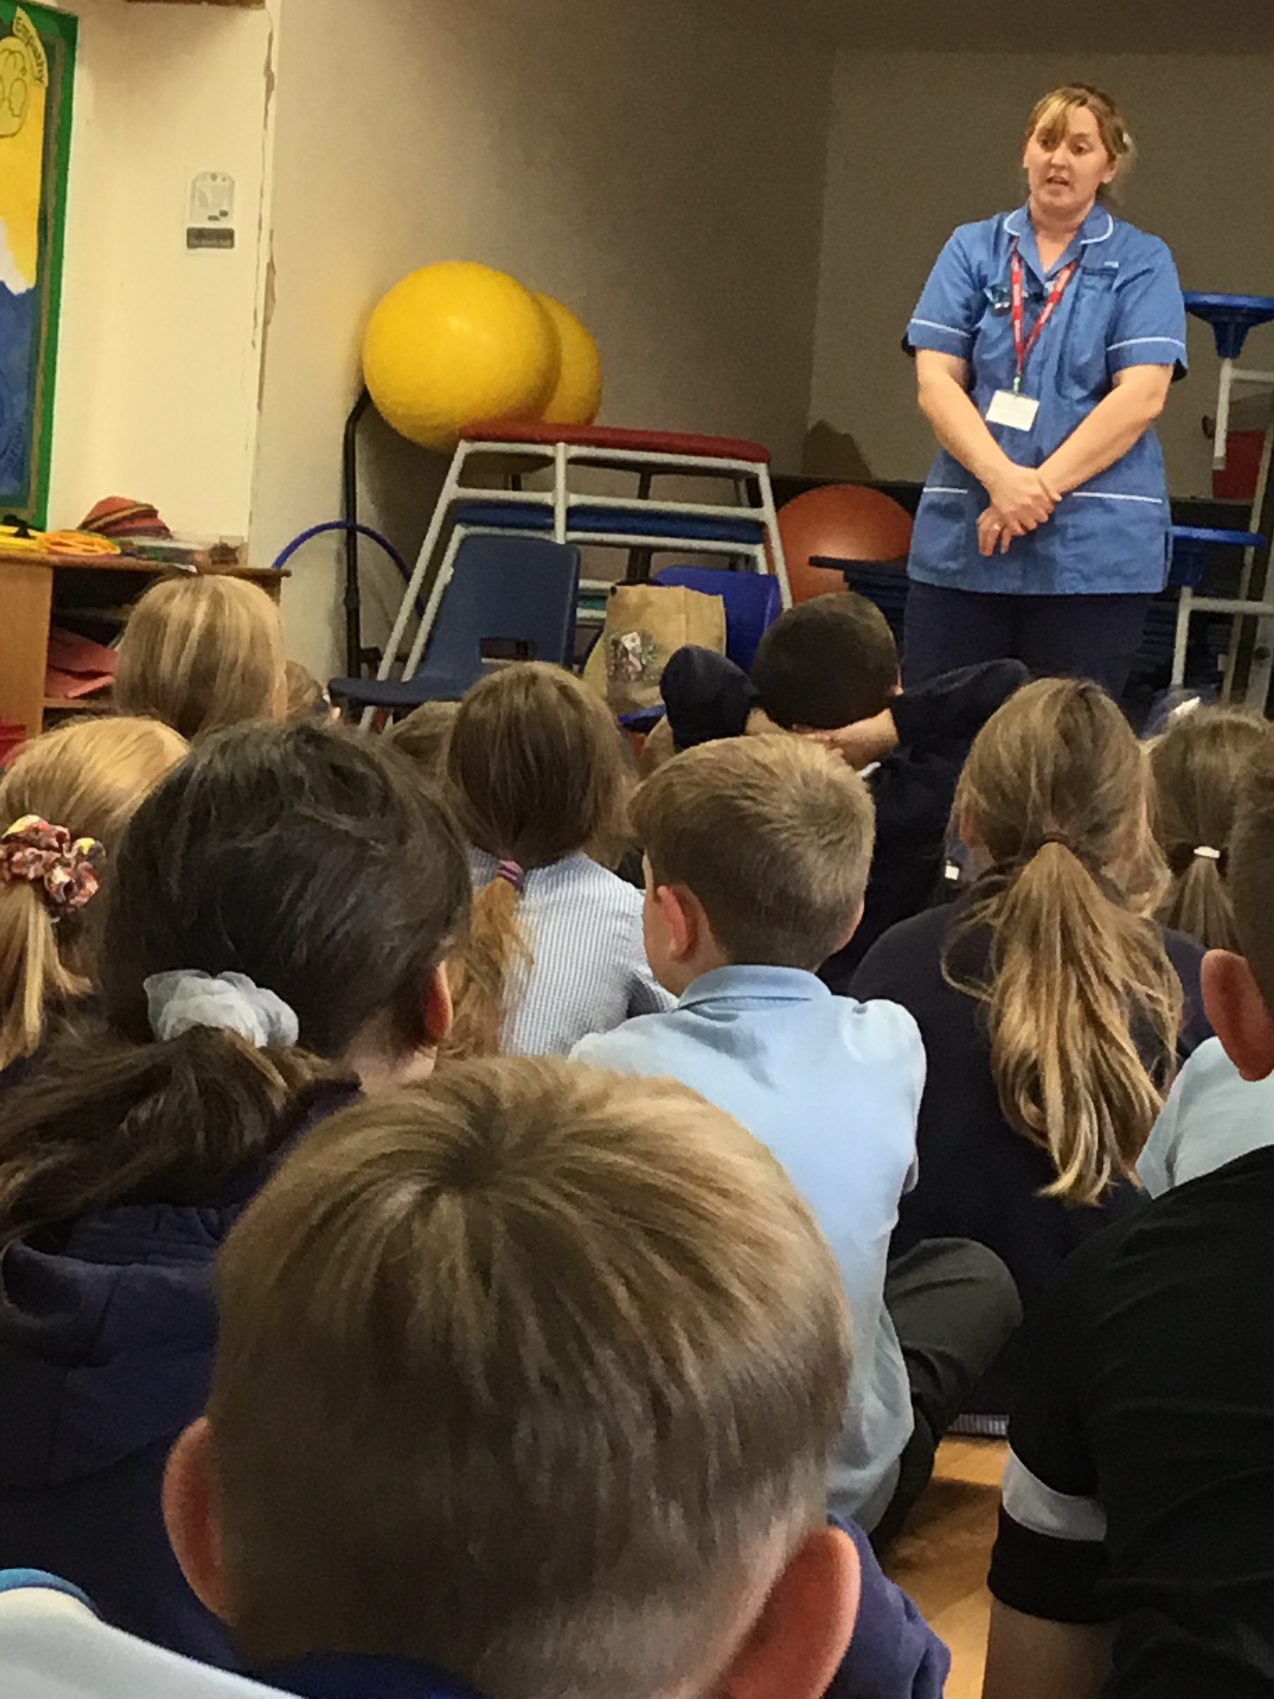
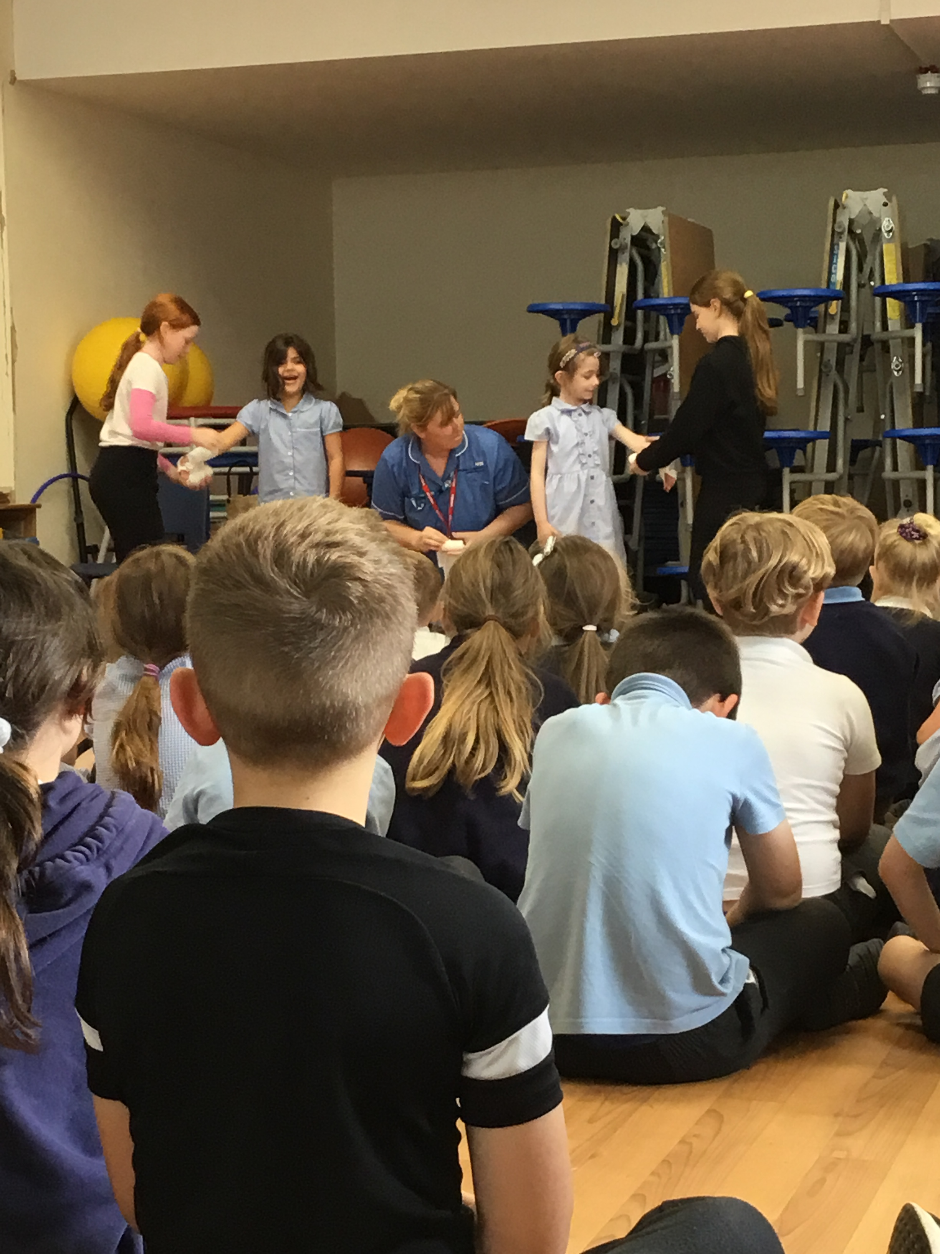
Career Visit: Nurse
On 2nd July, we welcomed one of our parents, Mrs Kerry to discuss her role as a nurse in one of our assemblies. We always love having visitors especially if it helps our children understand the importance of learning and the options they have later on in life.
Thank you Mrs Kerry for taking the time to talk about your very important role and in sparking interest amongst our children.

Slide 15
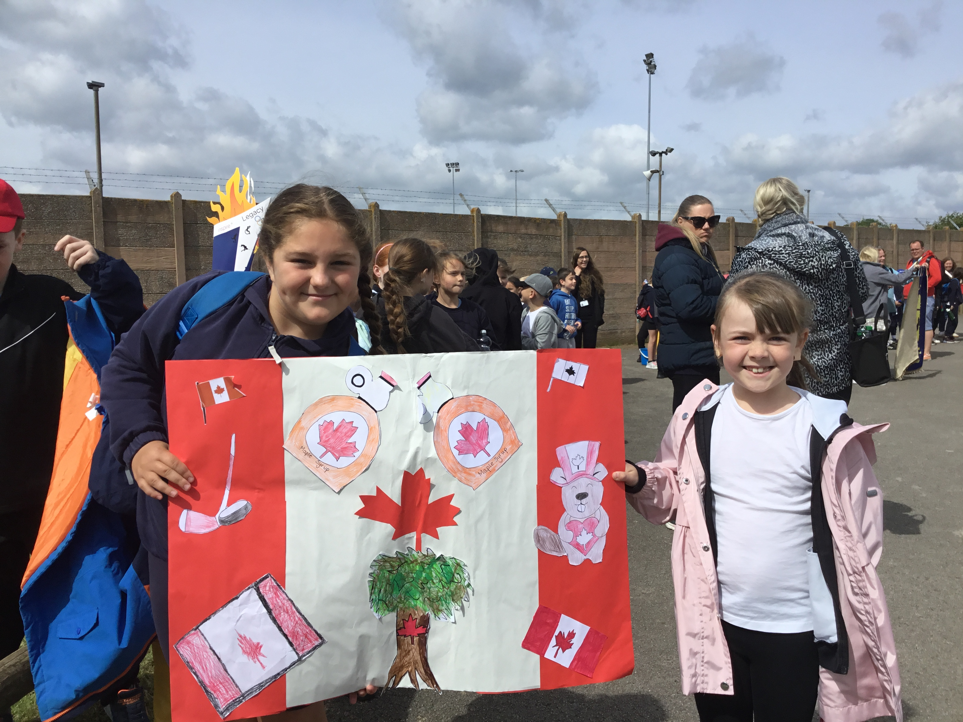
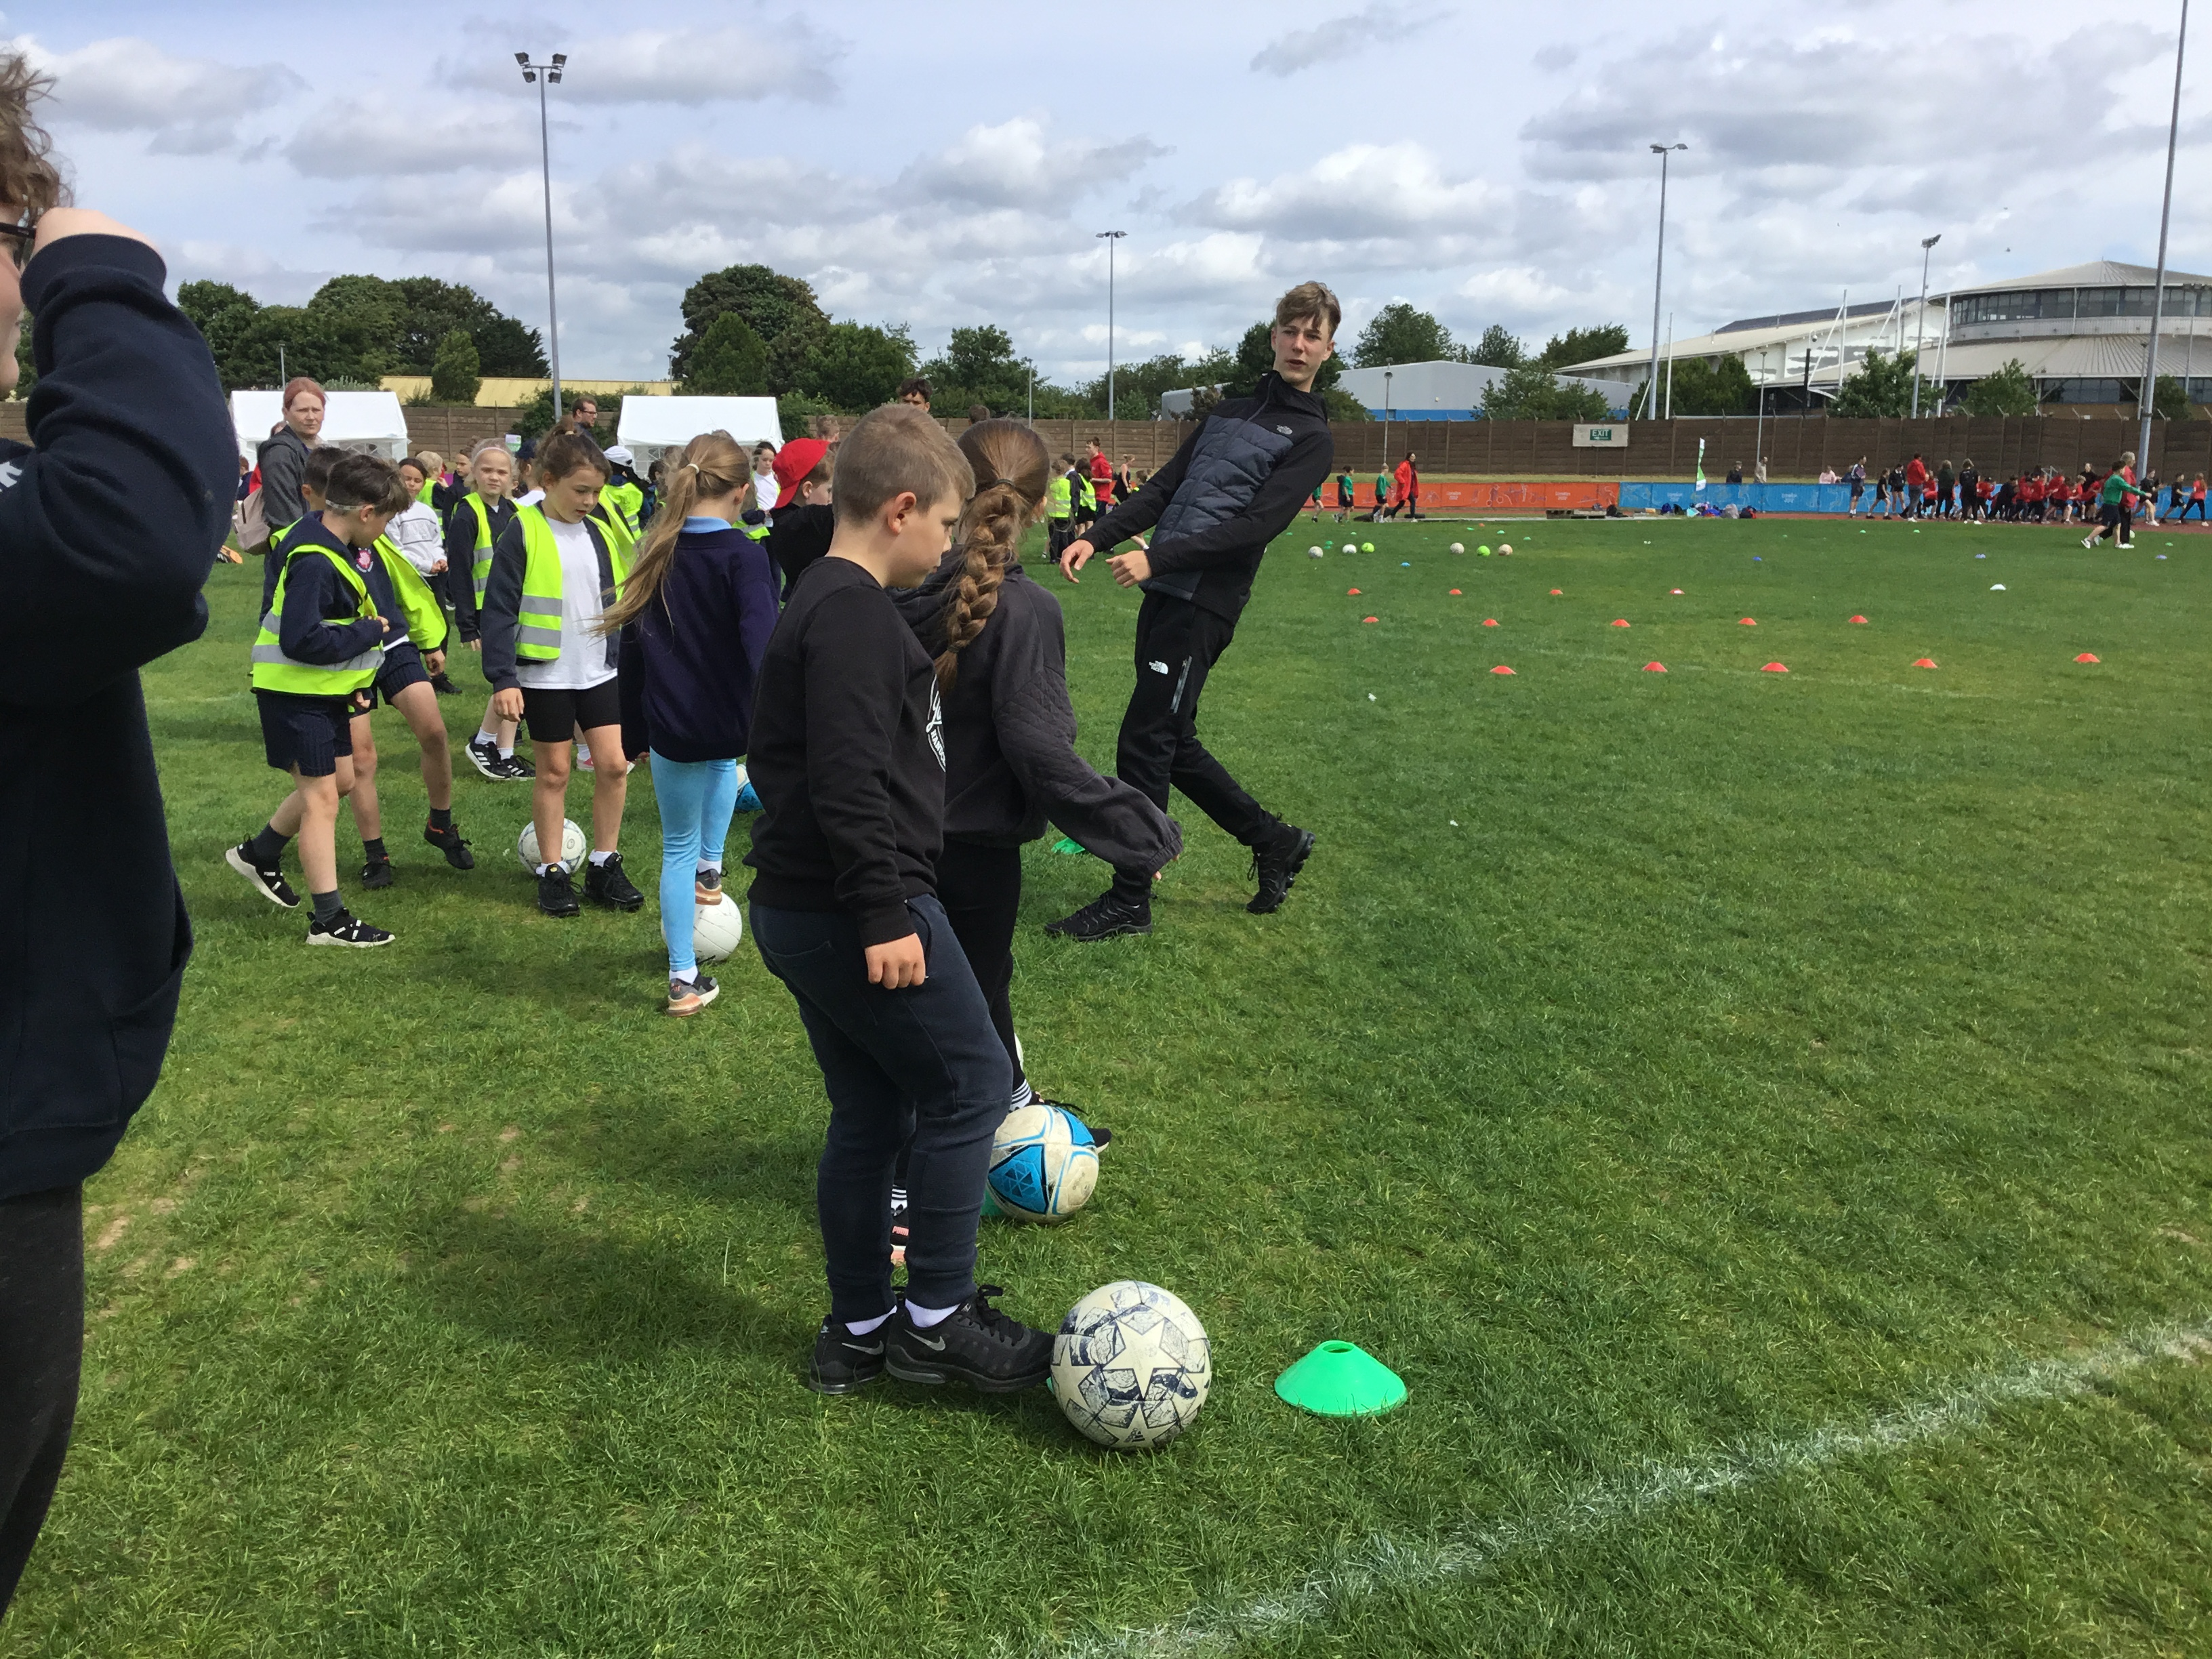
Mini Olympics
On Friday 19th June, pupils from Dahl and Morpurgo class (joined by the Tolkien class ambassadors) attended the Mini Olympics in Grantham which involved a whole day of competitive sport. The range of activities meant that all pupils could find something to get their teeth into and helped them further understand the importance of teamwork and healthy, positive competition.
Thank you Miss Long for arranging this fantastic event.

Slide 16
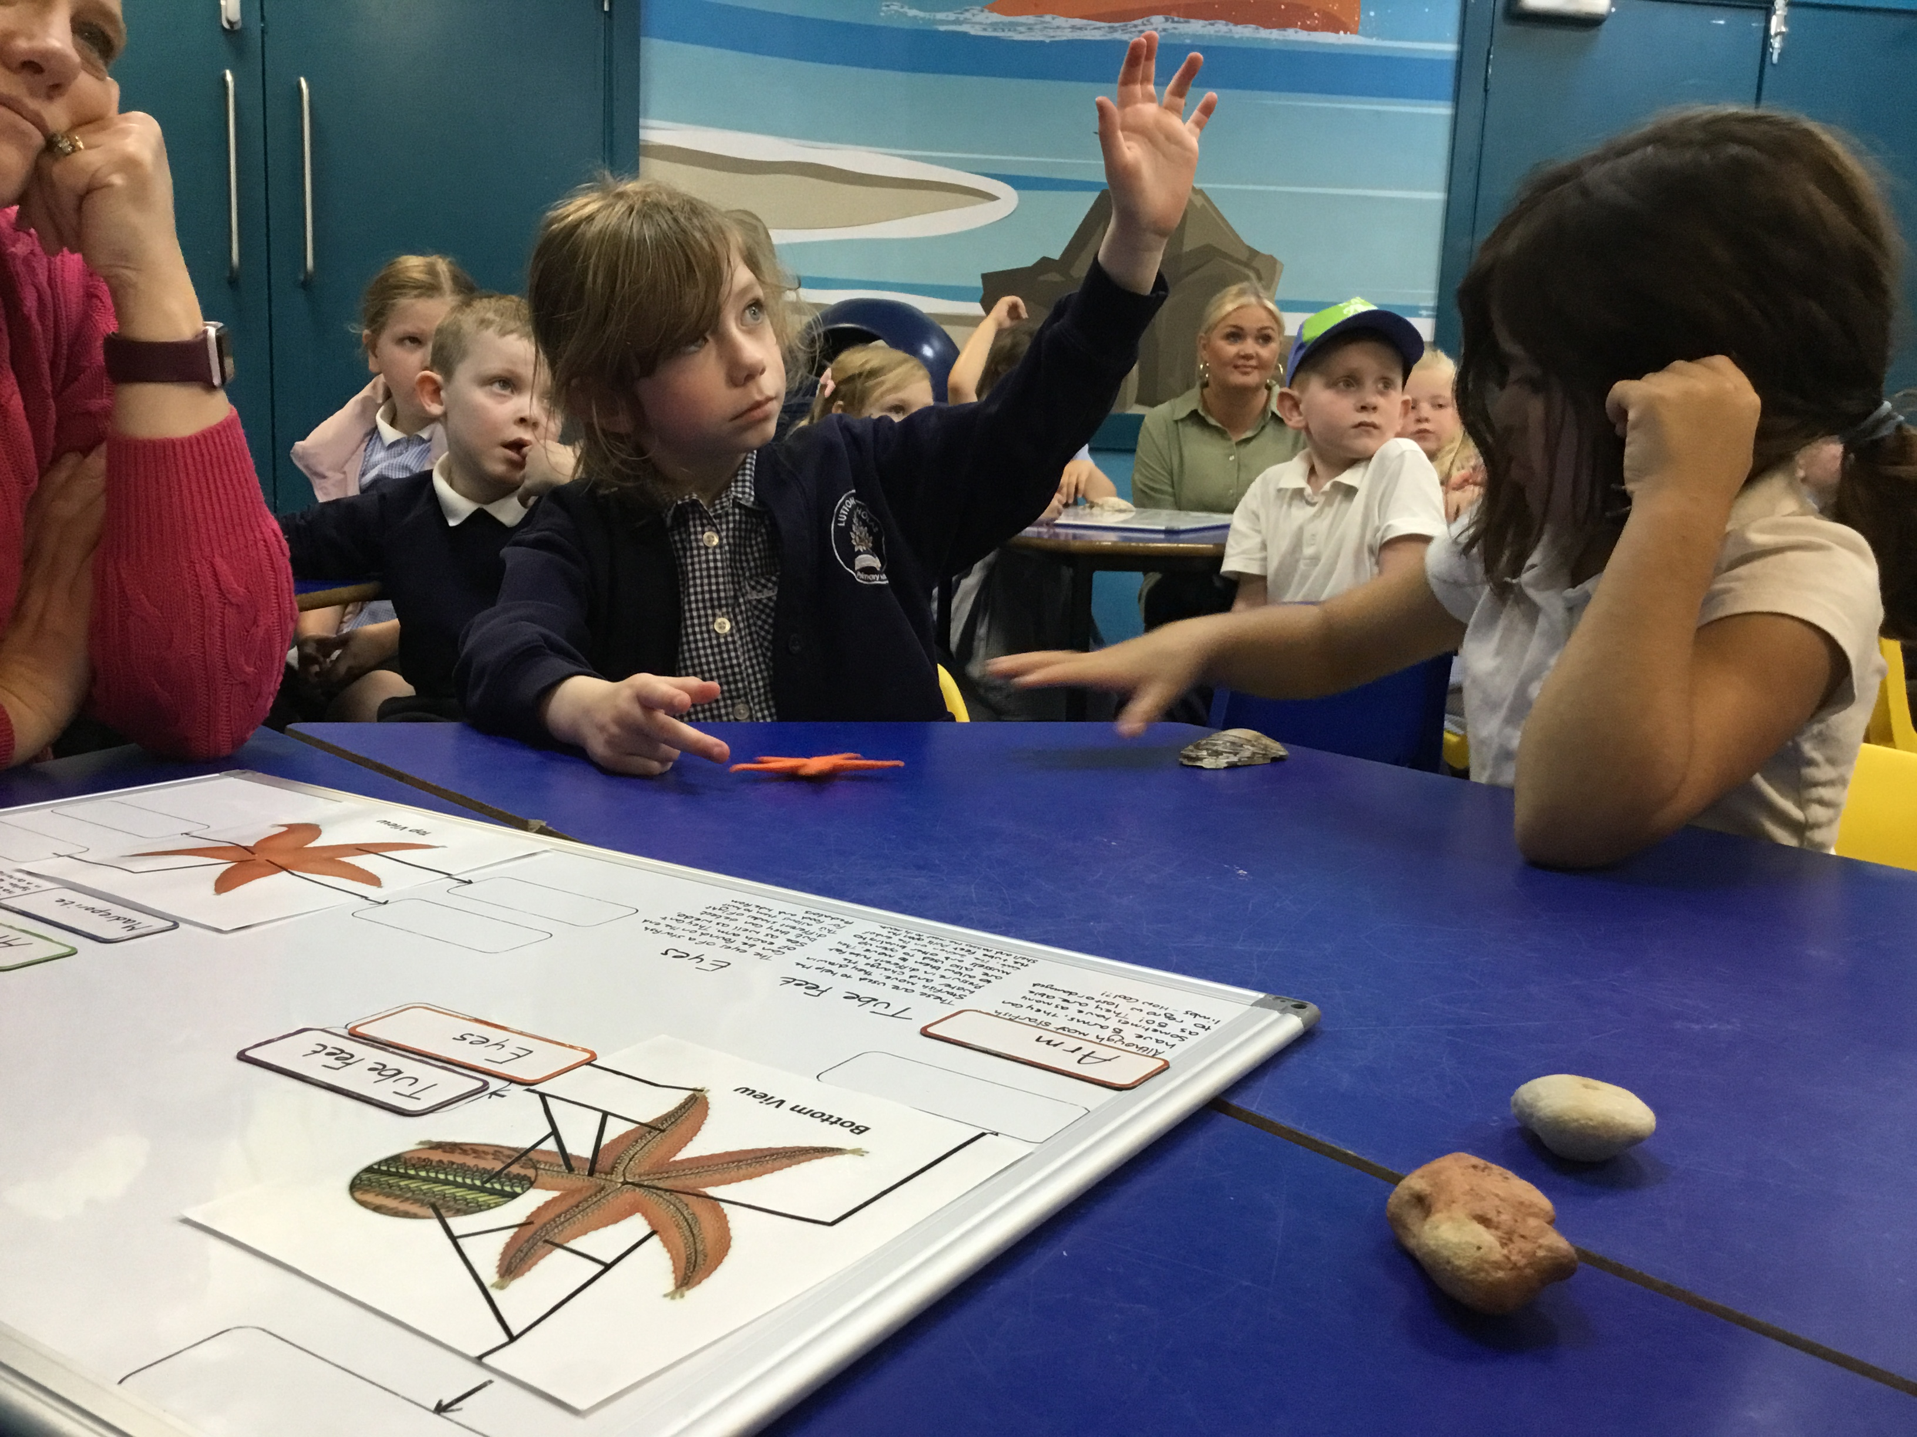
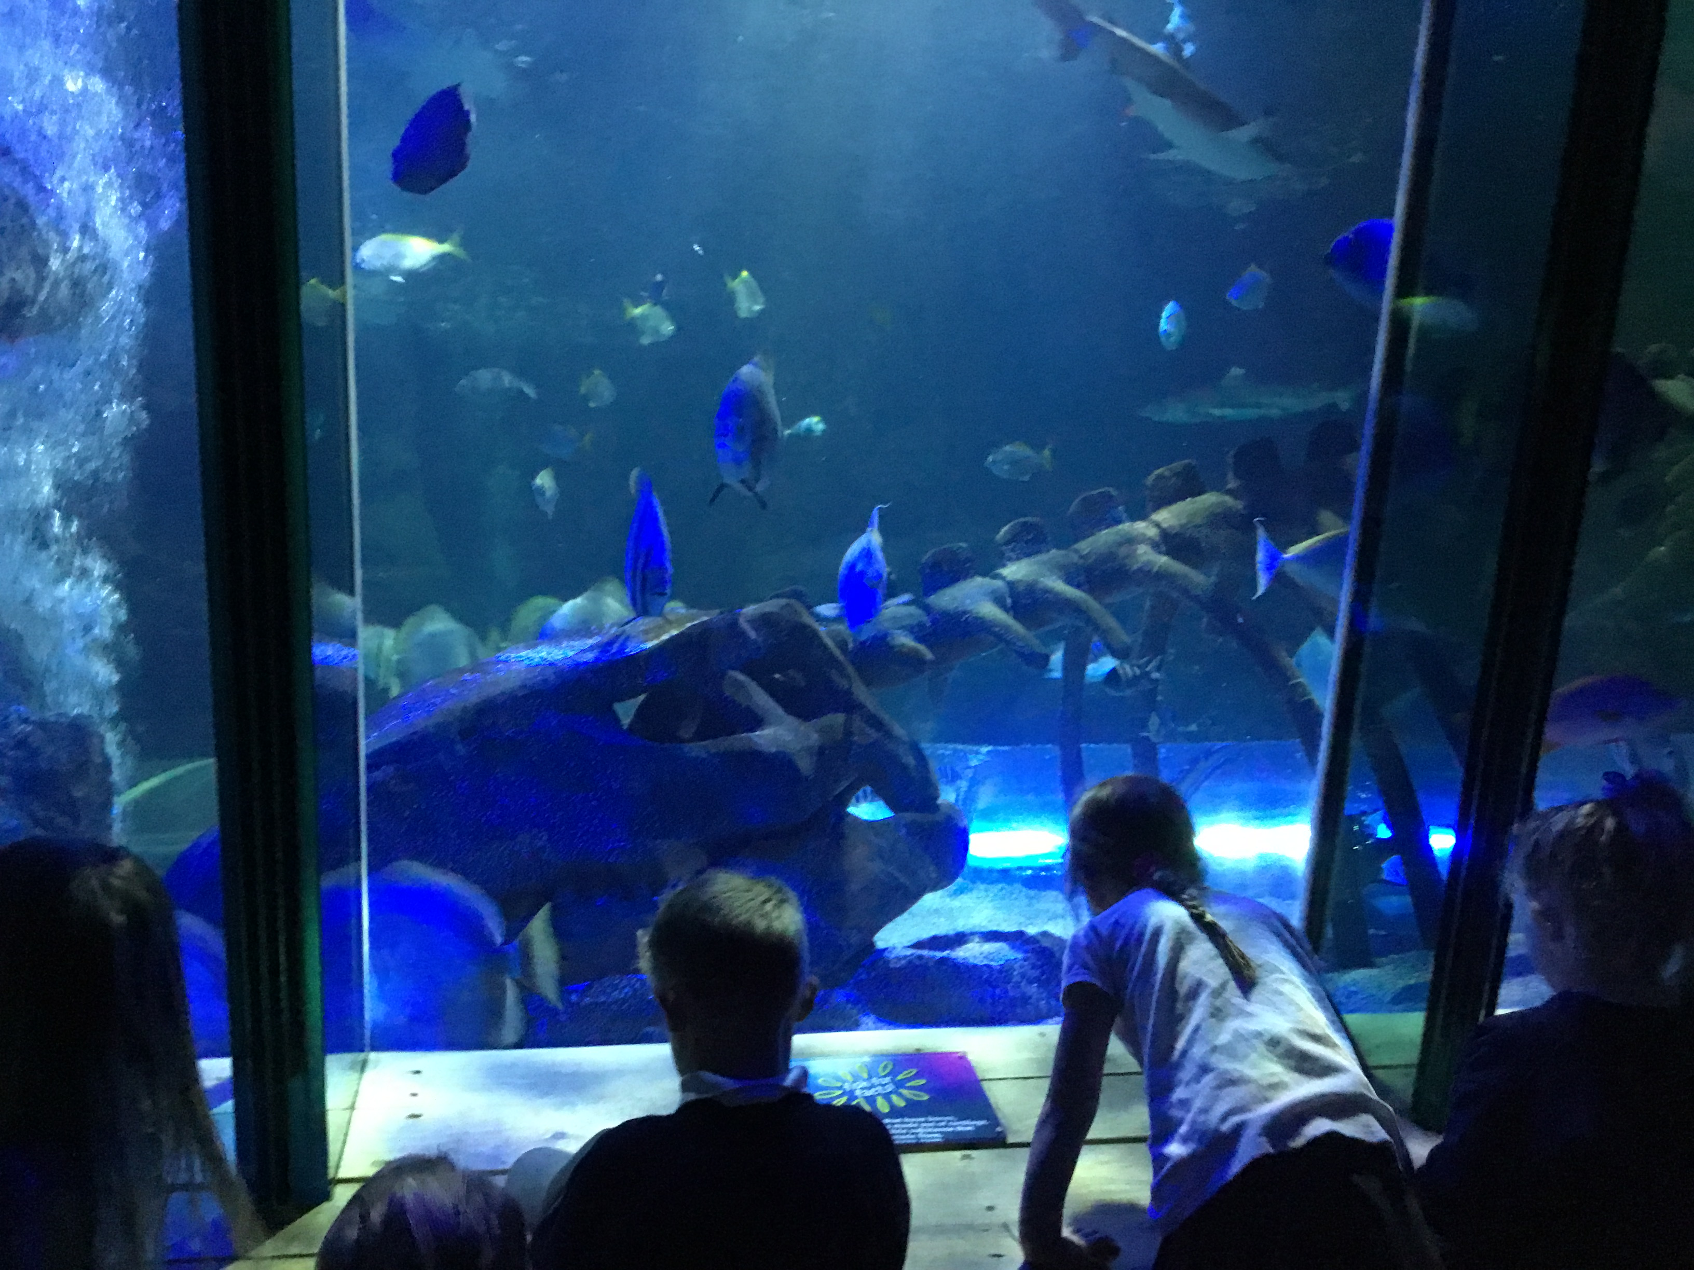
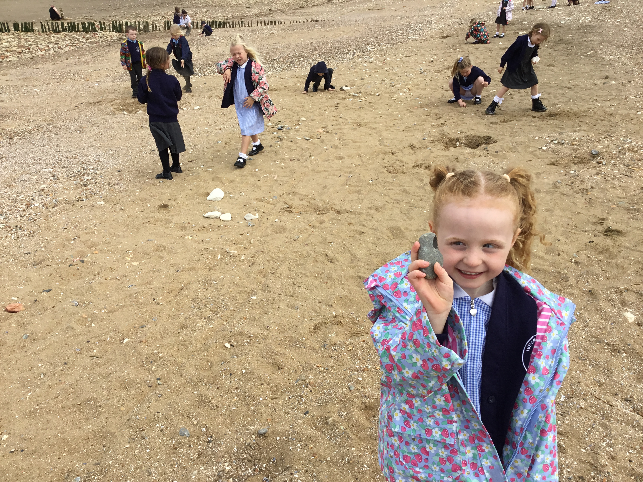
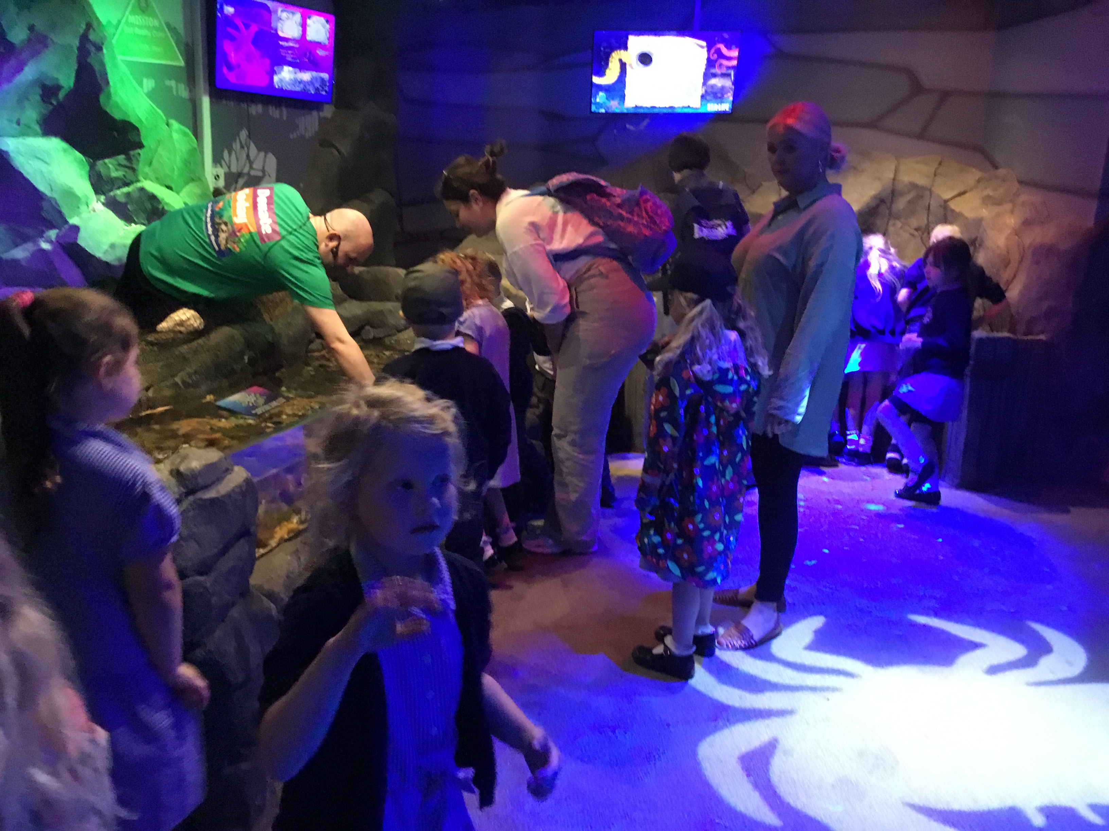
Sea Life Centre Trip
On Monday 17th June, Donaldson have visited the Sea Life Centre in Hunstanton. We had a great day and had some lovely weather to enjoy a short spell on the beach. We enjoyed looking for shells, rocks and building with the rocks with our friends. We had a short talk about creatures we would find in a rock pool. We found out that starfish have eyes at the end of their legs and the middle part of the starfish is its bottom! We had the opportunity to stroke the starfish in the middle of its leg and most of us were brave enough to have a go. Afterwards, we walked around the Sea Life Centre exploring the variety of fish. We also saw seals, penguins and otters. We were able to finish our trip with a treat, an ice lolly.
Thank you to our parent volunteers for supporting Donaldson class during their visit to Hunstanton Sea Life centre. The children had a fantastic time seeing the different animals and taking part in workshops. We would also like offer an enormous thank you to Mr and Mrs Heading for the ice cream treat!
Once we were back at school, we completed some work during the week linked to our trip. We sequenced our day at the Sealife Centre, wrote a recount about what happened on the trip in English and labelled parts of a fish in Science.

Slide 17
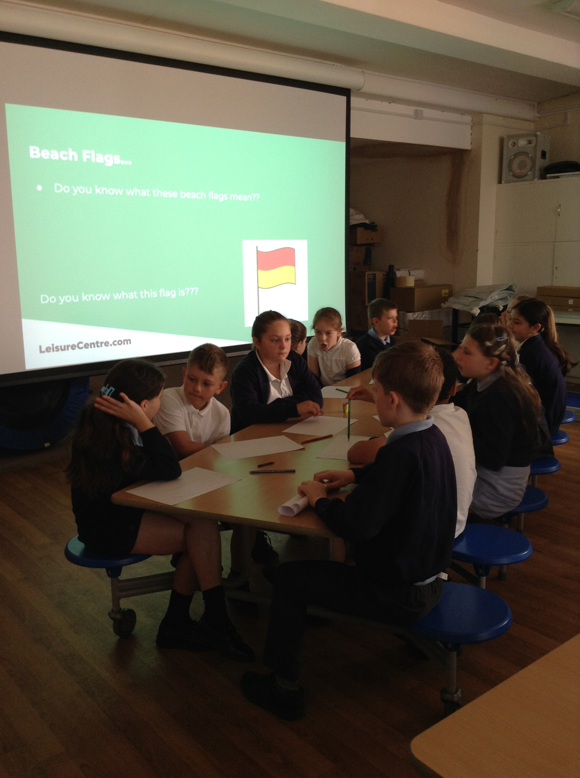
Water Safety Assembly
On the 20th of June, we welcomed Jojo from Castle Leisure Centre to help our pupils understand the importance of water safety.
It is often easy to underestimate the risks and dangers of water whether this be on the beach, in a pool or within the local area. Thank you Jojo for working with our pupils to help them understand ways in which they can remain safe.

Slide 18
Drama Workshop
On Tuesday 18th June, Ms Thomas from Lincolnshire Music Services visited Dahl class to complete a workshop on rhythm, teaching the pupils about different types of songs.
The children performed African and Gospels songs as part of their lesson and also learnt that a repeated phrase in a song is called an ostinato.

Slide 19
Bouncy Fun Day
On Friday 21st June, we welcomed the arrival of some rather large bouncy castles curtesy of the Friends of Lutton to help welcome in the summer season.
The children had a fantastic day today with various different bouncy castles on offer to explore. The children have been so active and thoroughly enjoyed themselves. A huge thank you to our FoLs for organising this final term event and for supporting the school in supporting the children. We say it a lot but we really mean it! Between the activity and beautiful sunshine we can safely say that many children will be tired and in need of a good bath!
Thank you parents and carers for staying behind and giving the children a second chance to drain their energy after school. A genuinely brilliant and memorable day for all (including me who someone found myself coaxed into the action too).

Slide 20
Sports Day
On Friday 28th June, we hosted our annual sports day and could not have asked for better weather! The children enjoyed taking part in different sporting activities in the morning with the assistance of 2 very helpful parent volunteers before moving into competition mode in the afternoon! The children really enjoyed taking part in the different events and even had time to enjoy a nice cold ice lolly in the afternoon sunshine.
Thank you to all of our parents and carers for visiting us during Sports Day.It was great to see you alongside our children cheering and celebrating the highs and lows that come with competitions. It was amazing to see all of our children try hard and show real teamwork. We would also like to thank a few others:
Our FoLs for the ice lollies, treats for organising our very successful raffle - many thanks for all your contributions too!
Mr Townsend, Mr Crane and Mr Easey for volunteering your time to support our school and make the experience much more memorable.
Miss Long for organising Sports Day and preparing pupils for the events.
Our amazing Bronze Ambassadors for helping keep everything on track and helping our younger pupils!

Slide 21
Roman Day
On Friday 5th July, Dahl class welcomed a Roman expert to help bring together all the learning they have done this term. They spent the morning completing Roman activities which included creating scent bags, necklaces, charms, mosaic tiles, Roman games and a Roman bag. In the afternoon, they had a Roman Feast involving food, drink and performances from the children. Dahl Class were superstars and we couldn’t be prouder of their behaviour and subject knowledge. We want to say a special thank you to our parent volunteers, who without their help today the day wouldn’t be such a success!

Slide 22
Year 6 Flip Out
Last week was filled with excitement and activity. It started with a thrilling day at Flip Out, where the children bounced around, performed tricks and enjoyed chasing each other around the apparatus. Following this energetic outing, they savoured Domino's pizza and homemade treats, courtesy of FOLS. The children's exemplary behaviour throughout the day made me incredibly proud. They managed to preserve their energy for Sports Day and performed admirably in all their races. Not only did they participate actively, but they also assisted in organising equipment, selling raffle tickets and supporting younger children eagerly awaiting their turns.

Slide 23
Y6 – Ready, Steady, Cook!
On Monday 8th July, Year 6 welcomed Darren from Roots to Food who spent a whole day with our Y6 pupils preparing a 3 course meal to serve to staff and parents. Their menu included a light carrot soup with fresh bread rolls, chicken breast with sauce and vegetables and Eton mess for dessert.
They also took on key roles such as Head Waiter and worked collectively to serve drinks, meals and support in the cleaning up and management of the night. Everything from table decorations to invitations all came from our fantastic Year 6 pupils. Thank you for your hard work and fantastic culinary delights! A separate thank you to Mrs Woodhouse for acting as our pot washer for the night, you are amazing!

Slide 24
Y6 – Transition Workshop
On Thursday 11th July, we welcomed back Micki, our fantastic community worker who supported our Year 6s in preparing them for secondary school.
Helping to talk about any worries and thoughts they had, Micki helped pupils complete some of the day-to-day jobs they may be asked to complete or think about such as managing homework, tying a tie and moving between classes!

Slide 25
Bake Sale for Deafblind UK
Tuesday 16th July 2024
Following a workshop from Deafblind UK on the challenges of living with disabilities, pupils in Year 6 asked if they could bake and sell goods to raise money for the charity.
As it is impossible to say no to children wanting to do a good deed, Year 6 spent the day creating a selection of delicious treats ranging from flapjacks to cupcakes with the assistance of a few adults. Thank you to Mrs Chapman and Mrs Wilkinson for supporting the pupils. The result of all of these efforts meant that we raised a fantastic £145.50 for the charity!

Slide 26
Summer Attendance Winners
We can now announce our termly winners for the attendance raffle this term! Prizes this term were all linked to games and family fun!
In EYFS and KS1: Gillian
In KS2: Caitlyn
Well done to all of our children for working hard on their attendance. It may feel far away but we will soon be in September where a new opportunity to win will soon appear. Thank you to our parents / carers for working to get the pupils here regularly and on time. We really appreciate it as very minute in the classroom makes such an enormous difference.

